Slide 1
Estate Planning

Slide 2
Disclosure
<Advisor Name, Approved Title/Designation(s)>
<Approved DBA Name>
<Insert pre-approved broker/dealer disclosure>
This presentation was created for educational and informational purposes only and is not intended as ERISA, tax, legal or investment advice. If you are seeking investment advice specific to your needs, such advice services must be obtained on your own separate from this educational presentation.

Slide 3

Welcome to the Estate Planning Basics Workshop
Today we will discuss:
The Unified Estate and Gift tax system
How to use basic planning strategies to pursue your goals and objectives
The elements of a good estate plan
Notes:
Today we will discuss what Estate Planning is and why it is important. We will also discuss some of your goals and objectives and learn how to use basic estate planning strategies to work toward these goals. We will also discuss in detail the elements of a good estate plan.

Slide 4

What is Estate Planning
Preparations made to give your assets to…
Whom You Want
When You Want
The Way You Want
…with the goal of minimizing tax consequences and legal fees
Notes:
Let me start by asking if anyone can tell me what Estate Planning is? (Read the definition). Lets take a minute now to refer to the activity that is in the folders that you were given. We are going to pause at several spots in this workshop to give you the chance to apply the concepts and ideas that you have just learned about to your own estate plan. These questions are designed to help you to begin thinking about the questions you will need to answer and the decisions that you will have to make in order to formulate your own estate plan. Lets start by looking at question #1 - take some time to read it over and check off any answers that are appropriate to your situation. Keep in mind that there are no right and wrong answers here – this is personal and you should focus on what is important to you and your family.

Slide 5
Why Plan?
Common goals of estate planning
Goal 1 | Minimize estate taxes
Goal 2 | Avoid probate and associated fees
Goal 3 | Direct the distribution of your assets
Notes:
There are three common goals to estate planning. The first goal is to minimize the consequences of estate taxes. Is anyone here to learn how to pay more estate taxes? I didn’t think so! We will definitely focus on how you can pay less estate tax in this workshop. The second goal is to avoid probate, and we will talk about probate and the reasons that you may want to avoid it later in the workshop. The third goal is to direct the distribution of your assets after you die. Does everyone have at least some idea of how you want your assets distributed when you die? We will talk about how you can do just that. I should add that the icons that you see after each goal above will be used throughout the workshop to show you which goals are being addressed by a given strategy.

Slide 6
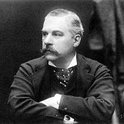
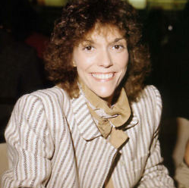
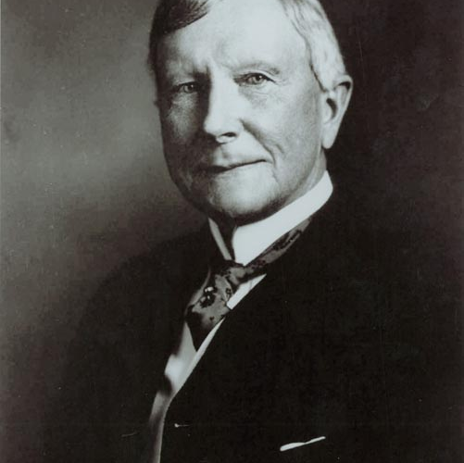
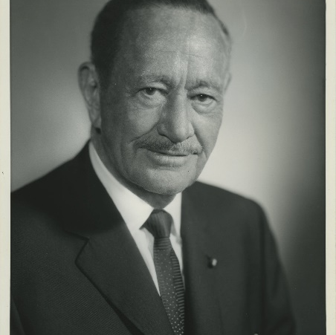
Why Plan?
Celebrity Estate Planning gone wrong
J.P. Morgan
Chairman, J.P. Morgan & Co.
69% lost to taxes and fees
Karen Carpenter
Singer / Actress
58% lost to taxes and fees
John D. Rockefeller, Sr.
Standard Oil
68% lost to taxes and fees
Conrad Hilton
Hilton Hotels
53% lost to taxes and fees
Notes:
Lets start today by looking at some famous people and how their lack of estate planning caused their heirs to pay. (READ NAMES AND AMOUNTS LOST TO TAXES AND FEES). As you can see, many people don’t focus on estate planning, and it’s their heirs that pay the price.

Slide 7

Unified Estate and Gift tax System
Ways to Pass Assets without “tax”
Lifetime Gifting
Unified Credit
Notes:
Today we will discuss what Estate Planning is and why it is important. We will also discuss some of your goals and objectives and learn how to use basic estate planning strategies to work toward these goals. We will also discuss in detail the elements of a good estate plan.

Slide 8

Lifetime Gifting
Gift up to $15,000 per person in 2018 without incurring gift tax
No limit on medical or qualified education expenses paid directly to institutions
No limit on charitable gifts
Advantage
Remove assets from your estate before death, thereby reducing taxes and expenses
Disadvantage
You no longer have use of the money
Notes:
Let’s start with lifetime gifting. As you can see here, all three icons are listed so this strategy can help you to address all three planning goals. In 2018 you are able to transfer up to $15,000 gift tax-free to as many individuals as you wish, they don’t even have to be relatives. We have already discussed the fact that transfers to your spouse have no limit, so we will focus this discussion on non-spouse beneficiaries. One way to make a gift is to pay someone’s debt, such as their mortgage, car loan, student loan, credit card, etc. If these gifts of debt payments are aggregated and fall under the $15,000 limit they will not be a taxable transfer. There are two special exceptions to this rule - medical expenses and education. As long as you pay someone’s medical or education expenses directly to the provider, there is no limit to your gift. You can even give $15,000 in addition to paying the medical expense, as long as the medical expense is paid directly to the institution. Similarly, there is no limit to what you can give to charitable organizations. In summary, lifetime gifting benefits you in many ways; it removes assets from your estate before death and therefore reduces taxes and expenses. The major disadvantage to lifetime gifting is that you no longer have the use of the money. Let’s now look at your worksheets and answer question #3. Check the yes box if you think that lifetime gifting is something that you would like to use as you get older.
NOTE TO PRESENTER: The link at the bottom of the page will launch a worksheet to illustrate the power of lifetime gifting as a tool to reduce estate taxes.
Source: https://www.fool.com/taxes/2017/10/25/2018-estate-tax-rates.aspx

Slide 9

Applicable Exclusion Amount for 2018
In 2018, each person has up to $5,600,000 they may transfer free of estate taxes to non-spouse beneficiaries
Portability for married couples
Assets in excess of $5,600,000 are taxed at the top tax rate of 40%
Notes:
Is anyone here familiar with the Unified Credit? It is a vehicle given to all of us to pass an amount of assets to our non-spouse beneficiaries during our lifetime and/or at death. In 2018 the amount that we can transfer is $5,600,000 of assets without paying the estate tax. Assets in excess of the $5,600,000 exemption amount are taxed at rates between 40% and 48%. You may also be aware that there is an unlimited marital deduction available which means that during your lifetime (or at death) you can transfer an unlimited amount of assets to your spouse with no estate tax.
Source: https://www.fool.com/taxes/2017/10/25/2018-estate-tax-rates.aspx

Slide 10

What’s Included in Your Estate?
Everything you own
  Property owned in your name
  Your share of jointly owned property
  Life insurance policies
  Property in which you have a beneficial interest
Notes:
Your estate is everything you own: Your home and other real estate; business; checking and savings accounts; investments in stocks, bonds, mutual funds, savings bonds, annuities, etc.; retirement plans and IRAs; personal property such as furniture, vehicles, collectibles, etc.; the proceeds of life insurance owned by you, and any other assets you may own or have an interest in. Individually owned assets are what you own or are titled in your name. This includes personal property and individual accounts such as retirement plans, annuities, and life insurance. Half of the property owned jointly with your spouse is generally included in your estate, subject to legal arrangements made prior to or during your marriage. Assets owned jointly with a non-spouse owner may be completely includable in your estate unless you can show what the other joint owner(s) contributed. One of the biggest surprises for most people is that life insurance proceeds owned by the decedent is includable in the person’s estate. While insurance proceeds may be income tax-free, if the policy was owned by the deceased, it will be includable in the estate and subject to estate taxes. Therefore, transferring ownership to someone else can keep it out of the insured’s estate. The IRS will only allow it to escape estate taxes if the transfer was completed at least three years before the insured’s death. We will discuss this in greater detail later in the workshop. If you are the beneficiary of a trust, receive an annuity or pension, or give your home or other real estate to someone and retain the right to live there or enjoy it for your lifetime, you may need to include the value of your beneficial interest as part of your estate.

Slide 11

What If I’m Not Worth $5,600,000 Yet?
Consider that you can still:
  Grow your estate over the years
  Control how your assets are transferred
  Take advantage of numerous estate planning strategies to accomplish your goals
  Minimize expenses for your heirs
Notes:
You may be thinking that with the growing Unified Credit Exemption that estate planning is something that you may not need to focus on. We are now going to discuss why that is just simply not true. There are several things that you can still consider: Your estate will be growing over the next eight years. What were some of the things that we discussed as being included in your estate? Things like your home, your investments and your retirement plans are all in your estate, and will most likely be growing in value. Estate Planning gives you the opportunity to control how your assets are transferred at your death. Without planning your assets are transferred according to the laws of the state in which you live. These laws may not necessarily match with your plans. We’ll discuss this in more detail when we discuss wills later in the workshop. There are numerous estate planning strategies that you can utilize to accomplish the goals that we discussed at the beginning of the workshop. One particular goal that many have is to minimize expenses for your heirs and a good estate plan can help you to achieve this.

Slide 12
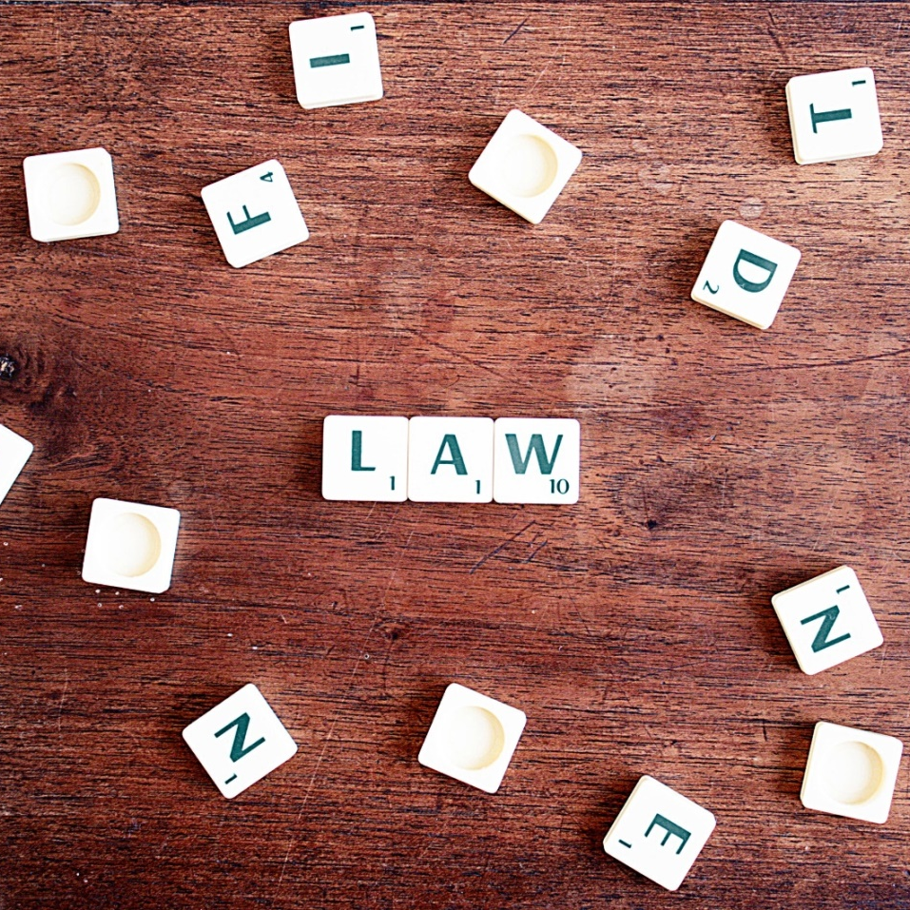
Probate
A legal process used primarily to transfer assets from the deceased’s estate to heirs
Probate involves:
  Appointing an executor
  Collection of property
  Payment of debts, taxes, and expenses
  Distribution of property to those who are entitled to receive it
Notes:
We have alluded to Probate earlier today – can anyone tell me what probate is? (Read the slide) A recent study by AARP found that probate is over a $1.5 billion business, enriching the courts, attorneys, bonding companies, and other organizations involved with probating an estate.

Slide 13
What Property Is Probated?
Probated | Not Probated
Individually held real estate Individually held bank accounts/CDs, stocks and bonds Business interests Tangible personal | Jointly held property Beneficiary-designated accounts like life insurance, IRAs, 401(k)s Accounts designated POD or TOD Living trust
Source: Estate Planning Concepts
Notes:
Lets take a look at which of our assets will pass through probate. Anything you own in your name alone will pass through probate. This includes individually held real estate, bank accounts, CDs, stocks, bonds, business interests and all of your tangible personal property like jewelry and other personal effects. Most assets owned jointly, with a beneficiary designation, with a POD/TOD designation or held in a living trust avoid probate.

Slide 14

Advantages & Disadvantages of Probate
Advantage
  Provides for an orderly transfer of assets via your will
Disadvantages
Time consuming
Expensive
Public
Source: Estate Planning Concepts
Notes:
Obviously Probate is big business, so lets discuss some of the advantages and disadvantage of probate. First of all, probate provides for an orderly transfer of assets through your will. This helps ensure that your wishes are actually carried out as the probate court oversees the entire process. The major disadvantages of probate are that it is time consuming – a typical estate can take from 3 months to one year or more to settle through probate. It can also be an expensive undertaking, and the actual costs are determined in the state that the decedent lived. Typical fees can be between 3 and 6 percent of the estate. The entire process of probate is also public - anyone can go to the county courthouse where someone died and get access to their will and the details of the probate process. In fact, there is even a website that allows you to read the wills of celebrities! (If anyone wants to know, the web site is www.ca-probate.com/wills.htm)

Slide 15

Will
Legal document that controls all property not otherwise disposed of
Takes effect only upon death
Only affects assets owned individually
Advantage
Provides for an orderly transfer of assets based upon your wishes
Disadvantages
Requires probate
Source: Estate Planning Concepts
Notes:
For most people a will is the first thing they think of when considering an estate plan. That’s because it is a legal document that controls the distribution of all property not otherwise disposed of. The will only takes effect at death and only affects assets that are owned individually. A will requires probate since the court will oversee transfer of the assets to beneficiaries. An important point to remember is that these wishes and transactions only occur after your death. The main advantage of a will is that it provides for an orderly transfer of assets after your death based upon your wishes. The main disadvantage is that a will does require the process of probate that we spoke of a few minutes ago. We illustrate the icon for goal three here since the major function of the will is to control where your assets will go at your death.

Slide 16

Why a Will?
Maintain control over:
How your property will be distributed
Who your executor will be
Who the guardian of your minor children will be
How/when your property will be distributed to your heirs
The preservation of property and reduction of estate taxes
Notes:
Let’s now take a look at the reasons you need a will. If it is important that your wishes be carried out, a will is a legal document that can be used to convey these written instructions. A will allows you to choose the executor who will settle your final financial affairs. In addition, it allows you to name a guardian to raise your children should something happen to you. It can also provide both how and when beneficiaries will receive their inheritance. For instance, minor children will have their inheritance deferred until they reach the age of majority in their state. Perhaps it is better to provide an annual income to a child because they would not know where to begin to invest it, or would just spend their inheritance. Wills may also contain provisions to reduce estate taxes.

Slide 17

No Will (Intestate)
Assets are distributed according to state’s laws of intestacy
Process for distribution of assets similar to that when you have a will, except you have no input
Assets are distributed to your family members
Can be worst method of transfer
Notes:
Now that we have discussed wills and probate, lets look at what happens if you die without a will. Passing away without a will could possibly be one of the worst thing to do. Your estate passes by “intestate succession” which means assets are transferred however your state law permits. Many people are surprised to find out that this is often done in a manner that does not match their ideas of who should get what. (PLANNER INSERT CURRENT STATE INTESTACY SUMMARY). Not only may your wishes not be carried out, but who will oversee that expenses do not get out of hand? Your wishes may not be carried out, as there’s no guidance from you and no guarantee. Intestacy is also usually the most expensive way to transfer assets as there is more court time and legal involvement. Lets take a minute to look at your worksheets again. This time take a look at questions #6 through #12 and start jotting down your thoughts regarding your will.

Slide 18

What is Trust ?
A legal entity that holds assets for the benefit of beneficiaries
Advantages:
Legal arrangement
Fiduciary responsibility of the trustee ensures that the beneficiaries’ interests are protected
Disadvantages:
Give up ownership of assets
Some trusts cannot be changed
Source: Estate Planning Concepts
Notes:
Lets spend some time looking at the Trust and how it can help you in your estate plan. Can anyone tell me what a trust is? A trust is a legal entity that holds assets for the benefit of someone else. Lets start by discussing the advantages of trusts. First of all, a trust is legal arrangement so all parties are protected by the law. The trust has a trustee who has a fiduciary responsibility to the beneficiaries - this means that the trustee must always protect the interest of the beneficiaries over anyone else. A trust can also typically be settled faster than assets in probate, which may reduce costs and be more advantageous to the beneficiaries. The disadvantages of a trust include the fact that you are giving up the ownership of the assets. The trust is the new owner and has all of the rights associated with it. Another key disadvantage is that some trusts are irrevocable and can not be changed after they are created, so you need to pay close attention when using one.

Slide 19

Testamentary Trust
Created by the will
Only takes effect upon death
One type keeps assets in trust for minor children
Advantage:
Allows for the passing of assets at death with control over when and how they are ultimately distributed to the beneficiary
Disadvantage:
May be subject to probate fees
Notes:
The first trust is the Testamentary trust. You see that the icon for goal 3 is listed here. This trust will help you to control the distribution of your assets. The testamentary trust is a trust that is created by your will and it only takes effect only upon your death. It is called a testamentary trust as it is formed in your last will and testament. These trusts are often used to keep assets in trust for beneficiaries who are a minor at the time of inheritance. The advantage of this type of trust is that it enables you to pass assets at your death with control over when and how they are ultimately distributed to the beneficiary. The main disadvantage to the testamentary trust is that it does not avoid probate as it is typically formed by the will and is part of the probate process.

Slide 20

Revocable Living Trust
A Trust put in place during your lifetime
You may name yourself as trustee
You maintain complete control of the assets (if you act as trustee)
Advantage:
Avoids probate
Provides privacy
Disadvantage:
Assets are still subject to estate tax
Notes:
The next type of trust we will discuss is the revocable living trust. This trust is often referred to as a “living Trust” since it is formed while the creator is still living. The living trust is an agreement that helps you to meet goal 2 and 3. It can help to reduce fees and gives you control of how the assets will be distributed after your death. This trust could hold most of your assets (usually retirement accounts aren’t included) which would be managed by a trustee subject to your instructions. What are some of the advantages of this type of trust? If you act as the trustee of your revocable trust, you maintain complete control of the assets. These assets avoid the timely and costly process of probate and are transferred with some privacy. There is a disadvantage to the revocable trust – since you maintain complete control of the assets, the value of the trust is still taxable in your estate.

Slide 21
Summary of Transfer Options
Through Probate | Outside Probate
Individually held real estate Individually held bank accounts/CDs, stocks and bonds Business interests Tangible personal property Testamentary trust | Jointly held property Beneficiary-designated accounts like life insurance, IRAs, 401(k)s Accounts designated POD or TOD Living trust
Source: Estate Planning Concepts
Notes:
This slide summarizes the vehicles that we just discussed. The left side of the page shows the assets that are subject to the process of probate. Any assets owned individually could pass through your will (or from a revocable living trust) into the credit shelter trust. This trust will avoid taxation in both spouses estates and pass directly to your heirs at the second death. We also discussed lifetime gifting, joint tenancy and beneficiary designations as ways to pass assets directly to your heirs without going through the process of probate. And finally, we discussed the irrevocable life insurance trust and the fact that if it is done properly the proceeds of your insurance policies can avoid both probate and estate taxes. Lets take a minute to look at question # 13 on your worksheets. Check off all of those trusts that you feel may help you in your estate plan.

Slide 22



Other Important Considerations
Power of attorney
Medical documents
Source: Estate Planning Concepts
Notes:
There are other important considerations regarding your estate plan. We will now discuss how the power of attorney and certain medical documents can be used to pursue your financial goals.

Slide 23

Financial Power Of Attorney
A document that a person uses to authorize another to act on his or her behalf in financial matters
Types:
  Durable power of attorney
  Springing durable power of attorney
Notes:
When someone has power of attorney it means you have given them authority to make financial decisions on your behalf. These documents may help protect us if we become incapacitated or incompetent, or if we just can’t or don’t want to make financial decisions for ourselves. There are two basic types of financial powers of attorney: A durable power of attorney gives the attorney-in-fact the ability to act currently and during your incapacity or on becoming incompetent. A springing power of attorney grants the attorney-in-fact the power when you become incapacitated or incompetent. Financial powers of attorney do not allow changes to be made to a person’s will or health care directives, and most need to be notarized before they are effective. Many times they must be relatively current (within three years) or they may not be recognized. Some financial institutions have their own forms that must be completed before they may let someone act on your behalf. It also assures them that you have not revoked, or cancelled, your power of attorney document.

Slide 24


Medical Documents
  Healthcare power of attorney
  Healthcare directive, or “living will”
Notes:
Health Care documents take two forms: the power of attorney document sets forth the people that can make health-related decisions on your behalf. The Health Care Directive, sometimes referred to as the living will, details the person’s feeling towards using life sustaining measures to continue their life. Now let’s look at questions #14 and #15 on your worksheets. These questions are designed to get you thinking about who you would name to make certain decisions for you if you became incapacitated and unable to speak your own wishes.

Slide 25

Element of a Good Estate Plan
Positioned to achieve your goals
Minimizes estate taxes and other expenses
Maximizes heirs’ inheritance
Plans for contingencies
Allows you to maintain control
Source: Estate Planning Concepts
Notes:
Lets summarize today’s workshop by discussing the elements of a good estate plan. First of all, a good estate plan is one that addresses your goals, maximizes all available tax benefits and minimizes estate taxes and other expenses. This ensures that you will only pay your fair share of tax. A good estate plan also enables you to pass most of your money to your family or to charity. The key here is that you control where your assets go after passing away. A good estate plan will plan for contingencies such as the care of your children. A good estate plan also gives you the power to control things and to ensure that your wishes are carried out after you have passed away.

Slide 26
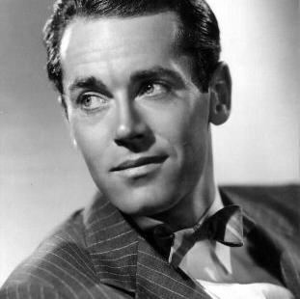
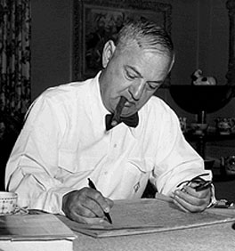
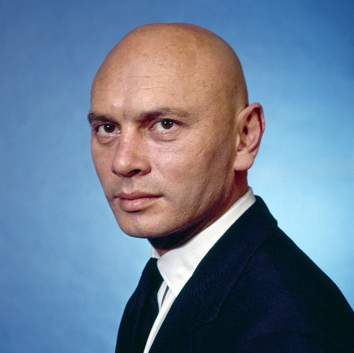

Why Plan?
Celebrity Estate Planning done well
IRA Gershwin
Henry Fonda
Actor
Composer
1% lost to taxes and fees
2% lost to taxes and fees
Yul Brynner
Steve Jobs
Actor
Executive
3% lost to taxes and fees
>1% lost to taxes and fees
Source: Estate Planning Concepts
Notes:
Now we look at four famous people that did do effective estate planning. (READ NAMES AND AMOUNTS LOST TO TAXES AND FEES). As you can see, with some thought and a good estate plan, you can control where your estate assets go as well as minimize taxes and expenses, thus ensuring that your heirs receive the most money possible.

Slide 27
Who Can Help ?
 | Attorney | CFP® | Trust Officer
Estate Planning | X | X | X
Asset Re-titling | X | X | X
Investment Management |  | X | X
Trust Administration |  |  | X
Drafting Legal Documents | X
Source: Estate Planning Concepts
Notes:
This chart illustrates the various topics in estate planning and which of your advisors can typically help with that topic. Lets finish up your worksheets by looking at questions #16 and #17 and check off those who you think may be able to help you in your estate plan.

Slide 28
Resources
Nolo Press: Estate planning and will software and guides. www.nolo.com
IRS: Refer to Form 706, Estate Tax; Publication 950 on estate tax; Publication 559 for executors. www.irs.gov
Legal Information Institute: Probate information by state. www.law.cornell.edu/uniform/probate.html
AARP: Unbiased info on wills, trusts and probate. www.aarp.org
Notes:
(Go through all the listed resources. DO NOT ADD YOUR OWN RESOURCES WITHOUT GETTING PERMISSION FROM FINANCIAL FINESSE FIRST.)
Here we have listed some of the resources that you can use to get more information on estate planning issues. These resources are also listed in your folders so you will have a hard copy to work from after this workshop.

Slide 29
Thanks for attending
Estate Planning Basics
Notes:
At this point I will open it up to any additional questions.
Thank you for attending today’s workshop on Estate Planning Basics. If you have any additional questions I will be around after the workshop to answer them.
(See Facilitator’s Guide for important information on your closing comments and ending the session.)

