Slide 1
Blank Presentation Template
, 2023
Presented By –

Slide 2
What is your WHY?
Notes:
We want to get started by talking about your retirement WHY. We will spend most of the presentation talking about that how, but even more important can be the why. You shouldn’t save for retirement just because we tell you it’s important. You should think about your own goals and why saving for the future is important to you. Maybe that’s so that you can spend more time with family, be charitable or create a legacy, maybe travel, live debt free, buy your dream retirement home. It can be as simple as wanting to spend less time working, I’m sure many of you eventually want to retire. The point is, when you think about saving for retirement, keep your WHY in mind so you know the reason it’s important to you.

Slide 3
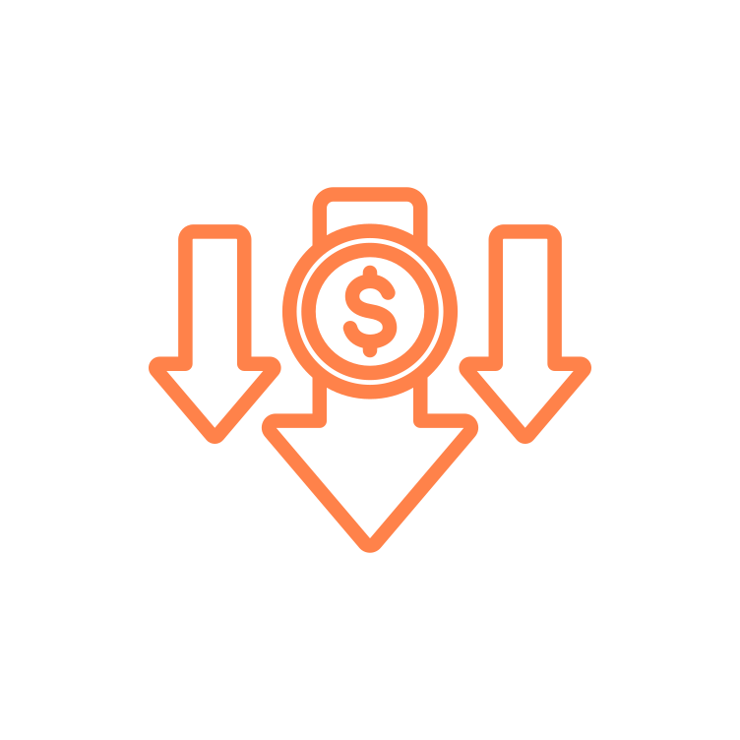
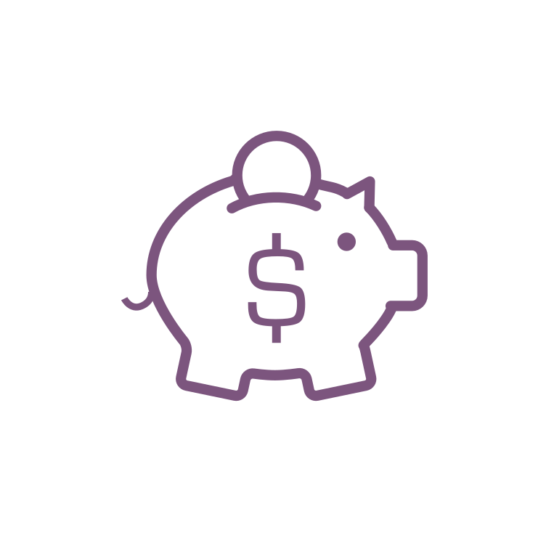
Purpose of a Retirement Account
30%
30%
100%
40%
For illustrative purposes only. 40% replacement is a general rule of thumb. Actual Social Security Replacement will vary. Source: https://www.ssa.gov/policy/docs/ssb/v68n2/v68n2p1.html
Notes:
Now if we look at the numbers, you’ll see the estimations for what we need to retire. The Social Security website estimates that Social Security will replace about 40% of your paycheck when you retire. You should also have about a 30% reduction in what you need now that you no longer need to put money into savings and have maybe paid off most of your debt. This leaves about 30% gap that we need to make up if we want to completely stop working. This is the purpose of a retirement account.

Slide 4
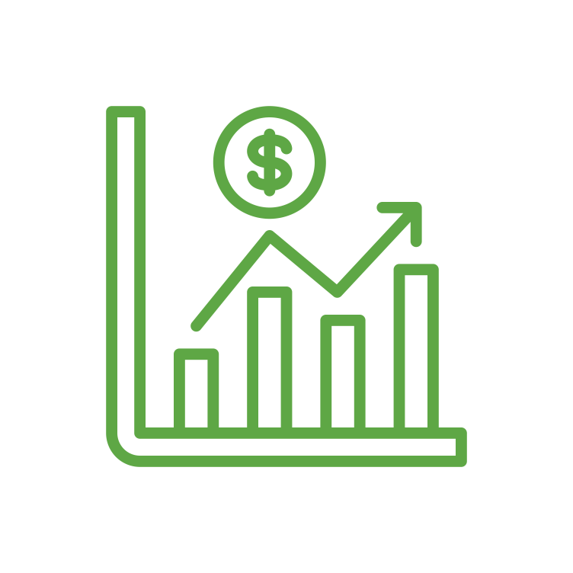
What is a 401(k) Plan?
Money In
Invest
Future Income
Notes:
The specific retirement account that you have is a 401(k) plan. The 401(k) allows you to put money away now, and invest the money so that it grows throughout your working years. This allows you to supplement your income throughout retirement. Think of it like putting money away now to create a paycheck for your future self.

Slide 5
401(k) Contributions
You
IRS Maximum - $22,500
Rollover
Employer
Rollover Contributions Accepted
Employer Matching Contribution
50+ Catch-Up - $7,500
Employer Profit Sharing
Notes:
In your 401(k), you are able to contribute…..

Slide 6
Getting Started
Eligibility
Age 21+ with 1 Month Service
Plan Entry
Monthly
Enrollment
Online at u.bpas.com
Plan Code:

Slide 7
Automatic Enrollment
Target Date Fund
3%
3 Months
Notes:
One feature of your plan

Slide 8
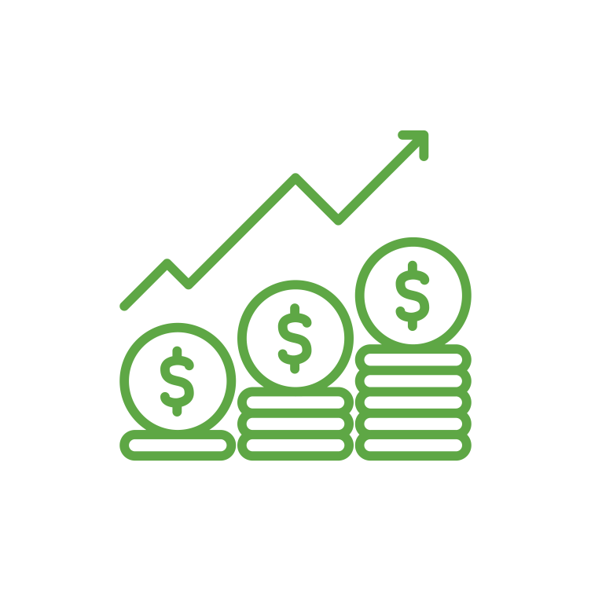
How Much Should I Contribute? 50/30/20 Rule
50% - Needs
30% - Wants
20% - Savings
Of the 20% total savings, retirement experts recommend 10-15% towards retirement.
Notes:
A common question we receive is – how much should I actually be contributing? One commonly-used budgeting rule is called the 50/30/20 rule. This rule tries to break your spending up into three categories: Needs, Wants, and Savings. Try and keep spending for needs such as housing, food, transportation to around 50% of your income. For wants, such as vacation, entertainment, dining out, try to keep this amount at about 30% of you income. This will leave you with 20% of your income for savings. Most experts will recommend savings 10-15% of your income towards retirement savings. If you can do that, and save the other 5-10% to pay debt or create an emergency fund, this should leave you help you get on track for your retirement needs.

Slide 9
Weekly Contribution Amount
Salary | 10% | 12% | 15%
$30,000 | $57 | $69 | $86
$40,000 | $76 | $92 | $115
$50,000 | $96 | $115 | $144
$60,000 | $115 | $138 | $173
$70,000 | $134 | $161 | $201
$80,000 | $153 | $185 | $230
Weekly contribution Rounded to nearest dollar.
Notes:
This slide breaks down the 10-15% goal we just talked about. You can see on a weekly basis was 10-15% would be towards your retirement. For example……

Slide 10
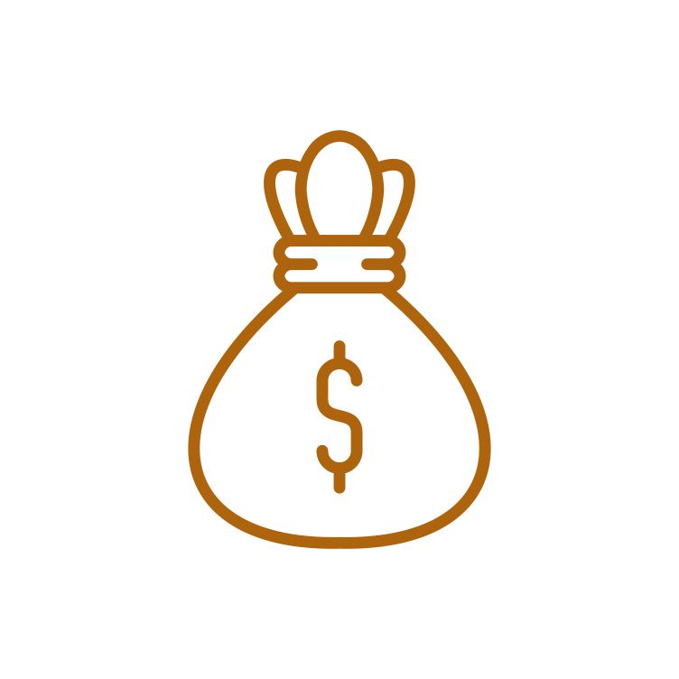
Compounding Growth
Doubling Your Money for 30 Days
$0.01
$10.24
$10,485
$5,368,709
Day 1
Day 10
Day 20
Day 30
For illustrative purposes only.
Notes:
Now we are going to talk about how compounding growth helps to make saving for retirement impactful over time. We’re starting with an exaggerated example, but if you double a penny for 10 days, it will be $10,24 after 10 days. If you double for another 10 days, is will be $10,485. Finally 10 more days and it is $5,368,709. If you recognize the pattern, it is that the more times the penny grows on itself, the more impactful the increases are.

Slide 11
Compounding Growth
Hypothetical example for illustrative purposes only. Calculated using the 403(b)/457/401(k) Savings Calculator at u.bpas.com. Assumptions: annual $3,000 contribution earning 5.5% rate of return annually. Age brackets are approximate, not to exact scale.
Notes:
Our retirement accounts can function much in the same way. We aren’t going to be able to double our money each day, like the penny, but if you look over time, you will see the same effect with retirement. At first, the growth in the account seems very modest, maybe even non-existent. However, over time, as your investments grow and compound on one another, the effect become more impactful. You can see that at about age 49, half the value is investment growth. By age 65, the investment growth is almost 3 times what you have actually contributed over the years.

Slide 12
Contribution Increases
Increasing Ian
$621,251
Consistent Connor
$495,425
Late Larry
$323,087
For illustrative purposes only. Calculated using the Retirement Account Contribution Accelerator at u.bpas.com. Assumptions: $60,000 salary, no annual salary increase, 5.5% annual rate of return, 1% contribution increases.

Slide 13
Pre-Tax Contributions
Tax-Free Contribution
Taxable Withdrawal
Tax-Deferred Growth
Taxes

Slide 14
Roth Contributions
Taxable Contribution
Tax-Free Withdrawal
Tax-Free Growth
Taxes
Must be 59 ½ with the first contribution 5+ years ago

Slide 15
When Pre-Tax May Make Sense
28%
Tax
15%
Tax
Current
Future
(Projected)
Pre-Tax

Slide 16
When Roth May Make Sense
28%
Tax
15%
Tax
Future
(Projected)
Current
Roth

Slide 17
Employer Contributions
By Contributing 6% you receive the Employer Full Match of 4.5%
Employer Matches 50% of the next 3% you contribute.
Employer Matches 100% of the first 3% you contribute.

Slide 18
Employer Contributions Vesting
1 Year
2 Years
3 Years
0%
0%
100%

Slide 19
Employer Contributions Vesting
1 Year
2 Years
3 Years
0%
20%
40%
4 Year
5 Years
6 Years
100%
60%
80%

Slide 20
Investing Terminology
Stock or Equity
Bonds
Fixed Income
Fund
Notes:
Stock Icon – Ownership of a company
Bond Icon – Issued typically by a government typically, but also companies
Fixed Income – Broader category (bonds, stable value, money market)
Fund – Investment into multiple companies or bonds to spread out risk.

Slide 21
Retirement Investment Strategies
The ‘Do-it-Yourself’ Approach
The ‘Hire Someone’ Approach
Target Date/Risk Fund
Model Portfolio
Asset Allocation
Notes:
Highlighting differences between creating your own asset allocation vs. choosing a target date or balanced fund.

Slide 22
Time Horizon
Early Career (30,000 Ft.)
Mid Career (20,000 Ft.)
Late Career (10,000 Ft.)
Retirement
(0 Ft.)
For Illustrative purposes only.
This suggested risk-based allocation process is not intended to represent investment advice that is appropriate for all investors. Each investor's allocation must be based on their personal goals, time frame, financial resources, risk tolerance and other pertinent factors. Because everyone's situation is different, you should consult a financial advisor to assist with the optimal allocation appropriate for you.

Slide 23
Risk Tolerance
Take the risk tolerance quiz at u.bpas.com
Aggressive
Moderately Aggressive
Moderate
Moderately Conservative
Conservative
Portfolio sample returns located at u.bpas.com ‘What Type of Investor are You? (Risk Tolerance). Sample returns are for illustrative purposes only and do not serve as investment advice.

Slide 24
Investment Categories
Foreign Stock
Small-Cap Stock
Growth Stock
Balanced Funds
Higher
Money
Market
Expected Return
Lower
Lower
Risk
Higher
For Illustrative purposes. General observations only.
Volatility for any given time period can vary from the above.
Notes:
As I mentioned earlier, one of the benefits of a 401(k) plan is the ability to invest your money, and allow it to grow over time. The investments that you have access to invest in, often fall into one of the categories on this chart. You can see on the left side of the chart are low risk, low return investments such as money market and bond funds. These funds provide low, but often consistent returns, which is great for preserving your account balance.
On the right side of the chart is the higher risk funds such as foreign and small cap funds. Because they are higher risk, we expect over a long time period to have a higher rate of return. That being said, because they are high risk, in any given period they can be much more volatile or have bigger decreases than more conservative investments.
On the left side of the chart are the more conservative funds. Because these funds are more conservative, they often provide less volatile investment returns, however their upside can be limited.
When investing, we often want to create a diversified balance so that we minimize risk. Investing in just foreign stock may leave you too risk heavy, while investing in just money market may not be a good long term strategy.

Slide 25
Your Investment Menu
Stable Value/Cash Reserves
Bonds
Blended
Equity
Sector/Specialty
International
Goldman Sachs Stable Value
Columbia High Yield Bond
Vanguard Target Date Funds
See Style Box (Next Slide)
American Funds EuroPacific Growth
DFA Real Estate Securities
Notes:
Now we will discuss your plan’s investment menu. Listed here are the different investments that you have available to you in your 401(k) plan. Also shown are the different categories under which these investments fall. Just like the former slide, the options on the left contain the lowest risk and each option to the right includes more risk, with the opportunity of higher returns.
Being too heavily weighted in any one fund may cause your portfolio to lack diversity and either be too aggressive or too conservative. Using asset allocation and investing in a variety of funds will help increase your account diversity, and protect you in the event that any one fund underperforms.
The blended options, as we mentioned earlier, aim to automatically balance your portfolio using stocks to maximize growth and bonds to minimize risk.

Slide 26
Your Investment Menu
` | Value | Blend | Growth
Large Cap | Vanguard Windsor II Vanguard Equity Income | Vanguard 500 Index JPMorgan U.S. Equity | Franklin Growth Vanguard Growth Index
Mid Cap | John Hancock Disciplined Value |  | Delaware Ivy Mid Cap Growth
Small Cap | American Century Small Cap Value |  | Brown Cap Management Small Company
Notes:
Listed here are the equity funds which were not listed on the previous slide. Equity funds invest in company stocks and can be sorted by their investment objectives, listed on the chart. Small, mid, and large cap refer to the size of the company, while value, blend, and growth refer to the investment strategy used by the fund.
Because small cap companies are generally less established, they are considered riskier investments. However, because they also have large growth potential, they can outperform mid and large cap funds. Mid Cap and Large cap Funds are conversely less risky and may provide more consistent and stable growth.
With value funds, investors believe the companies are currently undervalued in the marketplace, and their price will eventually reflect that. With Growth funds, investors believe these companies have the potential to grow faster than other companies similar companies. Finally blended funds include both value and growth companies.

Slide 27
Target Date Funds
Expected Retirement
Allocation Percentage
For Illustrative purposes. Not specific to any Target Date Series.
Types of funds held, expected retirement age, and Equity and Fixed Income percentages will vary by fund.
Notes:
A couple of slide ago, I mentioned that blended funds invest in multiple different categories in order to maximize return while minimizing risk. In your 401(k) plan, you have the Vanguard Target Date funds as an available investment option. These target date funds are a blended fund that automatically adjusts for you, as you get closer to retirement.
In your early working years when you are far from retirement, a target date fund will be heavily invested in equities such as stocks, to allow your account to maximize it’s growth. As you move closer to retirement, the fund will automatically invest in more fixed income options such as bonds and money market funds.
This is meant to reduce risk over time to secure the gains in your account, as you near retirement. Each company’s target date funds are different, but the above chart gives an idea of this investment strategy.

Slide 28
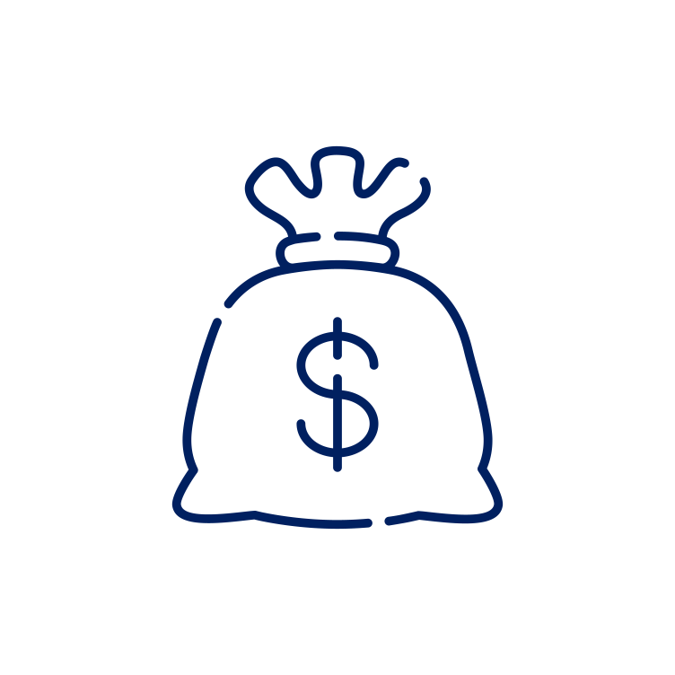
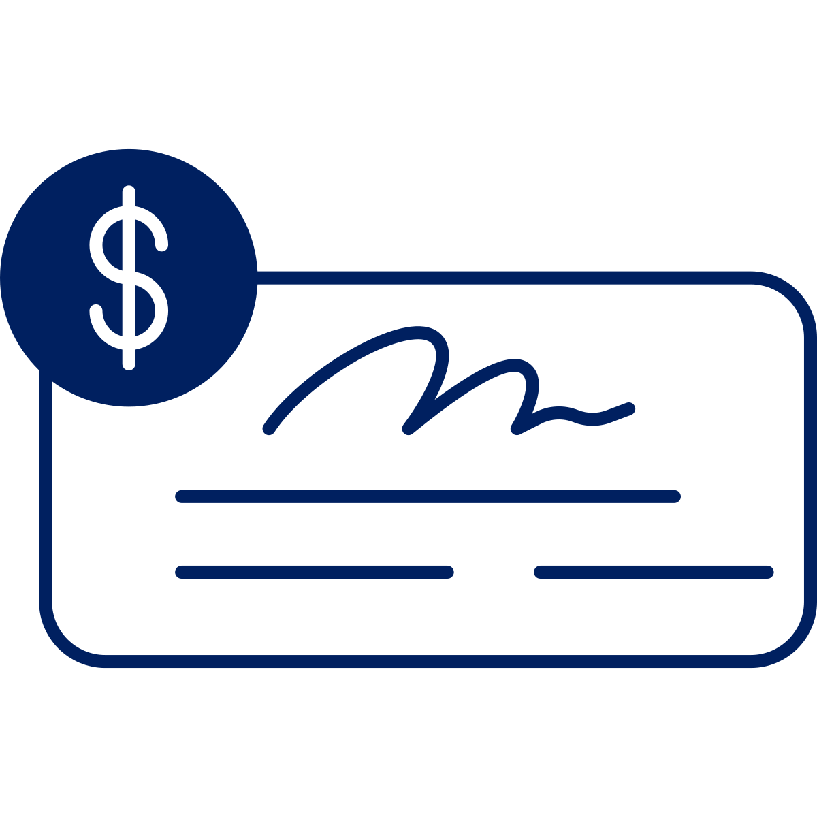
To vs. Through
Retirement Age
To Retirement
More Aggressive
More Conservative
Through Retirement
General observations for illustrative purposes only. Actual allocation of any target date fund series will vary.
Notes:
To retirement manages up to retirement age expecting you will take a lump sum at that point.
Through retirement manages through the retirement age, becoming it’s most conservative at a later date expecting you will continually withdrawal for income throughout.

Slide 29
Target Date Funds
If you were born….. | You might want to consider the BlackRock LifePath…..
Before 1963 | Retirement Fund
1963 - 1967 | 2030 Fund
1968 - 1972 | 2035 Fund
1973 - 1977 | 2040 Fund
1978 - 1982 | 2045 Fund
1983 - 1987 | 2050 Fund
1988 - 1992 | 2055 Fund
1993 - 1997 | 2060 Fund
After 1997 | 2065 Fund
Notes:
Here is a chart showing the different Vanguard Target Date Funds, listed by year, with an estimate of retirement date or date of birth. For example, you can see that if you were born between 1978 and 1982, the default target date fund would be the 2045 fund. You only have to invest in one fund and do not have to make changes, unless your objectives change. The fund will automatically adjust for you over time.
You also do not have to choose the fund that relates to your date of birth. If you would like to be more aggressive or expect to retire later than age 65, you can choose a later target date fund. Conversely, an earlier target date fund could be selected if you would like to be more conservative with your investments

Slide 30
Risk Managed Strategies
Conservative
Moderate
Aggressive
15 – 30%
50 – 70%
85 – 99%
General observations for illustrative purposes only. The percentages represent a typical equity holding for the fund. Name of the fund and percentages will vary by fund company.

Slide 31
Focus on the Long-Term Goals
Notes:
Keep in mind – investing for retirement is playing the long game. If you keep those goals in mind, that should help long-term.
Person in blue – sees that money has doubled over the last 3 years and is thrilled.
Person in green – money also double, however, they are more focused on the fact that last year money was $3,000 and is now $2,000. Focused on short-term which can lead to bad decisions.

Slide 32
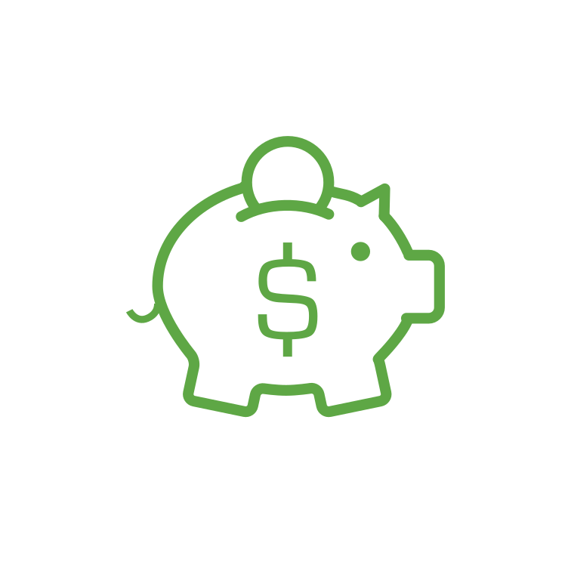
401(k) Plan Loan
Up to 50% of account $1,000 - $50,000
Maximum 1 outstanding loan
Pay back with interest over time
(typically 0-5 years)
Loans and distributions may be subject to fees, taxes and/or penalties. Review all documentation and consult with a financial professional prior to completing a withdrawal
Notes:
An Interest rate is a payment for borrowing money

Slide 33
Post-Employment & Distributions
Distributions
Taxable distribution if separate from service
In-Service Distributions at age 59 1/2
Financial Hardship Distributions are available
Rollover to an IRA or new Retirement Plan
Loans and distributions may be subject to fees, taxes and/or penalties. Review all documentation and consult with a financial professional prior to completing a withdrawal

Slide 34
Do Politics Matter?
9.2%
9.1%
10.0%
8.2%
Source: Bloomberg and AB as of December 31, 2019. Performance from DJIA from 1937 – 2019. For Illustrative purposes only and not a guarantee of future results.
Notes:
DJIA returns have been 9.2% and 9.1% respectively based on white house political party.
Bigger difference is between a unified government (8.2%) and divided government (10%).

Slide 35
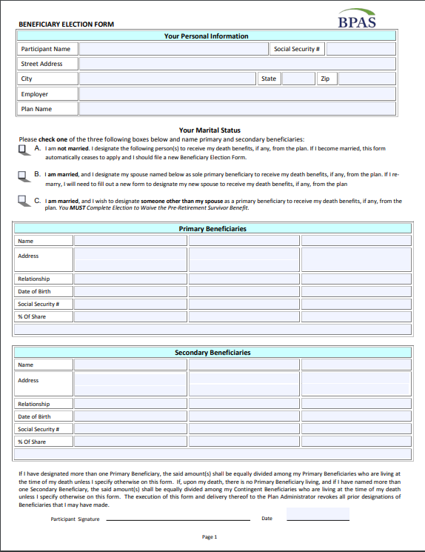
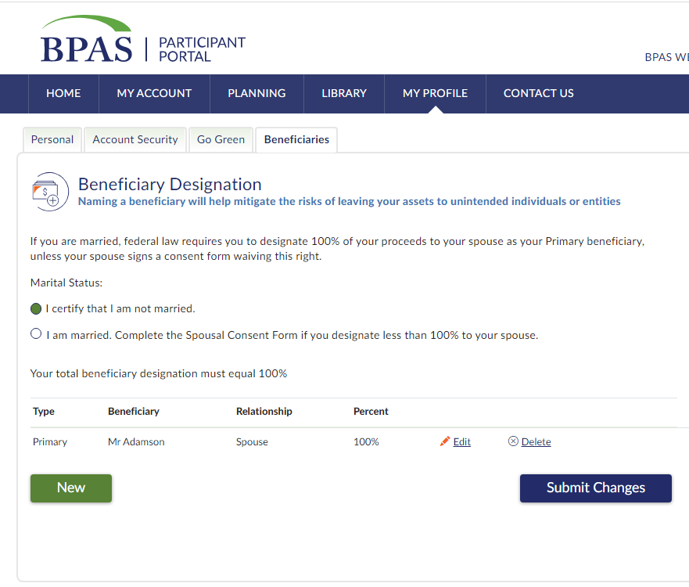
Beneficiaries

Slide 36
BPAS Participant Portal

Slide 37
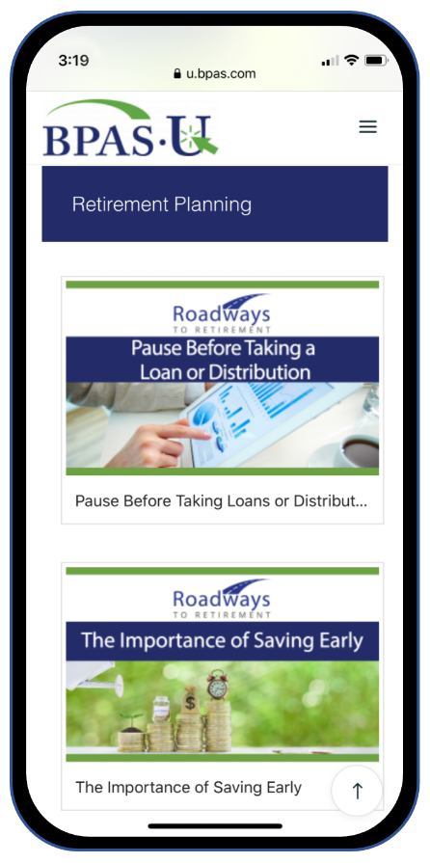
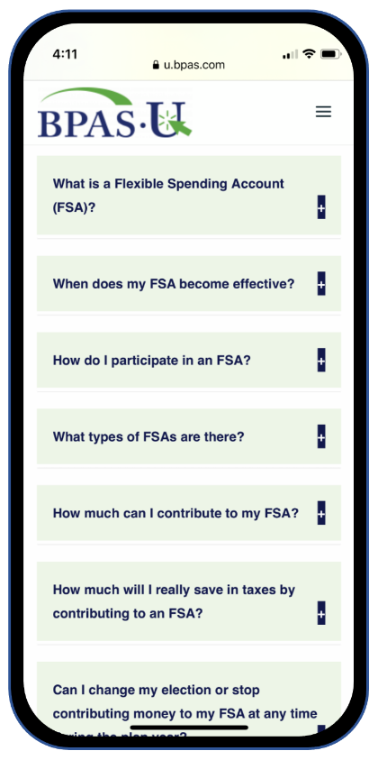
BPAS U Mobile App

Slide 38
Mile Marker Tool

Slide 39
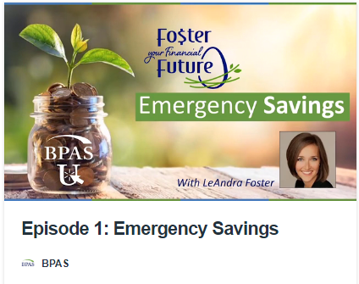
BPAS University (u.bpas.com)

Slide 40
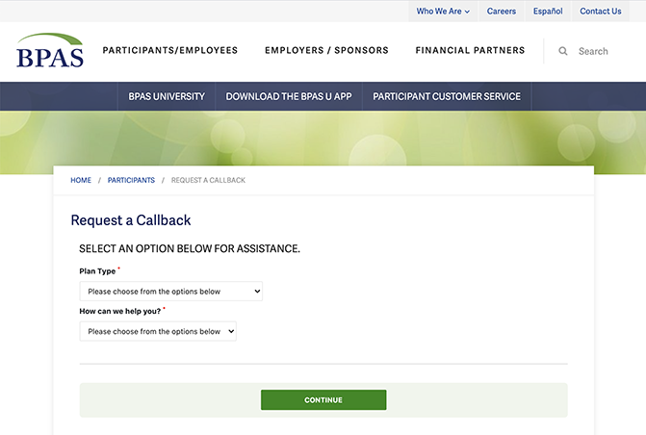
Participant Services
866.401.5272
Monday – Friday
8am-8pm ET

Slide 41
Action Steps
Some key takeaways…
Log in to your online account.
Make sure beneficiaries are up-to-date.
Ensure your investments reflect your risk tolerance.
Consider a contribution increase or setting up automatic increases.
Notes:
Finally, whether you are new just getting started, or have been saving for years, here are some great steps to take while your retirement is at the top of your mind.
Log in to your account or setup your account if you have yet to do so.
Make sure your beneficiaries are up to date, especially if you have had any recent changes in marital or parental status.
Take a look at your current investments and make sure they reflect your time horizon and retirement objectives.
Lastly, consider increasing your contribution amount or setting up an automatic increase to help reach your retirement savings goals.

Slide 42
Questions?
866.401.5272
@bpas.com
u.bpas.com
Notes:
Thank you for watching our presentation, if you have further questions please call our participant services or visit us online. Thank you,

