Slide 1
Plantilla de Presentación
, 2023
Presentado Por–

Slide 2
¿Cuál es tu POR QUÉ?
Notes:
We want to get started by talking about your retirement WHY. We will spend most of the presentation talking about that how, but even more important can be the why. You shouldn’t save for retirement just because we tell you it’s important. You should think about your own goals and why saving for the future is important to you. Maybe that’s so that you can spend more time with family, be charitable or create a legacy, maybe travel, live debt free, buy your dream retirement home. It can be as simple as wanting to spend less time working, I’m sure many of you eventually want to retire. The point is, when you think about saving for retirement, keep your WHY in mind so you know the reason it’s important to you.

Slide 3
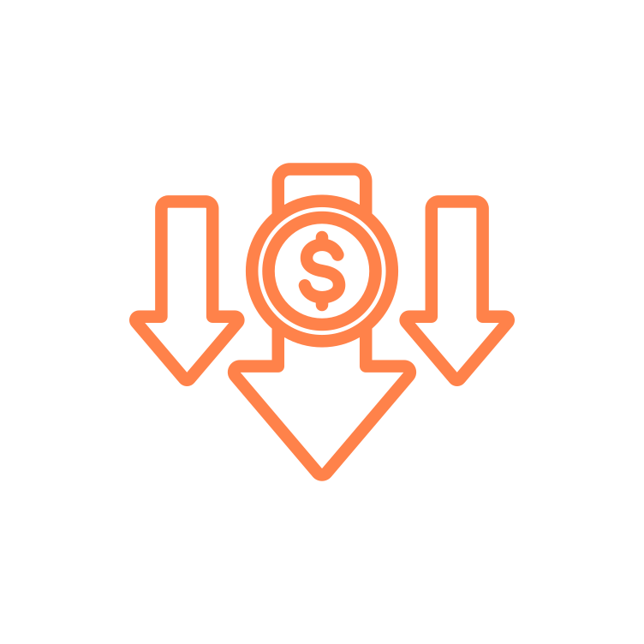
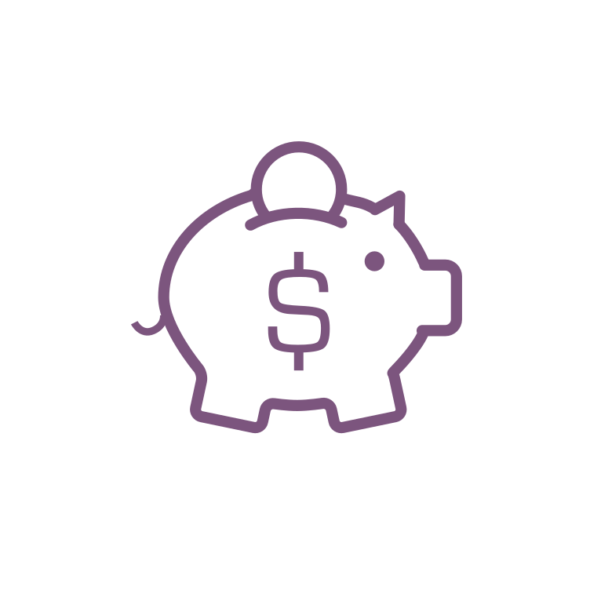
Propósito de una Cuenta de Retiro
30%
30%
100%
40%
Solo con fines ilustrativos. El reemplazo del 40% es una regla general. El reemplazo real del Seguro Social variará.
Fuente: https://www.ssa.gov/policy/docs/ssb/v68n2/v68n2p1.html
Notes:
Now if we look at the numbers, you’ll see the estimations for what we need to retire. The Social Security website estimates that Social Security will replace about 40% of your paycheck when you retire. You should also have about a 30% reduction in what you need now that you no longer need to put money into savings and have maybe paid off most of your debt. This leaves about 30% gap that we need to make up if we want to completely stop working. This is the purpose of a retirement account.

Slide 4
¿Qué es un Plan 401(k)?
Dinero Entra
Se Invierte
Tu Futuro Ingreso
Notes:
The specific retirement account that you have is a 401(k) plan. The 401(k) allows you to put money away now, and invest the money so that it grows throughout your working years. This allows you to supplement your income throughout retirement. Think of it like putting money away now to create a paycheck for your future self.

Slide 5
Aportaciones 401(k)
Tu
Máximo del IRS - $22,500
Transferencia
Empleador
Transferencias de Cuentas de Retiro se Acceptan
Contribución de Igualación de Aportes
50+ Catch-Up - $7,500
Contribución de Profit Sharing
Notes:
In your 401(k), you are able to contribute…..

Slide 6
Para Empezar
Elegibilidad
21 años con 1 mes de servicio
Entrada de plan
Mensual
Inscripción
En línea en u.bpas.com
Código del Plan

Slide 7
Inscripción Automática
Fondo de Fecha Objetivo
3%
3
Meses
Notes:
One feature of your plan

Slide 8
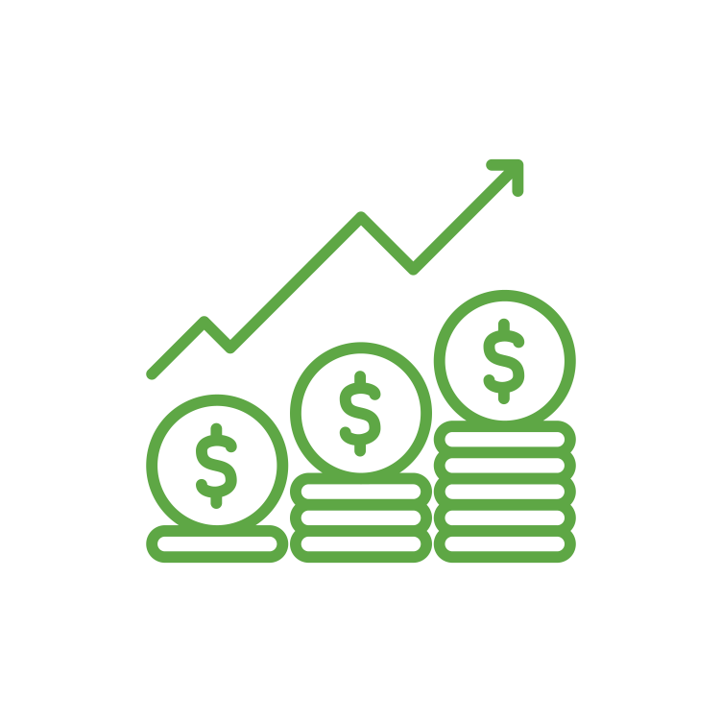
¿Cuánto debo aportar? La Regla de 50/30/20
50% - Necesidades
30% - Deseos
20% - Ahorros
Del 20% de ahorro total, los expertos en jubilación recomiendan 10-15% para el retiro.
Notes:
A common question we receive is – how much should I actually be contributing? One commonly-used budgeting rule is called the 50/30/20 rule. This rule tries to break your spending up into three categories: Needs, Wants, and Savings. Try and keep spending for needs such as housing, food, transportation to around 50% of your income. For wants, such as vacation, entertainment, dining out, try to keep this amount at about 30% of you income. This will leave you with 20% of your income for savings. Most experts will recommend savings 10-15% of your income towards retirement savings. If you can do that, and save the other 5-10% to pay debt or create an emergency fund, this should leave you help you get on track for your retirement needs.

Slide 9
Monto de la Aportación Semanal
Salario | 10% | 12% | 15%
$30,000 | $57 | $69 | $86
$40,000 | $76 | $92 | $115
$50,000 | $96 | $115 | $144
$60,000 | $115 | $138 | $173
$70,000 | $134 | $161 | $201
$80,000 | $153 | $185 | $230
Contribución semanal redondeada al dólar más cercano.
Notes:
This slide breaks down the 10-15% goal we just talked about. You can see on a weekly basis was 10-15% would be towards your retirement. For example……

Slide 10
Crecimiento Compuesto
Duplicando su dinero durante 30 días
$0.01
$10.24
$10,485
$5,368,709
Día 1
Día 10
Día 20
Día 30
Solo con fines ilustrativos.
Notes:
Now we are going to talk about how compounding growth helps to make saving for retirement impactful over time. We’re starting with an exaggerated example, but if you double a penny for 10 days, it will be $10,24 after 10 days. If you double for another 10 days, is will be $10,485. Finally 10 more days and it is $5,368,709. If you recognize the pattern, it is that the more times the penny grows on itself, the more impactful the increases are.

Slide 11
Crecimiento Compuesto
Ejemplo hipotético solo con fines ilustrativos. Calculado utilizando la calculadora de ahorros 403(b)/457/401(k) en u.bpas.com. Suposiciones: aportación anual de $3,000 ganando una tasa de rendimiento del 5.5% anual. Los grupos de edad son aproximados, no a escala exacta.
Notes:
Our retirement accounts can function much in the same way. We aren’t going to be able to double our money each day, like the penny, but if you look over time, you will see the same effect with retirement. At first, the growth in the account seems very modest, maybe even non-existent. However, over time, as your investments grow and compound on one another, the effect become more impactful. You can see that at about age 49, half the value is investment growth. By age 65, the investment growth is almost 3 times what you have actually contributed over the years.

Slide 12
Aumentos de Aportaciones
Angel, siempre incrementado
$621,251
Jose, el consistente
$495,425
Luis, el lento
$323,087
Solo con fines ilustrativos. Calculado utilizando el Acelerador de Contribuciones a la Cuenta de Retiro en u.bpas.com. Suposiciones: salario de $60,000, sin aumento salarial anual, tasa de rendimiento anual del 5.5%, aumento de aportación del 1%.

Slide 13
Aportaciones Pre-Tax
Antes de Impuestos
Aporte libre de impuesto
Retiro sujeto a tasación
Crecimiento con impuestos diferidos
Impuestos

Slide 14
Roth Contributions
Después de Impuestos
Aporte sujeto a tasación
Retiro libre de impuestos
Crecimiento libre de impuestos
Impuestos
Debe tener 59 ½ años con la primera contribución hace 5+ años

Slide 15
Cuando Pre-Tax puede tener sentido
28%
Impuestos
15%
Impuestos
Actual
Futuro
(Proyectado)
Pre-Tax
(Antes de Impuestos)

Slide 16
Cuando Roth puede tener sentido
28%
Impuesto
15%
Impuesto
Futuro (Proyectado)
Actual
Roth
(Despues de Impuestos)

Slide 17
Contribuciones del Empleador
Si aportas el 6%, usted recibe el total del 4.5% de lo que iguala su empleador.
El empleador iguala el 50% del siguiente 3% que usted contribuye.
El empleador iguala el 100% del primer 3% que contribuya.

Slide 18
Adquisición de Contribuciones de la Empresa
1 Año
2 Años
3 Años
0%
0%
100%

Slide 19
Adquisición de Contribuciones de la Empresa
1 Año
2 Años
3 Años
0%
20%
40%
4 Años
5 Años
6 Años
100%
60%
80%

Slide 20
Terminología de Inversión
Acciones
Bonos
Ingreso Fijo
Fondo
Notes:
Stock Icon – Ownership of a company
Bond Icon – Issued typically by a government typically, but also companies
Fixed Income – Broader category (bonds, stable value, money market)
Fund – Investment into multiple companies or bonds to spread out risk.

Slide 21
Estrategias de Inversión para el Retiro
El método de “hágalo usted mismo”
El método de "contratar a alguien"
Asignación de Activos
Fecha objetivo Fondo de riesgo
Cartera de modelos
Notes:
Highlighting differences between creating your own asset allocation vs. choosing a target date or balanced fund.

Slide 22
Horizonte de Tiempo
Inicio de la Carrera
(30,000 Pies)
Mitad de Carrera
(20,000 Pies)
Carrera Tardía
(10,000 Pies)
Retiro
(0 Pies)
Solo con fines ilustrativos.
Este proceso de asignación basado en el riesgo sugerido no pretende representar un asesoramiento de inversión que sea apropiado para todos los inversores. La asignación de cada inversor debe basarse en sus objetivos personales, horizonte de tiempo, recursos financieros, tolerancia al riesgo y otros factores pertinentes. Debido a que la situación de cada persona es diferente, debe consultar a un asesor financiero para que lo ayude con la asignación óptima adecuada para usted.

Slide 23
Tolerancia al Riesgo
Tome el cuestionario de tolerancia al riesgo en u.bpas.com
Agresivo
Moderadamente Agresivo
Moderado
Moderadamente Conservador
Conservador
Muestra de rendimientos de cartera están ubicados en u.bpas.com '¿Qué tipo de inversor eres? (Tolerancia al riesgo). Los rendimientos de muestra son solo para fines ilustrativos y no sirven como asesoramiento de inversión.

Slide 24
Categorías de Inversión
Acciones de Cap Pequeña
Acciones
Extranjera
Acciones de Crecimiento
Fondos Balanceados
A
L
T
O
Money
Market
Retorno
Esperado
B
A
J
O
Bajo
Riesgo
Alto
Con fines ilustrativos. Sólo observaciones generales. La volatilidad para cualquier período de tiempo dado puede variar de lo anterior.
Notes:
As I mentioned earlier, one of the benefits of a 401(k) plan is the ability to invest your money, and allow it to grow over time. The investments that you have access to invest in, often fall into one of the categories on this chart. You can see on the left side of the chart are low risk, low return investments such as money market and bond funds. These funds provide low, but often consistent returns, which is great for preserving your account balance.
On the right side of the chart is the higher risk funds such as foreign and small cap funds. Because they are higher risk, we expect over a long time period to have a higher rate of return. That being said, because they are high risk, in any given period they can be much more volatile or have bigger decreases than more conservative investments.
On the left side of the chart are the more conservative funds. Because these funds are more conservative, they often provide less volatile investment returns, however their upside can be limited.
When investing, we often want to create a diversified balance so that we minimize risk. Investing in just foreign stock may leave you too risk heavy, while investing in just money market may not be a good long term strategy.

Slide 25
Su Menú de Inversión
Valor Estable/ Money Market
Bonos
Balanceados
Acciones
Sector/ Especialidad
Internacional
Goldman Sachs Stable Value
Columbia High Yield Bond
Vanguard Target Date Funds
Ver cuadro de estilo
American Funds EuroPacific Growth
DFA Real Estate Securities
Notes:
Now we will discuss your plan’s investment menu. Listed here are the different investments that you have available to you in your 401(k) plan. Also shown are the different categories under which these investments fall. Just like the former slide, the options on the left contain the lowest risk and each option to the right includes more risk, with the opportunity of higher returns.
Being too heavily weighted in any one fund may cause your portfolio to lack diversity and either be too aggressive or too conservative. Using asset allocation and investing in a variety of funds will help increase your account diversity, and protect you in the event that any one fund underperforms.
The blended options, as we mentioned earlier, aim to automatically balance your portfolio using stocks to maximize growth and bonds to minimize risk.

Slide 26
Su Menú de Inversión
` | Valor | Combinación | Crecimiento
Cap Grande | Vanguard Windsor II Vanguard Equity Income | Vanguard 500 Index JPMorgan U.S. Equity | Franklin Growth Vanguard Growth Index
Cap Mediana | John Hancock Disciplined Value |  | Delaware Ivy Mid Cap Growth
Cap Pequeña | American Century Small Cap Value |  | Brown Cap Management Small Company
Notes:
Listed here are the equity funds which were not listed on the previous slide. Equity funds invest in company stocks and can be sorted by their investment objectives, listed on the chart. Small, mid, and large cap refer to the size of the company, while value, blend, and growth refer to the investment strategy used by the fund.
Because small cap companies are generally less established, they are considered riskier investments. However, because they also have large growth potential, they can outperform mid and large cap funds. Mid Cap and Large cap Funds are conversely less risky and may provide more consistent and stable growth.
With value funds, investors believe the companies are currently undervalued in the marketplace, and their price will eventually reflect that. With Growth funds, investors believe these companies have the potential to grow faster than other companies similar companies. Finally blended funds include both value and growth companies.

Slide 27
Fondos de Fecha Objetivo
Jubilación Prevista
Porcentaje de Asignación
Con fines ilustrativos. No es específico a ninguna serie de fechas objetivo.
Los tipos de fondos mantenidos, la edad de jubilación esperada y los porcentajes de renta variable y fija variarán según el fondo.
Notes:
A couple of slide ago, I mentioned that blended funds invest in multiple different categories in order to maximize return while minimizing risk. In your 401(k) plan, you have the Vanguard Target Date funds as an available investment option. These target date funds are a blended fund that automatically adjusts for you, as you get closer to retirement.
In your early working years when you are far from retirement, a target date fund will be heavily invested in equities such as stocks, to allow your account to maximize it’s growth. As you move closer to retirement, the fund will automatically invest in more fixed income options such as bonds and money market funds.
This is meant to reduce risk over time to secure the gains in your account, as you near retirement. Each company’s target date funds are different, but the above chart gives an idea of this investment strategy.

Slide 28
Hacia vs. A través de
Edad de Retiro
Hacia el Retiro
Más Agresivo
Más Conservador
A través del Retiro
Observaciones generales sólo con fines ilustrativos. La asignación real de cualquier serie de fondos de fecha objetivo variará.
Notes:
To retirement manages up to retirement age expecting you will take a lump sum at that point.
Through retirement manages through the retirement age, becoming it’s most conservative at a later date expecting you will continually withdrawal for income throughout.

Slide 29
Fondos de Fecha Objetivo
Si naciste | Es posible que desee considerar el fondo de BlackRock LifePath…..
Antes de 1963 | Fondo de Retiro
1963 - 1967 | Fondo 2030
1968 - 1972 | Fondo 2035
1973 - 1977 | Fondo 2040
1978 - 1982 | Fondo 2045
1983 - 1987 | Fondo 2050
1988 - 1992 | Fondo 2055
1993 - 1997 | Fondo 2060
Despues de 1997 | Fondo 2065
Notes:
Here is a chart showing the different Vanguard Target Date Funds, listed by year, with an estimate of retirement date or date of birth. For example, you can see that if you were born between 1978 and 1982, the default target date fund would be the 2045 fund. You only have to invest in one fund and do not have to make changes, unless your objectives change. The fund will automatically adjust for you over time.
You also do not have to choose the fund that relates to your date of birth. If you would like to be more aggressive or expect to retire later than age 65, you can choose a later target date fund. Conversely, an earlier target date fund could be selected if you would like to be more conservative with your investments

Slide 30
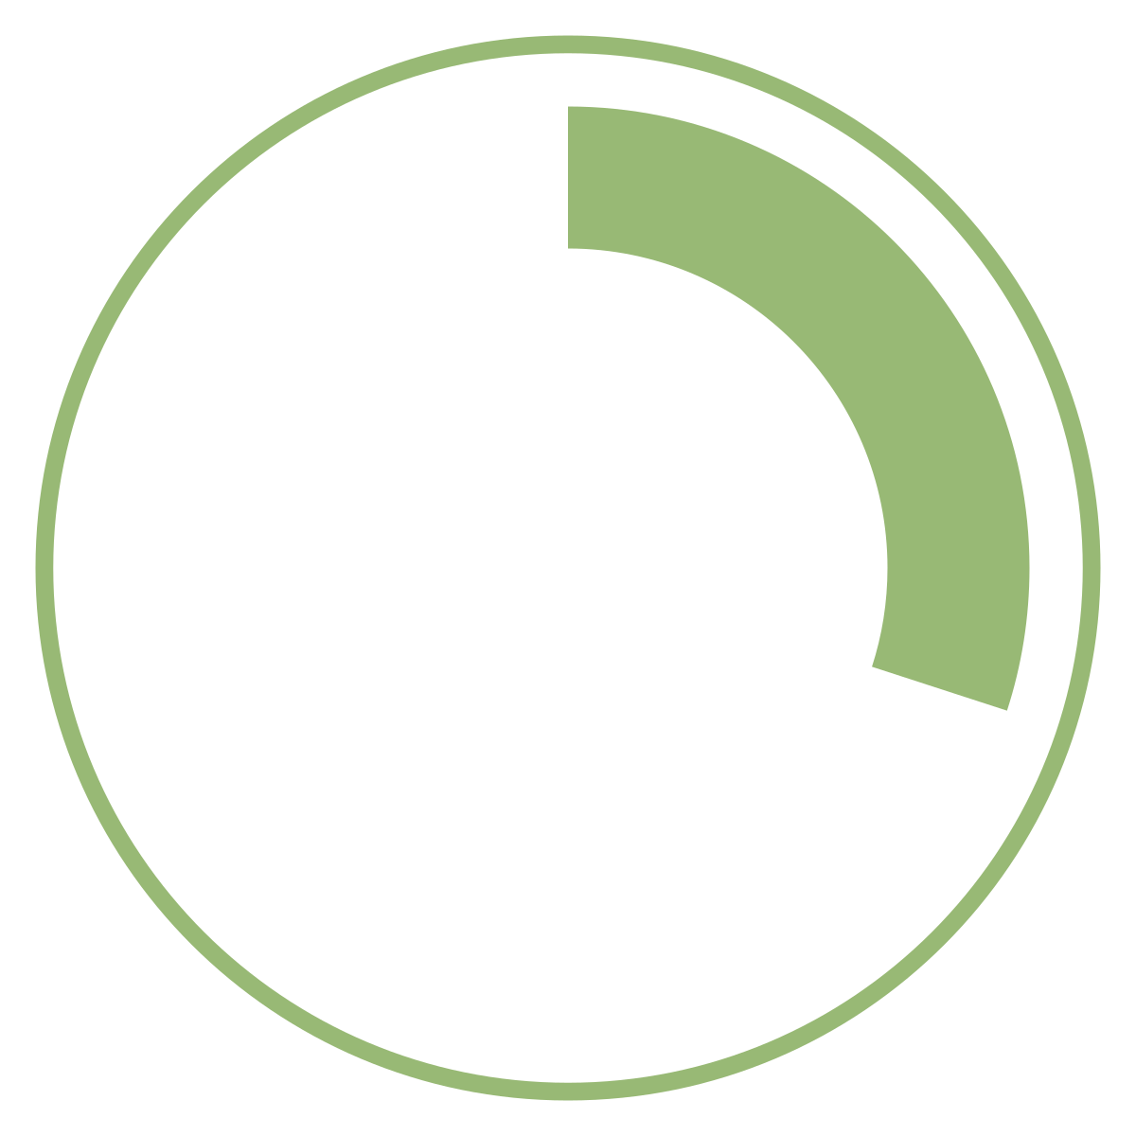
Estrategias de Gestión de Riesgos
Conservador
Moderado
Agresivo
15 – 30%
50 – 70%
85 – 99%
Observaciones generales sólo con fines ilustrativos. Los porcentajes representan una participación típica en los activos del fondo. El nombre del fondo y los porcentajes variarán según la compañía del fondo.

Slide 31
Concéntrese en los Objetivos a Largo Plazo
Notes:
Keep in mind – investing for retirement is playing the long game. If you keep those goals in mind, that should help long-term.
Person in blue – sees that money has doubled over the last 3 years and is thrilled.
Person in green – money also double, however, they are more focused on the fact that last year money was $3,000 and is now $2,000. Focused on short-term which can lead to bad decisions.

Slide 32
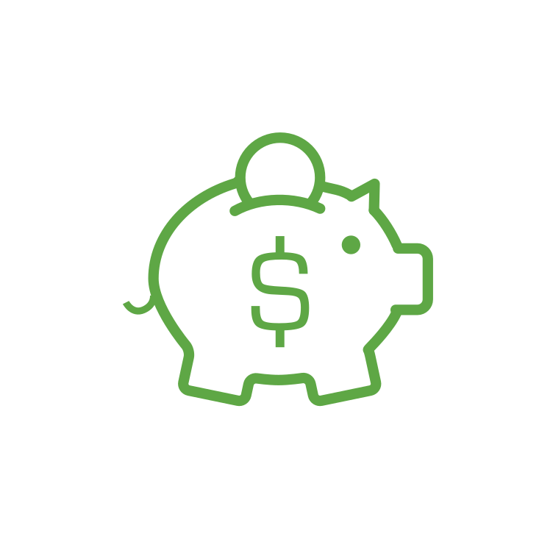
Préstamo del plan 401(k)
Hasta el 50% de la cuenta $1,000 - $50,000
Máximo 1 préstamo pendiente
Pagar con intereses a lo largo del tiempo
(generalmente 0-5 años)
Los préstamos y distribuciones pueden estar sujetos a cargos, impuestos y/o multas. Revise toda la documentación y consulte con un profesional financiero antes de completar un retiro.
Notes:
An Interest rate is a payment for borrowing money

Slide 33
Después del Empleo y Distribuciónes
Distribuciónes
Distribución sujeta a impuestos por separación de servicio
Retiro durante el servicio a edad 59 1/2
Distribuciónes por dificultad financiera estan disponible
Transferencia a una cuenta IRA o un nuevo plan de retiro
Los préstamos y distribuciones pueden estar sujetos a cargos, impuestos y/o multas. Revise toda la documentación y consulte con un profesional financiero antes de completar un retiro.

Slide 34
¿Importa la política?
9.2%
9.1%
10.0%
8.2%
Fuente: Bloomberg y AB desde el 31 de diciembre de 2019. Actuación de DJIA desde 1937 hasta 2019. Solo con fines ilustrativos y no una garantía de resultados futuros.
Notes:
DJIA returns have been 9.2% and 9.1% respectively based on white house political party.
Bigger difference is between a unified government (8.2%) and divided government (10%).

Slide 35
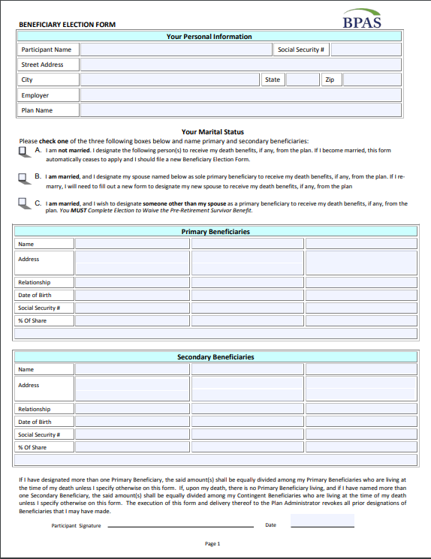
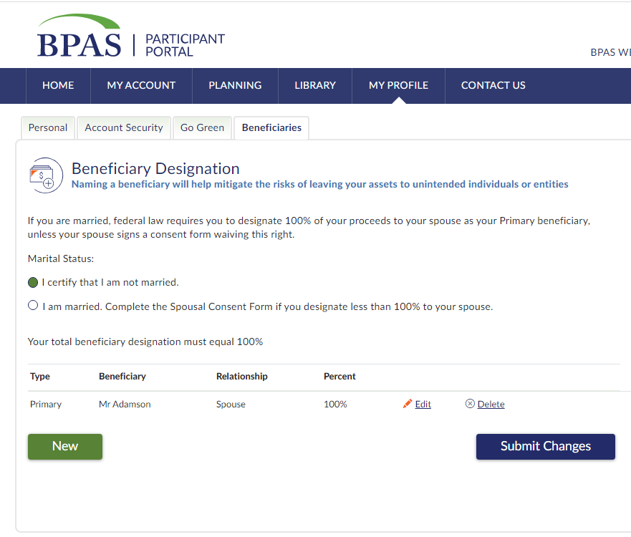
Beneficiarios

Slide 36
Portal del Participante

Slide 37
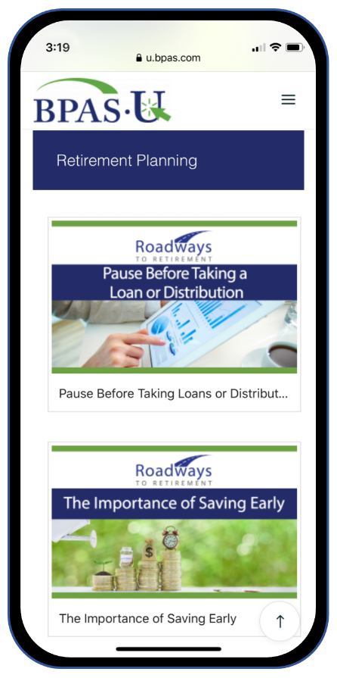
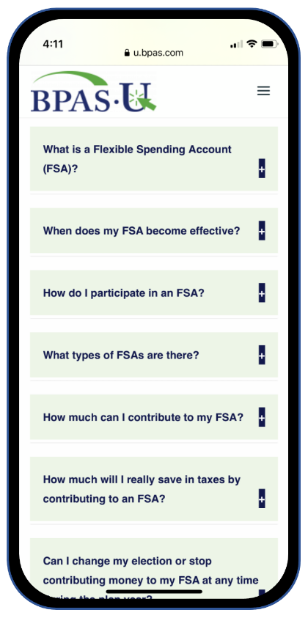
Aplicación Móvil BPAS U

Slide 38
Herramienta de Marcador de Millas

Slide 39
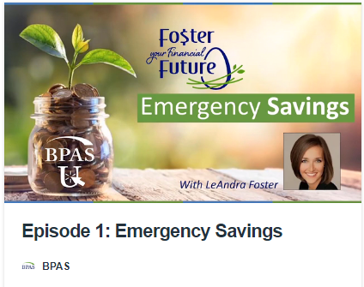
Universidad BPAS (u.bpas.com)

Slide 40
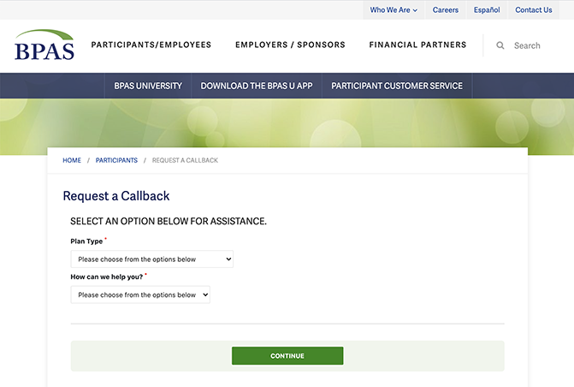
Servicios para Participantes
866.401.5272
Lunes – Viernes
8am-8pm ET

Slide 41
Próximos pasos
Algunos artículos para revisar...
Inicie sesión en su cuenta en línea.
Asegúrese de que sus beneficiarios estén actualizados.
Asegúrese de que sus inversiones reflejen su tolerancia al riesgo.
Considere un aumento de aportación o la configuración de aumentos automáticos.
Notes:
Finally, whether you are new just getting started, or have been saving for years, here are some great steps to take while your retirement is at the top of your mind.
Log in to your account or setup your account if you have yet to do so.
Make sure your beneficiaries are up to date, especially if you have had any recent changes in marital or parental status.
Take a look at your current investments and make sure they reflect your time horizon and retirement objectives.
Lastly, consider increasing your contribution amount or setting up an automatic increase to help reach your retirement savings goals.

Slide 42
¿Preguntas?
866.401.5272
@bpas.com
u.bpas.com
Notes:
Thank you for watching our presentation, if you have further questions please call our participant services or visit us online. Thank you,

