Slide 1
Simplified Solutions
customized for
Client Name
presented by:
Advisor Name – Job Title
October 03, 2023

Slide 2

Today’s Discussion
growing our relationship
Introductions
Review Situation and Objectives
BPAS Overview
Program Highlights
Q&A

Slide 3

Current Plan
our observations
Low Participation Rate
Ongoing ACP Test Failure and Return of Contributions to HCE’s
Impact of Exclusions from Definition of Compensation and 414(s) Testing

Slide 4

BPAS
One Company. One Call.
4,500 Retirement Plans
$1.3 Trillion
in Fund Administration
$110
Billion
in Trust
Assets
620,000 Participants
National provider of:
Retirement plans
Benefit plans
Fund Administration
Collective Investment Trusts
Retirement plan service provider since 1973!

Slide 5





Four Roles. One Provider.
focused on saving you time and headaches
Administration
advanced plan consulting for the full spectrum of retirement plan types and designs
direct access to fully-credentialed experts dedicated to your account
Custody
single system for recordkeeping and trust/custodial services
handle transactions once
no replicating records between plan and trust system
Recordkeeping
drive participant outcomes
ease day-to-day burden for HR
create high client satisfaction
full census file with each payroll submission means we simplify the process and take ownership
Trading
flexible, open-architecture
offer funds from 350+ fund families (representing 20,000+ tickers)
NSCC-traded collective trusts
work with you to determine best investment menu for your plan
Notes:
Maybe add animation to have each text section populate

Slide 6








Simplified Administration
We track all your employees, regardless of balance, simplifying year-end compliance testing, contribution allocations, Form 5500, and more.
You’re kept in the loop with notices and reports on contribution rate changes, new loan issuances, loans nearing default, new hardships, and more.
Online enrollment, automatic enrollment, and auto-escalation eliminates paper, boosts participation, and reduces errors.
Receive real-time participant account updates with each payroll file, including vesting and eligibility, ensuring
accurate plan data, all the time.
Yes,
BPAS can help with that!
We monitor eligibility and mail welcome letters to newly eligible participants, saving you time.
We interact directly with participants on loans, hardships, and distributions, without HR involvement, meaning
you’re no longer the middleman.
Web self-service features for plan sponsors and participants puts your
plan management at a click of a mouse.
Our certified audit package
streamlines the process
for plans subject to audit.

Slide 7
Beyond Recordkeeping
Premier Administration with Top Technology
Eligibility Determination | Monitoring for Late Deposits
Edit Checks on Census Files | Audit Support
Vesting | Clean-up Support
Loan, Hardship and Distributions Adjudication | Full Online Enrollment
Compliance Testing | Full Auto Enrollment Outsourcing
Year-end Allocations | Preparation of Annual Notices
RMDs | Signature Ready 5500
Complete Plan Consulting Services
3(16) Administrative Fiduciary Services | BPAS Mailing Services
Distribution of Annual Notices | Distribution of Annual Notices
Enrollment Monitoring
5500 Submission
QDRO Services

Slide 8
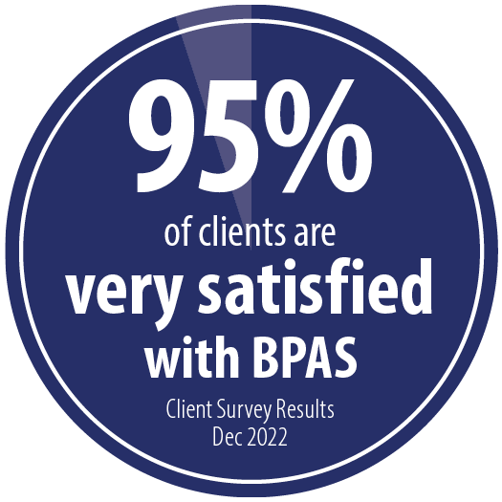
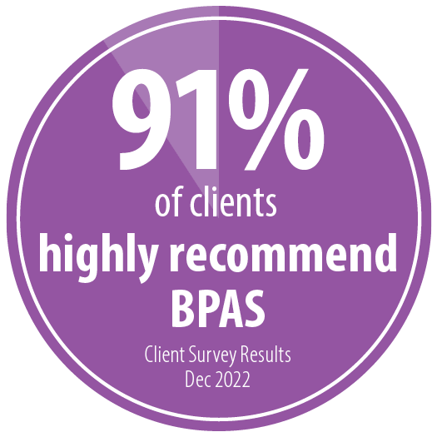
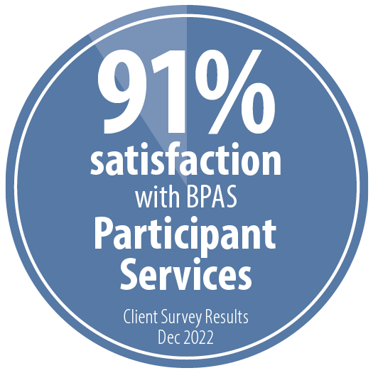
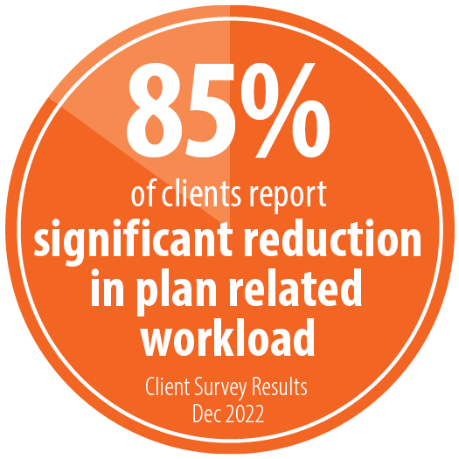
Client Survey Results
December 2022
"I encourage BPAS to keep doing what you've been doing. Continue delivering a superior service experience along with memorable, capable sales professionals as you have been."
"I implemented new payroll software at the end of 2021. I love the 360 integration between BPAS and (our new system). It saves me lots of time."
"Great company. Easy to work with."
"Great support, reasonable fees, and deep fund options."
"They're an excellent resource!"
"Professional and excellent service."
"New site is very informative and is a great tool for our employees."

Slide 9




Client Survey Results
BPAS Plan Consultants
9.20
rating
out of 10
December 2022
BPAS Plan Consultants
Average rating on a scale of 1 to 10
"Incredible customer service!"
Quality & Accuracy: 9.20
Knowledge: 9.24
Communication: 9.15
“Diligent, quick responder, and caring are all words we use to describe (our BPAS plan consultant).”
Responsiveness & Accountability: 8.90
Our consultants are distinguished by their depth of ERISA experience and dedication to excellence.
Your fully credentialed plan consultant will handle:
compliance testing
year-end contributions and forfeiture allocation
match true-up calculation
signature-ready Form 5500 and schedule preparation
census file assistance
plan change management
audit support

Slide 10

NAPA Advisors’ Choice Awards
When it comes to first-rate service, expertise, and accountability,
BPAS delivers!
NAPA Advisors placed BPAS in the Top 5 Recordkeepers covering 18 categories
across all markets, Micro (< $1 million in assets) to Mega (>$250 million in assets)
According to the NAPA announcement, “The Advisors’ Choice awards are a means for committed retirement plan advisors to acknowledge best-in-class recordkeepers in a dozen different categories in the target market(s) they service.”

Slide 11





New Contribution Workflow
Data first, money second means
BPAS can fulfill steps on your behalf
1
2
3
4
5
Plan sponsor or payroll provider imports census file into CensusPRO
BPAS receives file, performs edit checks, and sends email to Plan Sponsor
Plan Sponsor logs in to CensusPRO and reviews and/or approves ACH verification
If approved by 3:30 pm ET, BPAS initiates mutual fund purchases at that evening’s prices
Participant sees trades reflected on BPAS portal that evening; BPAS required funds from Sponsor account to settle prior day’s contributions

Slide 12
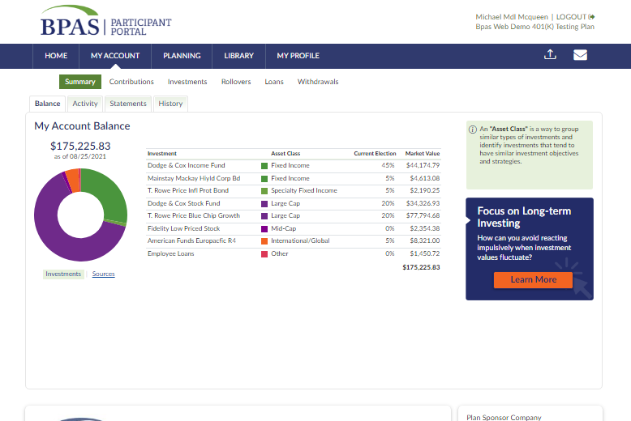
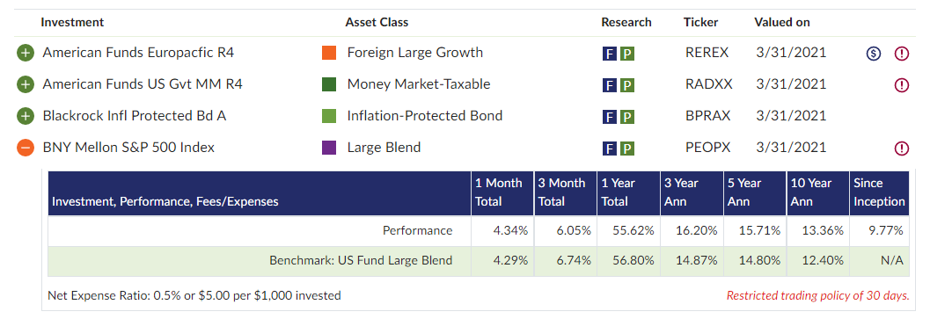
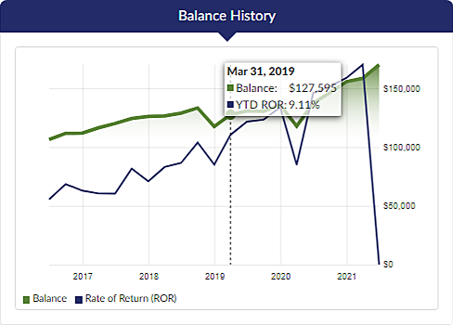
Participant Engagement
12

Slide 13
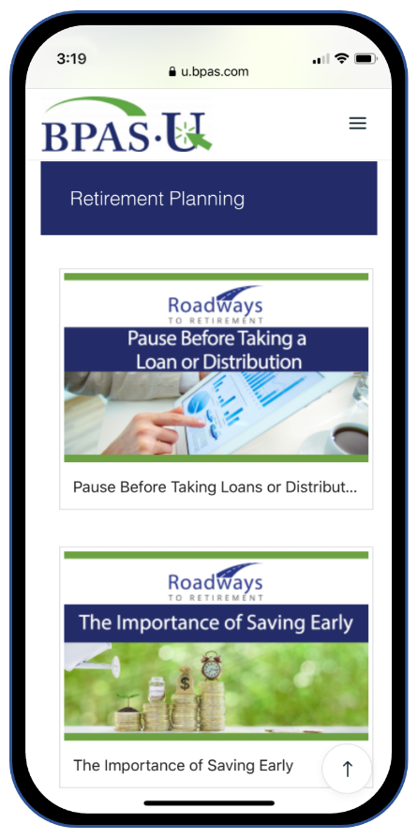
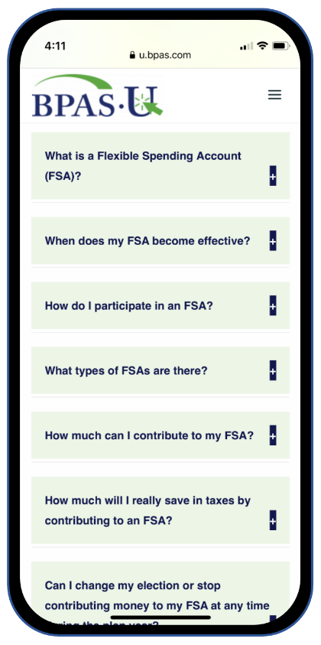

Participant Engagement
13

Slide 14

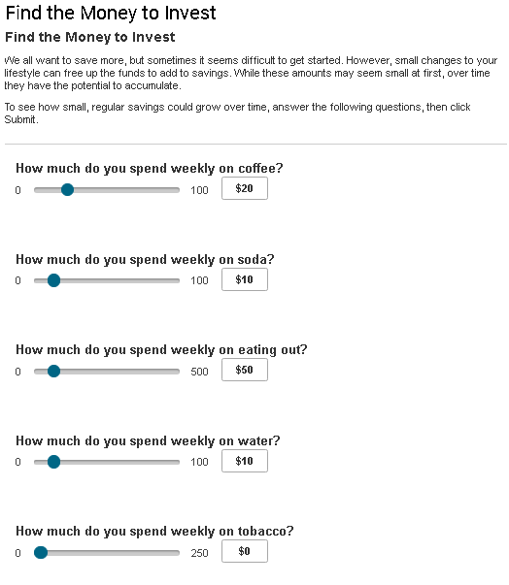

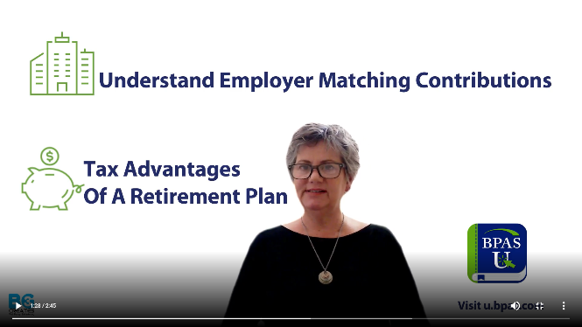
Participant Engagement
14

Slide 15
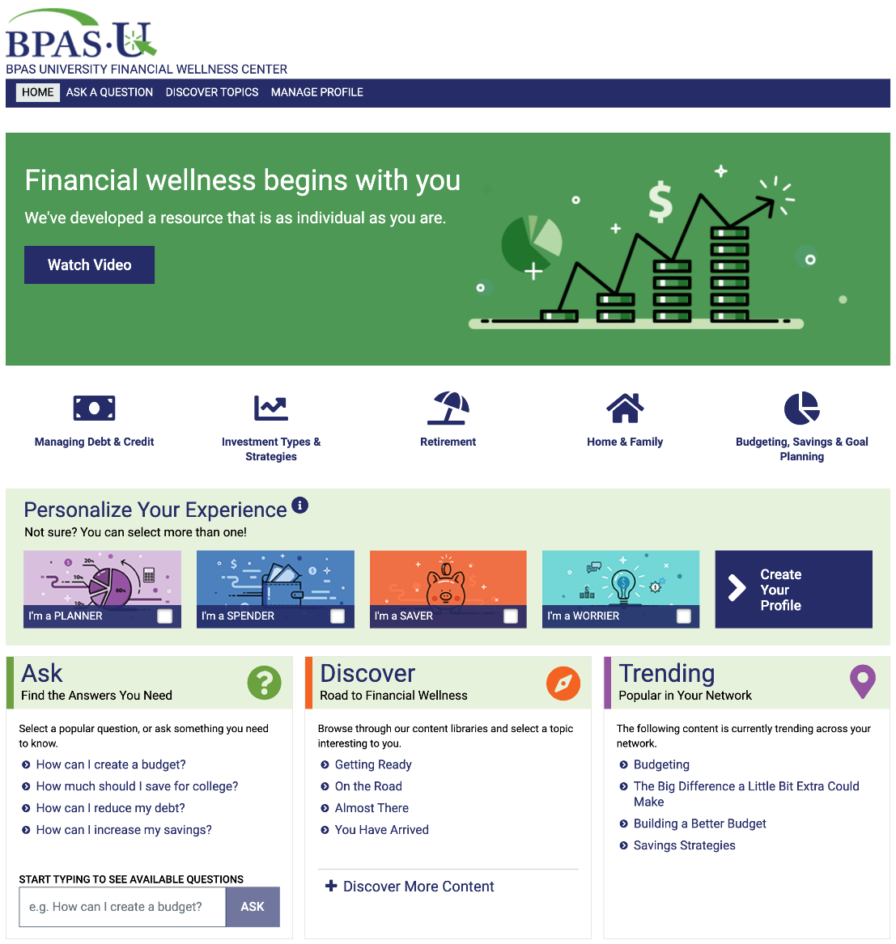

Participant Engagement
The Importance of Starting Early
15

Slide 16

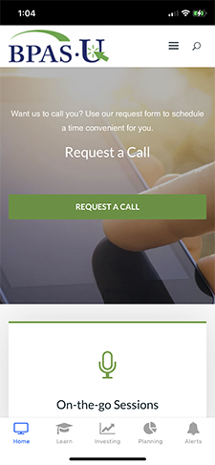
Participant Engagement
US-based and staffed by BPAS employees
Monday — Friday
8 a.m. to 8 p.m. EST
English and Spanish speaking representatives, plus translation services
Secure email options

Slide 17
True Investment Flexibility
350+ fund families traded
20,000+ total funds available
No proprietary funds or requirements
100% revenue neutral
Full range of share classes available
Revenue sharing is used to offset fees at the level of each fund
  far superior to ERISA recapture methodology
  fee fairness among participants

Slide 18





Proven, Easy Onboarding
managed by Conversion Team minimizing work for Plan Sponsor
2 months prior 1 month prior month 1
submit installation kit
complete fund selections
distribute new provider memo to employees
determine black out period
set enrollment meetings
collect enrollment data
begin processing employee contributions per investment elections
receive file from prior recordkeeper
complete fund map-over/re-registration of shares (typically 1 to 2 business days)
plan is live
welcome letters mailed to participants
This illustration depicts the typical sequence of events in a map-over process conversion. Actual circumstances of each plan conversion will drive the ultimate outcome, including the timeliness and accuracy of data received from prior recordkeeper.

Slide 19
Flexible Plan Costs
subhead statement here
Fees based on: $ x,xxx,xxx in assets, with xxx participants |  | $ 4,300,000
Base Fee |  | $x,xxx
Per Participant Fee | $xx/year X xx participants | $xxxx
Platform Fee | 0.xx% (xx basis points) | $xx,xxx
3(16) Fiduciary Services | $xx/year X xx participants | $x,xxx
 | Total | $xx,xxx
 | Total without 3(16) | $xx,xxx

Slide 20

Next Steps
subhead statement here
Bullet #1
Bullet #2
Bullet #3
Bullet #4
Bullet #5

Slide 21
Thank You!
866.401.5272 | TrustSales@bpas.com | bpas.com

Slide 22
Dedicated BPAS Team
always here to support you
Name
Designation
Title
Name
Designation
Title
Name
Designation
Title
Name
Designation
Title
Name
Designation
Title

Slide 23



Participant Education Tools
Service Center | BPAS University | Financial Wellness
state-of-the-art US-based staffed by BPAS employees Monday — Friday 8 a.m. to 8 p.m. EST | free proprietary online library diverse financial planning tools including: articles videos calculators links, and much more | Q&A forum to quickly find content Personalized recommendations Customized based on your: financial persona browsing history financial journey

Slide 24


Participant Loan Options
Traditional Loans
Sponsor handles through payroll deduction
Multiple loan deductions with differing pay dates
Additional payments at even multiples of amount
Potential for loan defaults
Terminated participant must repay outstanding balance within 90 days or default
MyPlanLoan
Sponsor gets out of loan business
BPAS assumes monitoring and payment processing
Participants may make additional payments at any time
Terminated participants continue to pay loans, not default (compassionate solution)
Ideal for employees with significant variable compensation

Slide 25

In Good Company
many BPAS clients are common household brand names

