Slide 1
Cash Balance
Defined Benefit Plans
January 1, 2026

Slide 2
BPAS Overview retirement plan service provider since 1973
10,375 retirement plans
980,000 participants
$132 Billion
trust assets
$1.3 Trillion
fund admin
Ownership | Subsidiary of Community Financial System, Inc. (NYSE: CBU) Forbes: one of America’s best banks Newsweek: one of America’s most trusted co.'s 3,000+ employees and $16B in assets
Services | Workplace Retirement Plans| Actuarial & Pension | Fund Administration | Fiduciary | Health Benefit Consulting | IRA | VEBA/115 Trust | Health & Welfare Plans | Institutional Trust
Subsidiaries | BPAS Trust Company of Puerto Rico Global Trust Company | Hand Benefits & Trust NRS Trust Product Administration

Slide 3
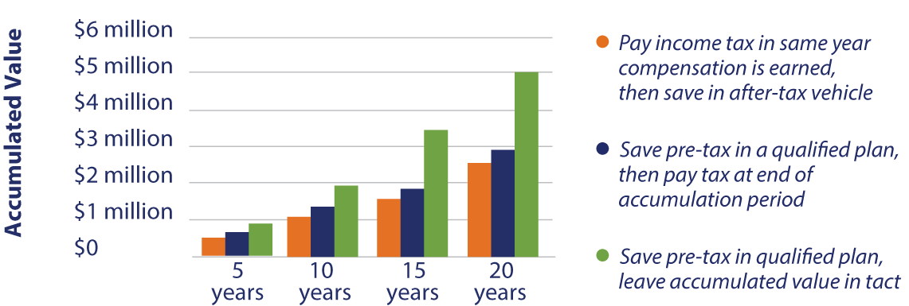
Why Save Pre-Tax?
Projected Value of Saving $150,000 of Compensation Annually (5% annual investment returns)
  Required/disciplined savings ensures that assets are set aside for retirement (i.e., not spent)
  Qualified retirement plans are protected from creditors

Slide 4
Save More than $70,000 a Year
How can you save more than $70,000 in a tax-deferred vehicle?
It’s Easy
A Cash Balance Plan

Slide 5

Retirement Program Components
New Comparability Allocation (typically the best design)
2025: $23,500
Catch Up Contribution
(for employees age 50 or over): an additional $7,500
4% Match or 3%
Non-Elective
Safe Harbor
Company
Discretionary Match
Profit Sharing Employer Contribution
401(k) Salary Deferrals
Requires Cross Testing with 401(k)
Employer Matching Contribution
Cash Balance Employer Contribution

Slide 6
Why Cash Balance Plans?
Cash Balance Plans are the most rapidly growing segment of retirement plans for 2 reasons:
01
Wealth Accumulation for Retirement
• Many small business owners have focused on building their business and not their retirement nest egg
• The $70,000/$77,500 contribution maximums in a 401(k) plan are not enough for those who started saving late
• Is selling business to fund retirement realistic?
02
Taxes
Larger tax deferrals
Potential for permanent tax savings (State specific)

Slide 7

Similarities & Differences
DC Plan Similarities
Pension-Specific Differences
Hypothetical account for each participant
Accounts grow annually based on contributions and interest credits
Vesting schedule
Account balance portable upon termination
Actuarial Calculations
Benefit based on defined benefit formula
Annuity benefit option
EE benefits not affected by investment return
Benefits may be guaranteed by (PBGC)

Slide 8
The Power of Cash Balance Plans
Maximum Service Credits for 2025
Age 62 NRA
Maximum
Maximum
Maximum
Age
CB Credit
Age
CB Credit
Age
CB Credit
30
$
73,000
42
$
133,000
54
$
241,000
31
$
77,000
43
$
139,000
55
$
253,000
32
$
81,000
44
$
146,000
56
$
266,000
33
$
85,000
45
$
154,000
57
$
280,000
34
$
89,000
46
$
162,000
58
$
294,000
35
$
94,000
47
$
170,000
59
$
309,000
36
$
98,000
48
$
179,000
60
$
325,000
37
$
103,000
49
$
188,000
61
$
341,000
38
$
109,000
50
$
197,000
62
$
359,000
39
$
114,000
51
$
207,000
63
$
352,000
40
$
120,000
52
$
218,000
64
$
344,000
41
$
126,000
53
$
229,000
65
$
336,000
Maximum Lump Sum
$
3,587,797

Slide 9




Higher Contributions
Cash Balance Plan contributions are higher because:
It’s a defined benefit (DB) pension plan
Statutory maximum is annual benefit at retirement ($280,000 payable no earlier than age 62
Present Value of maximum benefit – the maximum permitted accumulation – is more than $3.59M
Maximum allowable contributions are those necessary to fund this maximum age 62 accumulation over a period of not less than 10 years

Slide 10

Higher Contributions
Higher Tax Deferrals
A high wage earner in NYS with $200,000 in tax-deferred savings will lower taxes by:
$74,000 in Federal taxes deferred (top rate of 37%)
$13,700 in NYS taxes deferred (top rate of 6.85% - excludes “millionaire” tax)
$1,800 in Obamacare Medicare taxes saved (0.9%)

Slide 11

Potential
Medicare Tax Savings
Contributions made to a plan instead of paid as W-2 taxable compensation (e.g., owners in C-Corp “bonused out” at year-end)
Medicare taxes at the combined EE/ER 2.9% rate are saved, not deferred (not applicable to pass-through entities)
• $87,700 in tax deferrals
• $7,600 in permanent tax savings
Total tax reduction = $95,300 – almost half!
Retiring to a state without income tax turns state tax deferrals into permanent tax savings

Slide 12
What About the Existing Plan?
Cash Balance contributions are often in addition to maximum DC plan contributions
Complicated tax deduction rules apply to small professional service employers (<25) and Owner-Only plans
A 55-year-old could potentially get:
CB contribution of $253,000
plus the $70,000 DC maximum
plus $7,500 in 401(k) catch-up contribution
Total = $330,500 annually

Slide 13
Plan Design Summary

Slide 14

What’s the Catch?
Qualified retirement plan = complex IRS rules
  Coverage & non-discrimination
  Maximum benefits
  Minimum eligibility, participation, and vesting
DOL (ERISA)
  Reporting/Disclosure requirements
PBGC coverage & premiums, unless exempt (professional services < 25 plan participants and owner only)
2025 flat rate = $106/ participant (plus variable rate premium if plan is under funded)
Point: need expert/specialist to administer

Slide 15


Cash Balance Plan Candidates
Owners that are relatively older than employees
Owners with compensation at or near $350,000 after funding.
Business cash flow is sufficient to fund the program for at least 3-5 years
Owners max out the DC plan at $70,000
Owners are able to contribute 7.5% to 10% of pay for employees annually on a non-matching basis

Slide 16
Investing Holistically
The Spectrum of Vehicles
 | Totality of Vehicles | Cash Balance Plan | 401(k) Plan |  | IRA |  | Outside of Tax Qualified Plans
Accumulations |  | Cap on Lump Sum | No Maximum Lump Sum |  | No Maximum Lump Sum |  | No Maximum Accumulation
Investment Options |  | Pooled Investments | Individual Direction Limited by Plan Options |  | Individual Direction with Some Statutory Restrictions |  | Individual Direction
Taxability |  | Distributions Taxed as Ordinary Income |  |  |  |  | Potential for Favorable Capital Gains Tax Treatment
Common Investment Approach
Risk Seeking Assets | 40-80% | 20-50% |  | Depends on Appetite for Risk |  | Depends on Appetite for Risk | 60-100%
Fixed Income | 20-60% | 50-80% |  |  |  |  | 0-40%
Conservative Aggressive

Slide 17


BPAS Expertise
Service
Experience
Compliance
Given the complexities of a combined CB/401(k), it is advantageous to have the same provider service both plans
BPAS Delivers
BPAS Actuarial & Pension Services (APS): Provides expert Cash Balance services and coordinates interaction between plans
BPAS Plan Administration & Recordkeeping (PARK): Provides expert, flexible Defined Contribution services
One company. One call.

Slide 18






2023 Client Survey Results
99%
would choose BPAS again
BPAS Plan Consultants scored outstanding or higher in these categories:
Every aspect of service provided has been outstanding
Not only do they have expertise in their field, they are great listeners and very tolerant of all my dumb questions. We are lucky to have them on board.
Overall Value
Innovative Ideas
Responsiveness
Meets Objectives
Our People
Communication
99%
would recommend BPAS
I would highly recommend this group of people!
Very professional, very responsive, very knowledgeable and very patient. I enjoy working with them all.
98%
say BPAS exceeds their expectations
The BPAS staff far exceeded our expectations.
30 years in business, you are the “Best.”
We appreciate all that you do for us.

Slide 19

Let’s Connect
  ( 315-703-8916
  * jdisco@bpas.com
    Referring a Lead?
    Provide census information in Excel
    Provide information on corporate structure (e.g., C-Corp, S-Corp, Partnership, etc.), existing plan, if any, prospective client objectives, and any other relevant information
Jason Disco
Senior Vice President, Pension Sales & Consulting
BPAS Actuarial & Pension Services

Slide 20
Q&A
Open Discussion

