Slide 1




Retirement Savings Plan
Presentation - 2025
Presenter Name Here
Presenter Title Here
Notes:
Good morning and welcome to this morning’s session on (plan sponsor name’s) (Plan type: 401k) Retirement Plan. My name is (Presenter Name) and I am your presenter. As I move along the presentation, feel free to submit your questions in the chat. At the end I will be answering all your questions, but I will check the chat periodically as I move along.

Slide 2


GET INSPIRED
“Retirement is not the end of the road. It is the beginning of the open highway.”
Unknown
Notes:
Let's begin our presentation with this inspiring quote: 'Retirement is not the end of the road. It is the beginning of the open highway.' This perfectly captures the essence of retirement. It shouldn't be seen as a finish line, but rather as an exciting new chapter in your life, a chapter filled with travel, hobbies, and spending time with loved ones.
Just like any road trip, a smooth retirement requires preparation. The earlier you start planning, the more time your money has to grow and the more freedom you'll have in your golden years. Whether you’re just getting started in your career, approaching retirement, or are somewhere in between, our goal is that you’ll leave today with the tools and knowledge to get on the right track for a fulfilling retirement journey.

Slide 3



What is your WHY?
Notes:
Dreaming about how you envision your life in retirement can be exciting and is one way stay to motivated but making sure you have identified your retirement "Why" is a huge driving force in helping you get to your final destination. Think about your goals and why saving for the future is important to you. For example: You may be thinking about retiring from your job to start your own business, to travel, or pursue hobbies, maybe it's to spend time with family and friends, or volunteer, with your favorite charity.
Your lifestyle decisions will have a big impact on your need for income in retirement. By starting to envision how you’re going to live, you can start putting together a savings plan. And with the right planning, you can avoid a financial cliffhanger and paint a stunning picture of your future. Remember, you are the driver, and the wheel is in your hands. When you think about saving for retirement, keep your eye on the road ahead and focus in on your reasons why retirement is your desired destination.

Slide 4

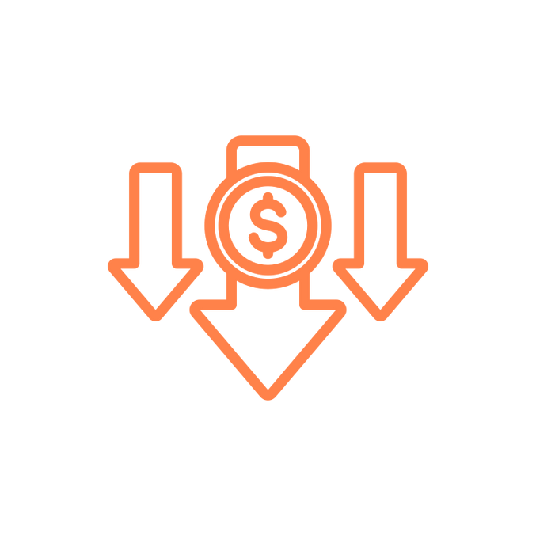


Purpose of a Retirement Account
30%
30%
100%
For illustrative purposes only. 40% replacement is a general rule of thumb. Actual Social Security Replacement will vary. Source: https://www.ssa.gov/policy/docs/ssb/v68n2/v68n2p1.html
40%
Notes:
So, what is the purpose of a retirement account? If we look at the numbers, you’ll see the estimations for what we need to retire. This year (2025) the Social Security website estimates that Social Security will replace about 40% of your paycheck when you retire. You also may have about a 30% reduction in what you need once you no longer need to put money into your retirement savings and have hopefully paid off most of your debt. This leaves about 30% gap that we need to make up if we want to completely stop working. This is the purpose of a retirement account.
Before we go any further, I want to address the fact that EVERY one of us is at a different stage in our life, has a slightly different experience, family background, income, etc. A retirement account might sound like a luxury, a no-brainer, both, or anything in-between. No matter what time in your life, and no matter what perspective you’re coming from, having a retirement account ultimately is about having financial security in your later years. Not everyone has that, but we want everyone to have that, and we want you to have the tools to achieve that. So, remember your retirement "why" because it really will make contributing to your retirement account feel easier -- allowing you to pave the way to the retirement you've always dreamed of!

Slide 5
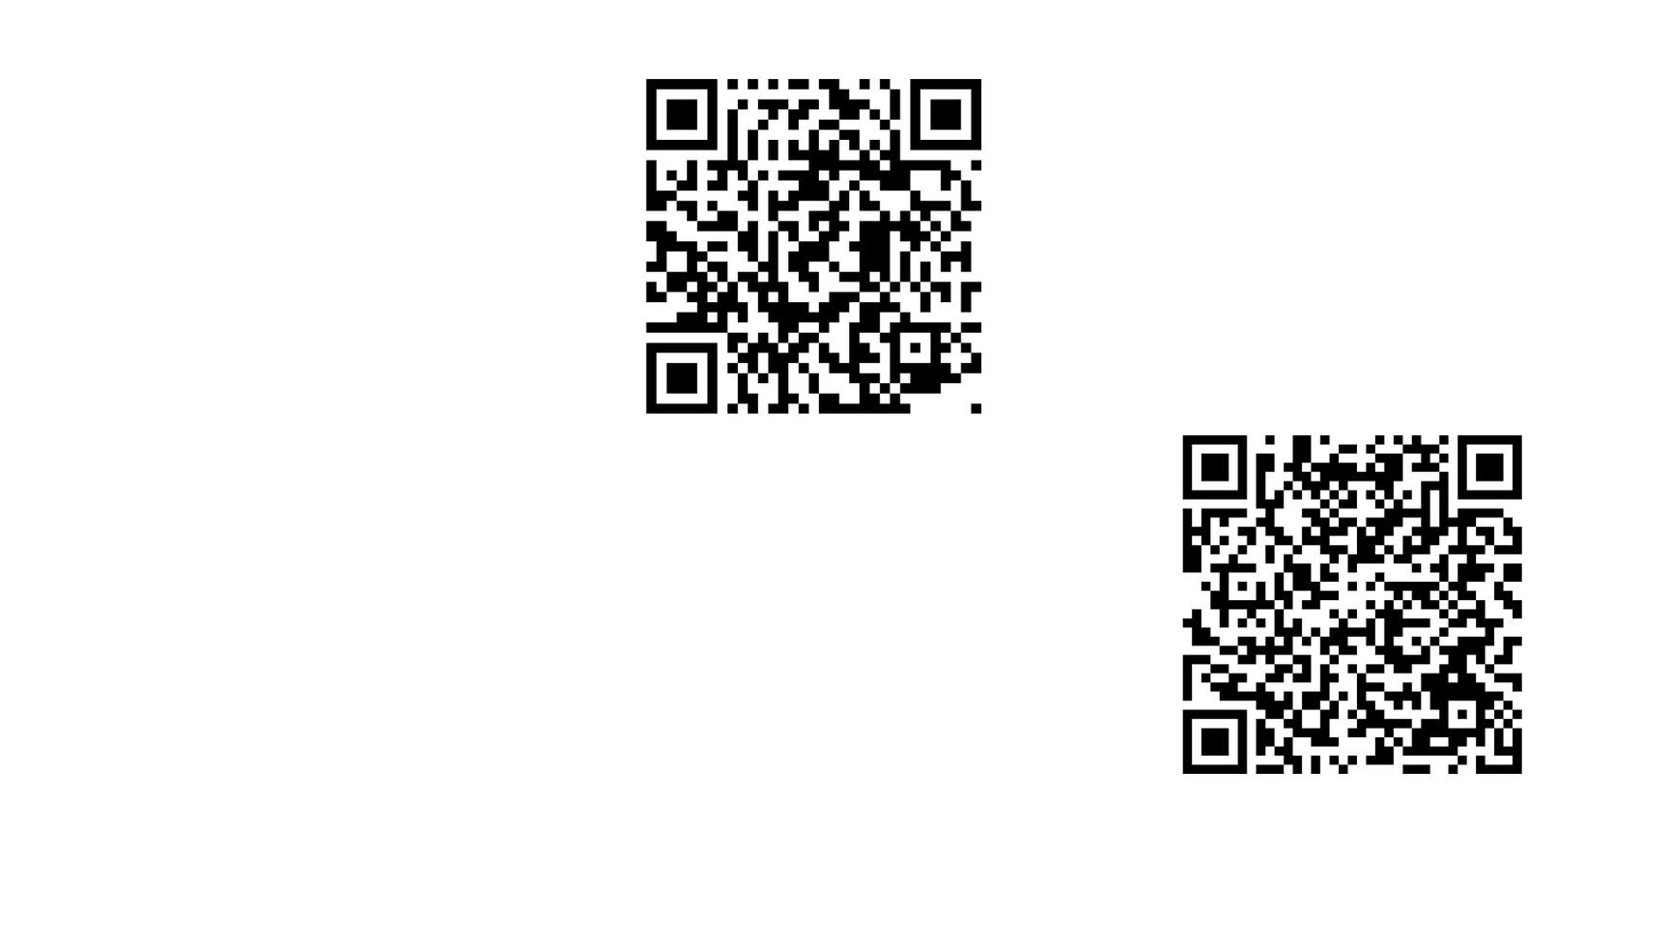


Your Retirement Plan
Money In
Invest
Future Income
Notes:
Let's now talk about your specific retirement plan. Your (Enter Plan Name) Retirement Plan account is a (plan type: 401(k), 403 (b) etc.) plan. With this plan you can put money away now and invest the money so that it grows throughout your working years. This allows you to supplement your income throughout retirement. Think of it like funding your future business, so when you retire, the business that you created will hire you as a retiree and pay you for you to enjoy life as you wish. Put in even more simple terms, you’re creating a paycheck for your future self.

Slide 6
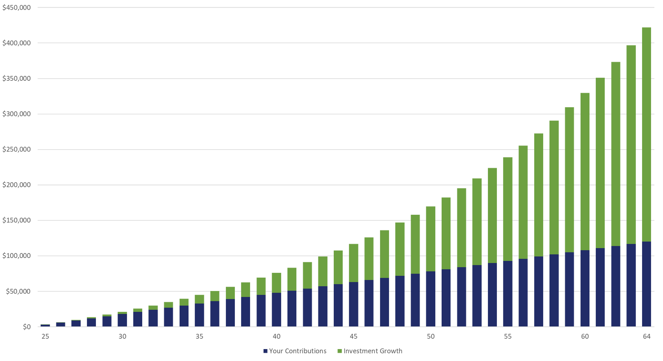
Compounding Growth
Hypothetical example for illustrative purposes only. Calculated using the 403(b)/457/401(k) Savings Calculator at u.bpas.com. Assumptions: annual $3,000 contribution earning 5.5% rate of return annually. Age brackets are approximate, not to exact scale.
Notes:
One of the great benefits of a (Plan type: 401(k), 403(b) etc) is the ability to invest your money and allow that to grow over time. Because of the effect of compounding growth, getting started early and being consistent can have great effects over the long term.
On this slide, we show how powerful the effect of compounding interest is. At first, the growth in the account seems very modest, maybe even non-existent. However, over time, as your investments grow and compound on one another, the effect becomes more impactful. You can see that at about age 49, half the value is investment growth (green). By age 65, the investment growth is almost 3 times what you have actually contributed (blue) over the years.
It’s never too late to start, so if you have not started savings for retirement yet, there is no time like the present!

Slide 7

Pre-Tax Contribution
Tax-Free Contribution
Taxable
Withdrawal
Tax-Deferred Growth
Taxes
Notes:
There are (REMOVE " Two different ways" if no ROTH) two different ways that you can contribute to your account, each with different tax advantages.
The first, is pre-tax contributions, which is sometimes referred to “traditional”. Pre-tax contributions allow you to defer your taxes until you start taking qualified withdraws. That means, whatever you contribute to your (plan type: 401(k), 403 (b) etc.) account, is tax free now, and taxable when you take those withdraws in retirement. This may be most beneficial if you have a higher tax rate now than what you expect it to be when you start taking withdraws.

Slide 8
Roth Contribution
Taxable Contribution
Tax FREE
Withdrawal
Tax-FREE Growth
Taxes
Roth contributions are not taxed at distribution; however, earnings may be subject to taxation if the account has not been in existence for at least
5 years and taken prior to attainment of age 59 ½ , death or disability.
Notes:
Optional: Remove if not applicable
The second way that you can contribute is called a Roth contribution. Roth contributions essentially work in the opposite way as pre-tax contributions. Roth contributions are taxable now, however, when you start taking qualified withdraws, your contributions and the growth within the account, will be tax free.
Roth contributions may be beneficial if your tax rate is lower now than what you expect it to be in the future.
Finally, in order for Roth withdraws to be tax free, you must have the account for 5 years, AND be 59 ½ . Or if the distribution is due to death or disability.
When you decide to contribute, you could do one or the other or both and you can split it however you like.

Slide 9


Contribution Effect On Paycheck
PRE-TAX
ROTH
Weekly Paycheck: $1000
Taxable Income: $1000
Taxes Withheld (18%): $180
Take home Pay: $820
Contribution: $60
Taxable Income: $940
Taxes Withheld: $169
FINAL PAYCHECK:
$771
Contribution: $60
Taxable Income: $1000
Taxes Withheld: $180
FINAL PAYCHECK:
$760
Larry
PRE-TAX
ROTH
Weekly Paycheck: $500
Taxable Income: $500
Taxes Withheld (18%): $90
Take home Pay: $410
Contribution: $50
Taxable Income: $450
Taxes Withheld: $81
FINAL PAYCHECK:
$369
Contribution: $50
Taxable Income: $500
Taxes Withheld: $90
FINAL PAYCHECK:
$360
Jenny
Notes:
Optional: Remove if no ROTH
If you were to start contributing today, this is what it would look like.
Using our friends Larry and Jenny as examples:
Larry's weekly paycheck is $1,000 less taxes his take home pay is $820. If Larry were to contribute $60/week pretax his take home pay will be $771 after income taxes. notice his taxable income is reduced by $60. If he contributed the same amount to his ROTH 401k, his taxable income remains $1000, the same as someone making no contribution. The difference is that all ROTH contributions and any earnings would now be eligible for withdrawal tax free when taking qualified withdrawals after age 59 and 1/2 and after holding the account for at least 5 years. In all, both contribution types offer tax benefits, but you enjoy those benefits at different times.

Slide 10


Identifying Your Savings Goals
When Do You Plan to Retire?
The age you plan to retire can have a large impact on the amount you need to save. The longer you postpone retirement, the longer your savings can grow.
Retirement Lifestyle
How do you want to live in retirement? Do you expect your expenses to go up, down or stay the same?
Medical Expenses
Utilize an HSA to forecast and save for your medical expenses
How Long Do I Want My Retirement Savings to Last?
Many are outliving their savings--the simplest way to estimate how long your money will last in retirement is to weigh your total savings, plus investment returns over time, against your annual expenses.
Be Patient
Saving for retirement involves a great deal of planning, patience and determination.
Notes:
Determining the right amount to save for retirement can be overwhelming.
Estimating how much to save involves two main challenges. First, predicting your future expenses and income needs for a retirement that may be years or even decades away can be tricky. Secondly, even after setting a target, it can be challenging to determine if you are saving enough to reach that target.
Consider the following when setting your retirement goal:
When do you plan to retire?
What lifestyle do you hope to have in retirement?
Forecast any medical expenses
How long do you hope your retirement savings lasts you?
and last but not least, remember to be patient. Saving for retirement involves a great deal of patience, planning and determination.

Slide 11










How Much Should I Contribute?
50% - Needs
30% - Wants
20% - Savings
Of the 20% total savings, retirement experts recommend 10-15% towards retirement.
Notes:
A common question we receive is – how much should I actually be contributing? One commonly-used budgeting rule is called the 50/30/20 rule. This rule tries to break your spending up into three categories: Needs, Wants, and Savings. Try and keep spending for needs such as housing, food, transportation to around 50% of your income. For wants, such as vacation, entertainment, dining out, try to keep this amount at about 30% of you income. This will leave you with 20% of your income for savings. Most experts will recommend savings 10-15% of your income towards retirement savings. If you can do that, and save the other 5-10% to pay debt or create an emergency fund, this should leave you help you get on track for your retirement needs.

Slide 12


Start Saving Early
Make the most of compounding growth and allow your money to generate returns for you!
Starting to save early means less concern about catching up in the future.
Tips & Tricks:
  Once you become eligible, enroll in your plan promptly.
  Making a small contribution is preferable to making no contribution at all.
  If you are not eligible yet, begin setting aside the intended deferral amount now.
Notes:
Make the most of compound interest by starting to save now. Experts recommend saving 70 to 80% of your income for retirement. Time is your friend; time allows your money to grow and reduces the stress of reaching your savings target. Even if you think it's too late, remember the proverb: "The best time to plant a tree was 10 years ago, and the second-best time is today." Making small and affordable contributions now is better than making no contribution at all.

Slide 13

Plan
Highlights
11
Notes:
Next we will discuss your specific plan details

Slide 14


Plan Highlights
Eligibility
Plan Entry
Enrollment
Employee Contributions:
  add provisions here
Employee Contributions:
  add provisions here
Online at u.bpas.com
Automatic Enrollment:
  After 1 year of service & 1,000 hours worked within a 12 month period
Plan code for enrollment is found on your welcome letter.
Notes:
As a (plan sponsor name) employee, you are eligible to participate in the retirement plan (insert eligibility). To Enroll, all you need to do is log into your BPAS retirement account online, select your contribution amount and investments and watch your nest egg grow!
When enrolling, you will need the enrollment code found in the Welcome Letter you should have received mailed to your home address upon eligibility.
Optional: If after a year you are not participating in the plan you will be automatically enrolled.

Slide 15
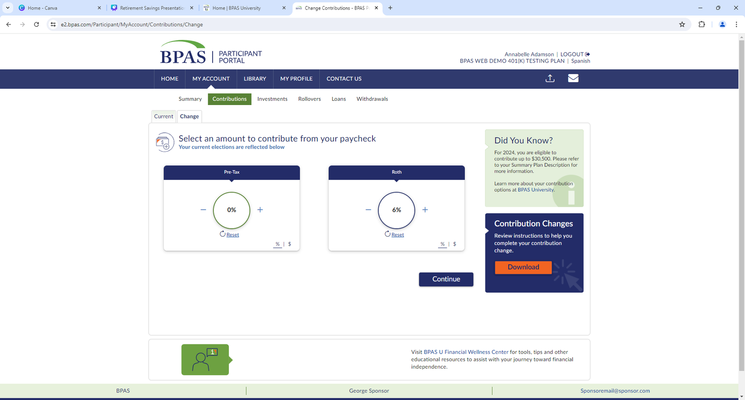
Automatic Enrollment &
Re-Enrollment
Automatically enrolled at __% of pay in the _______, based on your date of birth
    After 1 year of service, you will be auto enrolled on the first day of the next calendar quarter: 1/1, 4/1, 7/1 or 10/1
  You will receive a letter in the mail before automatic enrollment
  An automatic increase of ___% will occur each year on anniversary until it reaches ___%
  Re-enrollment: Employees not enrolled or contributing less than __% will be re-enrolled
Make changes online
    Log in to your account at u.bpas.com
    Choose Payroll Contributions on the Home Page or under My Account and select Contributions
Notes:
Optional: Remove if plan does NOT feature Auto Enrollment
Your plan features automatic enrollment.
If you are automatically enrolled in the plan….
Talk about each of the points on the screen.

Slide 16
Workplace Retirement Plan Contributions
You
    Contribute up to the 2025 IRS Limit – $23,500
    Age 50+ Catch-Up Contributions – An Additional $7,500
    Age 60 - 63 Catch-Up Contributions – An Additional $ 11,250
    Pre-Tax and/or Roth contributions automatically deducted from your paycheck
    100% immediately vested
    You may change your contribution amount anytime!
Employer
    (Company Name) matches your contributions: _______________
    Non-elective contribution: ________________________________
    Employer contributions are made on a pre-tax basis
    Employer contributions will be 100% vested after __ years of service.
Notes:
Let’s look at the different ways money comes into the plan….
Your contributions, your employer's matching contributions or contributions rolled over from another retirement savings account.
Update slide with Plan Info & Talk about each of the points

Slide 17




Scan to Download Rollover Form
Qualified Rollovers
Easy: Holistic view of your retirement readiness.
Easy
Convenient: One website. One statement.
Convenient
Flexibility
Flexibility: Easy access to money from a single account at retirement.
Peace of Mind
Peace of mind: Reduce the risk of loosing sight of retirement accounts.
Contact an Incoming Rollover Specialist at 866-401-5272 Ext. 35007
Notes:
Consolidating your accounts into one place simplifies tracking your overall retirement progress. You can see your total retirement savings at a glance and get a clearer picture of your readiness for retirement. It also gives you the opportunity to manage everything in a single location. No more logging into multiple accounts or sifting through different statements. That also makes it potentially easier to access your funds when you retire ultimately streamlining the process of withdrawing or managing your retirement income. And finally, it can potentially reduce the chance of losing track of retirement accounts you may have left with previous employers.

Slide 18

Employer Discretionary Match
(Company Name) Matches 100% of the first 3% you contribute
Then 50% of the next 2% you contribute
By contributing 5%, you receive the (Company Name) full match of 4%
Notes:
REMOVE if no match
Let's talk a little more about that Employer match.
Your (Company Name) plan provides for discretionary employer matching contributions on elective deferrals made into your 401(k) plan. (Company Name) will match ___% of the first ___% you contribute. The discretionary matching contribution will be made on both pre-tax and ROTH after-tax contributions. However, contributing both pre-tax and after-tax ROTH deferrals does not increase the match amount a participant can receive.

Slide 19
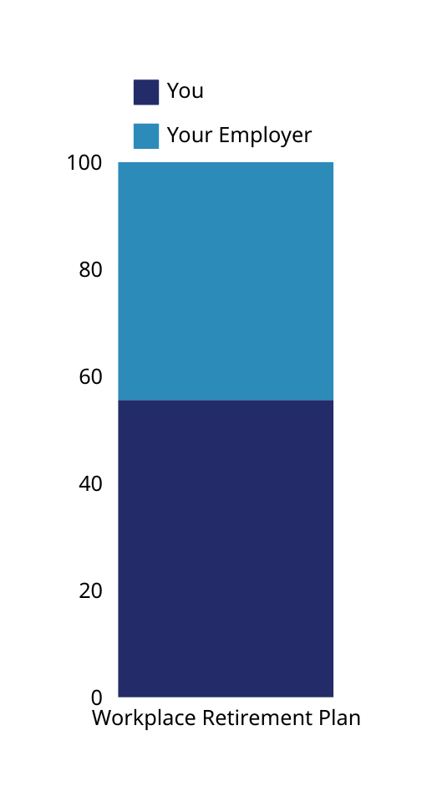
Value of an Employer Match
Salary​ | 5% Pre Tax Deferral​ | 3% Matching Contribution​ | ​Total of Pre Tax Deferral and Matching Contribution​​
$20,000​ | $38​ | $23 | $61
$30,000​ | $57 | $34 | $91
$40,000​ | $76 | $46 | $122
$50,000​ | $96​ | $57 | $153
$60,000​ | $115​ | $69 | $184
$70,000​ | $134​ | $80 | $214
Calculations are based upon a biweekly pay cycle with 26 pay periods per year.
Notes:
Optional: Be sure to customize slide to reflect accurate match percentages.
The chart below shows a better idea of how much the deduction is in each paycheck depending on your annual salary. For example, an employee with a salary of $30,000 per year contributes 5%, taking full advantage of the company's 3% match. This employee has a total pre-tax deferral of $57 per paycheck, an employer matching contribution of $34 for a total biweekly contribution of $91. Start thinking of a dollar amount or percentage you would be comfortable with. Every little bit counts and remember that something is better than nothing!

Slide 20
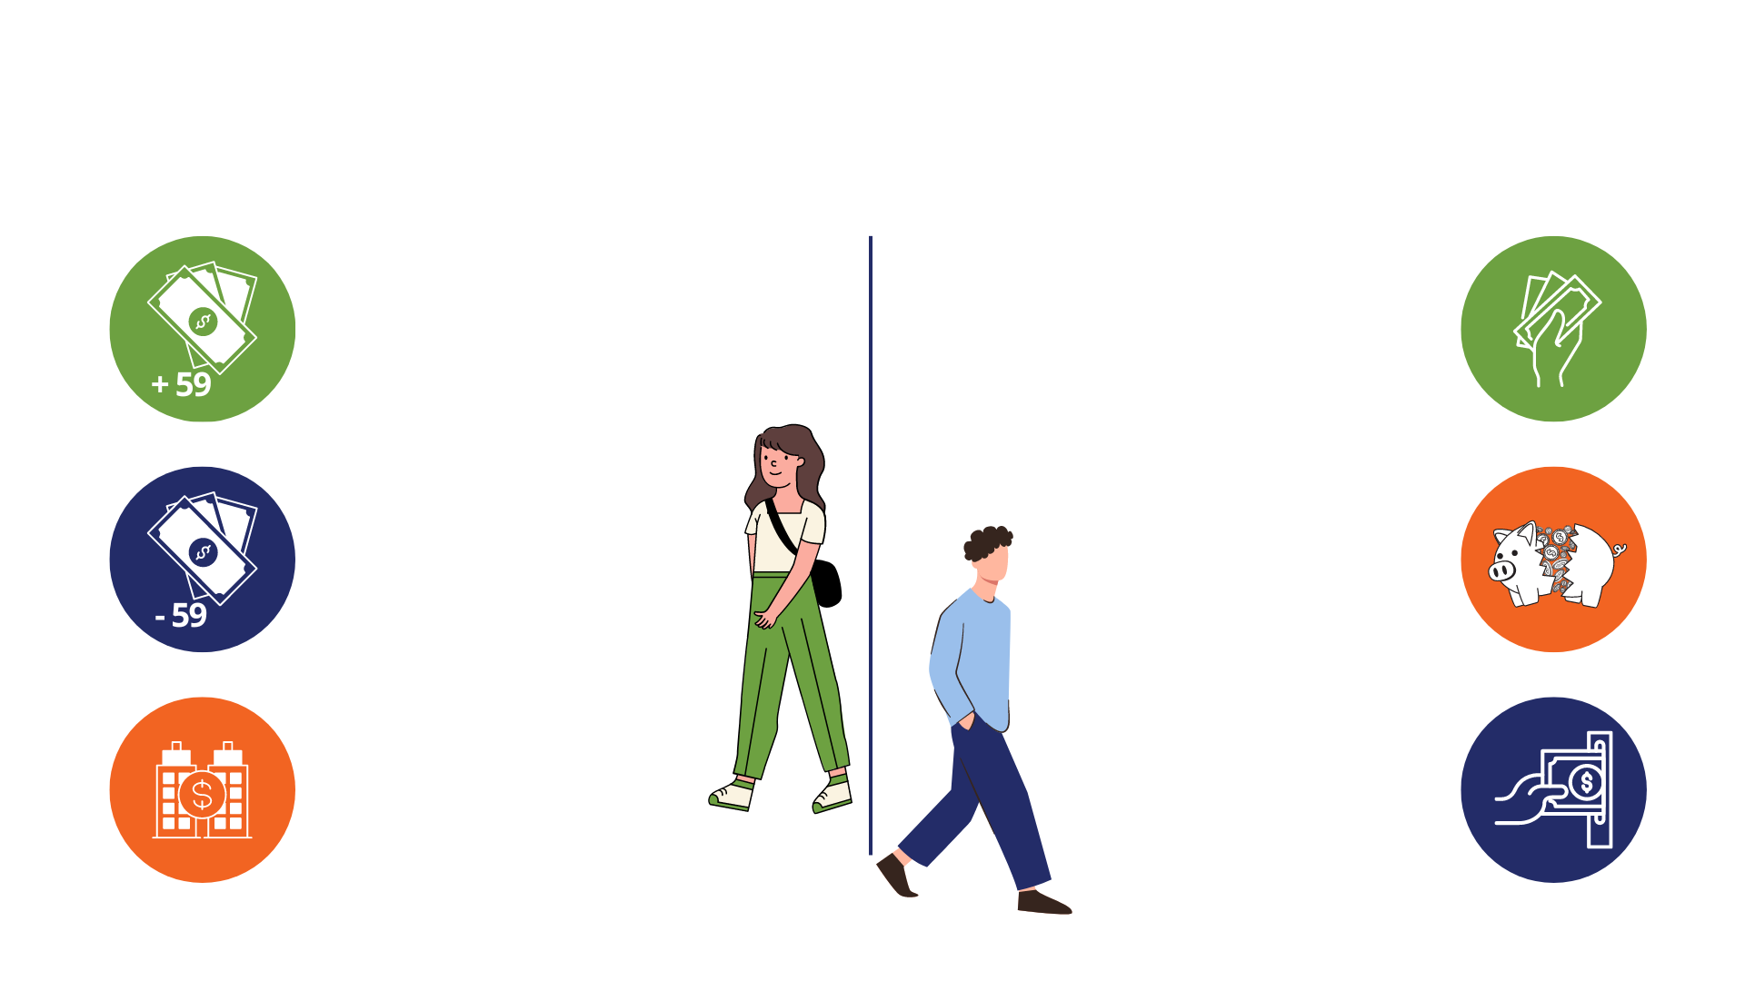
Taking Money Out of a 401(k)
WHEN YOU LEAVE YOUR JOB
WHEN YOU ARE STILL IN YOUR JOB
Regular 401(k) Withdrawal
Withdrawals are taxed, but there is no penalty after 59
401(k) Plan loan
Borrow funds with interest. The minimum loan amount is $1,000 with one loan outstanding at a time.
Hardship withdrawal
Allowed, subject to restrictions, check eligibility and paperwork requirements online or call BPAS Participant Services.
Early 401(k) withdrawal
Taxes apply plus subject to a
10% tax penalty
401(k) Rollover
Transfer to IRA or other employer retirement plan. No taxes. No Penalties.
In-Service Withdrawal
Allowed, while still employed
if over 55
Notes:
Because a Workplace Retirement Plan is meant to help you save for retirement, there are certain restrictions for taking money out of the plan, including an additional tax penalty if you are under the age of 59 ½ when taking the distribution.
That being said, you have the option to take distributions under certain circumstances listed here

Slide 21

Plan Loan
  You can request up to 50% of your account balance, ranging from $1,000 to $50,000
  Repay the loan with interest over a period of time, usually within 0-5 years
  Maximum Number of Outstanding Loans: 1
Loans and distributions might incur fees, taxes, and penalties.
30 Day Rule: After fully repaying a loan, you must wait 30 days before applying for a new one.
Before making a withdrawal, carefully review all documentation and seek advice from your financial advisor.
Notes:
OPTIONAL: Remove if plan doesn't allow loans
One nice feature within your plan is the ability to borrow money from yourself through a 401(k) plan loan.
If necessary, you may request up to 50% or $50,000 of your account balance and repay the loan with interest.
However, it is important to remember that withdrawing funds from your account means you're missing out on potential growth. It could also hinder your ability to make contributions while repaying the loan. It's advisable to consult with a financial expert before deciding to take a loan from your account.

Slide 22

Investments
Notes:
Next we will discuss investments.

Slide 23

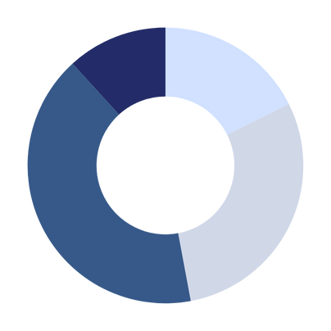

Investment Strategies
You pick a mix of funds consisting of cash, bonds, and stocks based on your objectives, risk tolerance, time horizon.
Asset Allocation
The ‘DIY’ Approach
You pick one fund and that is already diversified based on your target retirement date or risk tolerance.
Target Date/Risk
Fund
The ‘Hire Someone’ Approach
Notes:
There are two investment strategies: Asset Allocation or the “do it yourself” approach and the Target Date/Risk Fun or the “hire someone” approach.
If you are someone who is familiar with and have a solid understanding of terms such as time horizon, stocks, bonds & risk tolerance then asset allocation may be the way to go. Asset allocation is the idea of determining the best asset class mix based on your needs and objectives.
Alternatively, if you're like me and are not a DIY’er the Target Date/Risk fund may be a better solution. Target date funds are a blended fund that automatically adjusts for you, as you get closer to retirement. In your early working years when you are far from retirement, a target date fund will be heavily invested in equities such as stocks, to allow your account to maximize it’s growth. As you move closer to retirement, the fund will automatically invest in more fixed income options such as bonds and money market funds. This is meant to reduce risk over time to secure the gains in your account, as you near retirement.

Slide 24






Time Horizon
Early Career
30,000 Ft.
Mid Career
20,000 Ft.
Late Career
10,000 Ft.
Retirement
Final Destination
For Illustrative purposes only. This suggested risk-based allocation process is not intended to represent investment advice that is appropriate for all investors. Each investor's allocation must be based on their personal goals, time frame, financial resources, risk tolerance and other pertinent factors. Because everyone's situation is different, you should consult a financial advisor to assist with the optimal allocation appropriate for you.
Notes:
Determining your comfort level of Risk can be depicted here. Early in your career or flying comfortably at 30,000 feet your tolerance for turbulence or risk is higher and not as scary. However, the closer you get to landing or retirement the less tolerant of turbulence or risk you become.

Slide 25
Basic Types of Investments
Money Market/ Stable Value | Bonds | Stocks
Typically invest in a variety of interest-bearing investments Generally provide a lower return with very little to no stock market risk | Loans from an investor to an institution (corporation or government) for a pre-determined rate-of-return Attributes may include: duration, interest payment, financial strength of the entity | Represents ownership in a company Most susceptible to short-term fluctuations in value. Often classified by the size and style of the company
“Fixed Income”
“Equity”
Lower
Potential Risk/Potential Return
Higher
For Illustrative purposes. General observations only.
Volatility for any given time period can vary from the above.
Notes:
There are three basic types of investments: Money market funds, bonds, and stocks.
Bonds are debt securities that entitle the holder to receive interest payments. They're essentially IOUs from companies or governments. You loan them money, and in return, they pay you a steady stream of interest. You also get your original investment back at that point. This predictable income can be a valuable part of your retirement plan, helping you cover your essential expenses.
Stocks (Higher risk/higher return)
A stock is essentially a piece of ownership in a company. When you buy a stock, you're buying a share (like a tiny slice) of that company. Imagine a company cuts up its ownership into millions of pieces of paper, and you buy a few of those pieces. That's kind of how stocks work. This technically means that over the long run, you'll make money from stocks if the business continues to grow and make money. You can also make money off stocks when share prices increase or when the board of directors declares a dividend payment. Same as if the business is not doing so well, then the value of the stock price drops. This is what makes stocks a riskier investment.
Lower risk, lower return – the more money market and stable value.

Slide 26






Asset Allocation
Take the risk tolerance quiz at u.bpas.com
Asset allocation is the strategy of creating a balanced portfolio of
fixed income investments (bonds, cash, stable value) and equity investments (domestic stock, foreign stock) based on time horizon, objectives, risk tolerance and more.
There is no one-size fits all, your asset allocation is specific to your needs, goals, and preferences.
Your asset allocation should change over time as your goals or needs change.
Fixed Income
Equity
Your Portfolio
Notes:
Here’s a little more detailed view of what asset allocation looks like. And it’s the process of dividing an investment portfolio among different asset categories, such as stocks, bonds, real estate, and commodities, in order to achieve a desired risk and return profile. Asset allocation can be a key factor in achieving investment goals, as it helps investors balance risk and reward, and can potentially enhance long-term investment returns. It should be based on an investor's individual risk tolerance, investment goals, and time horizon.
If you want help with determining personal results to what your asset allocation should be, go to u.bpas.com and take the risk tolerance quiz. You may also scan the QR Code shown on the screen

Slide 27



Your Investment Menu
Money Market/Cash Reserves
Bonds
Blended
Equity
International
Sector/
Specialty
The BPAS portal has a wealth of information about the investments available in your plan.
To learn more, log into your account and then navigate to the Research Tab under Investments.
You’ll be able to complete the following research:
  Fund Links: Next to each investment name, you may view the prospectus by clicking the P icon or a fund fact sheet by clicking the
F icon. It’s important to carefully review the investment information prior to selecting your investment options.
  Fund Performance: Expanding each investment option will allow you to view Historical Prices, Benchmark Data, and
the Net Expense Ratio.
Notes:
UPDATE SLIDE with Plan specific investments.
Now let’s go over your plan’s investment menu. Listed here are the different investments that you have available to you in your (Plan Type) plan. Also shown are the different categories under which these investments fall. Just like the former slide, the options on the left contain the lowest risk and each option to the right includes more risk, with the opportunity of higher returns.
Being too heavily weighted in any one fund may cause your portfolio to lack diversity and either be too aggressive or too conservative. Using asset allocation and investing in a variety of funds will help increase your account diversity and protect you in the event that any one fund underperforms.
The blended options, aim to automatically balance your portfolio using stocks to maximize growth and bonds to minimize risk.

Slide 28
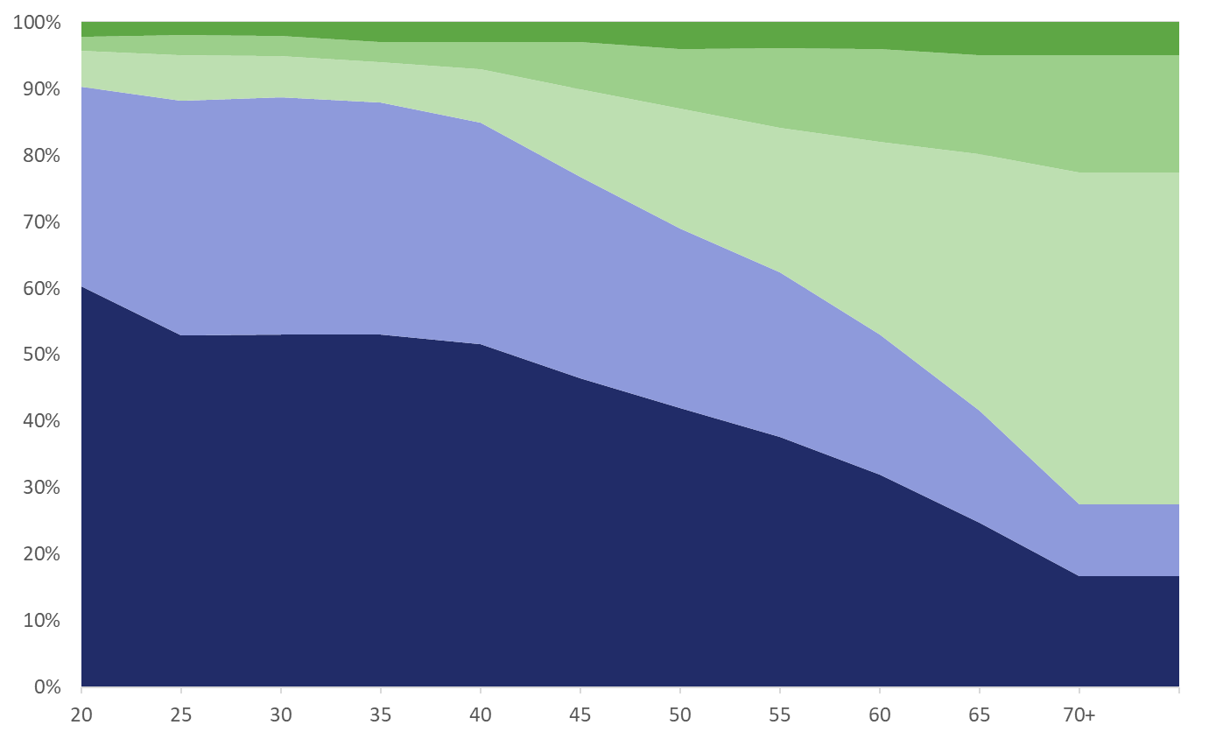

Target Date Funds
Expected Retirement
Cash
Foreign Bonds
U.S. Bonds
Foreign Stocks
Allocation Percentage
U.S. Stocks
Age
For Illustrative purposes. Not specific to any Target Date Series.​ Types of funds held, expected retirement age, and Equity and Fixed Income percentages will vary by fund.
Notes:
A couple of slides ago, I mentioned that blended funds invest in multiple different categories in order to maximize return while minimizing risk. In your (Plan Type), you have Target Date funds as an available investment option. These target date funds are a blended fund that automatically adjusts for you, as you get closer to retirement.
In your early working years when you are far from retirement, a target date fund will be heavily invested in equities such as stocks, to allow your account to maximize its growth. As you move closer to retirement, the fund will automatically invest in more fixed income options such as bonds and money market funds.
This is meant to reduce risk over time to secure the gains in your account, as you near retirement. Each company’s target date funds are different, but the above chart gives an idea of this investment strategy.

Slide 29
Target Date Fund Menu
If You Were Born In | Target Date Investment to Consider | Estimated Number of Years to Retirement
2003-2007 | Target Retirement 2070 | 45 Years
1998-2002 | Target Retirement 2065 | 40 Years
1993-1997 | Target Retirement 2060 | 35 Years
1988-1992 | Target Retirement 2055 | 30 Years
1983-1987 | Target Retirement 2050 | 25 Years
1978-1982 | Target Retirement 2045 | 20 Years
1973-1977 | Target Retirement 2040 | 15 Years
1968-1972 | Target Retirement 2035 | 10 Years
1963-1967 | Target Retirement 2030 | 5 Years
1958-1962 | Target Retirement 2025 | Approaching retirement
1953-1957 | Target Retirement 2020 | In retirement
Before 1953 | Target Retirement Income Fund | In retirement
Age based target date funds based
on normal retirement age
Notes:
Here is a chart showing the different Target Date Funds, listed by year, with an estimate of retirement date or date of birth. For example, you can see that if you were born between 1978 and 1982, the default target date fund would be the 2045 fund. You only have to invest in one fund and do not have to make changes, unless your objectives change. The fund will automatically adjust for you over time.
You also do not have to choose the fund that relates to your date of birth. If you would like to be more aggressive or expect to retire later than age 65, you can choose a later target date fund. Conversely, an earlier target date fund could be selected if you would like to be more conservative with your investments

Slide 30





Diversification
Diversification is like a balanced diet.
Spread your investments across different assets to
promote growth and minimize risks.
Diversifying your portfolio is essential for maintaining financial stability.
It acts as a shield against total financial collapse, ensuring long-term wealth.
Regular review of your account is important!​​
Notes:
Diversification is the strategy of distributing your money across various investments to foster growth while reducing risk.​ Think of it as a balanced diet. While eating broccoli is a healthy choice, you wouldn't want to eat just broccoli. To have a healthy balanced meal you need broccoli, water, maybe some fruit and a grain. Instead of investing heavily in a single asset and facing potential financial loss, diversifying your portfolio safeguards your financial stability. By diversifying, you shield yourself from complete financial downfall. Diversification is crucial for establishing lasting wealth.
Regular review of your account is important!​​
Monitor the balance, contributions, projected balances, and investment allocations. Often adjustments may be needed
due to changes in investment strategy or performance.

Slide 31


Focus on Long-Term Goals
$3,500
$2,500
$3,000
$1,500
$700
$500
$1,000
Notes:
Remember, investing for retirement is a long-term strategy. Maintaining a focus on your goals will aid in the long run. It's crucial to maintain a balanced view and consider both short-term fluctuations and long-term trends when evaluating your investments. Emotional reactions to market volatility can often lead to impulsive decisions that might undermine your overall financial goals.
To further illustrate, let's take the example of two investors. The individual in Blue steadily contributes a fixed amount to their retirement fund every month, regardless of market conditions. Over time, this disciplined approach, known as dollar-cost averaging, reduces the impact of market volatility and helps in accumulating wealth consistently. Meanwhile, the individual in green attempts to time the market, buying and selling based on short-term predictions. This strategy, while potentially lucrative, often results in missed opportunities and increased stress.
Ultimately, a well-thought-out and diversified portfolio, paired with a calm and patient mindset, is often the most effective way to secure a prosperous retirement. Regularly reviewing and adjusting your investment strategy to align with your evolving goals and risk tolerance is also key.

Slide 32


Your Online Account
Notes:
Ready to start saving for YOUR future!? Getting started with setting up your account is easy!

Slide 33






Creating Your
Online Account
Even if you’re not contributing today, you should still follow these steps to safeguard your identity.
Have Your Welcome Letter Handy
Setup Your Account at u.bpas.com
Select Your
Contribution
Amount
Choose
Your Investments
Designate Your Beneficiary
Plan code for enrollment can be found on your welcome letter.
Notes:
Visit u.bpas.com and have your plan code and welcome letter handy! Your plan code can be found on your Welcome Letter. Once logged in you will need to select your contribution amount, choose your investments and designate your beneficiaries.

Slide 34
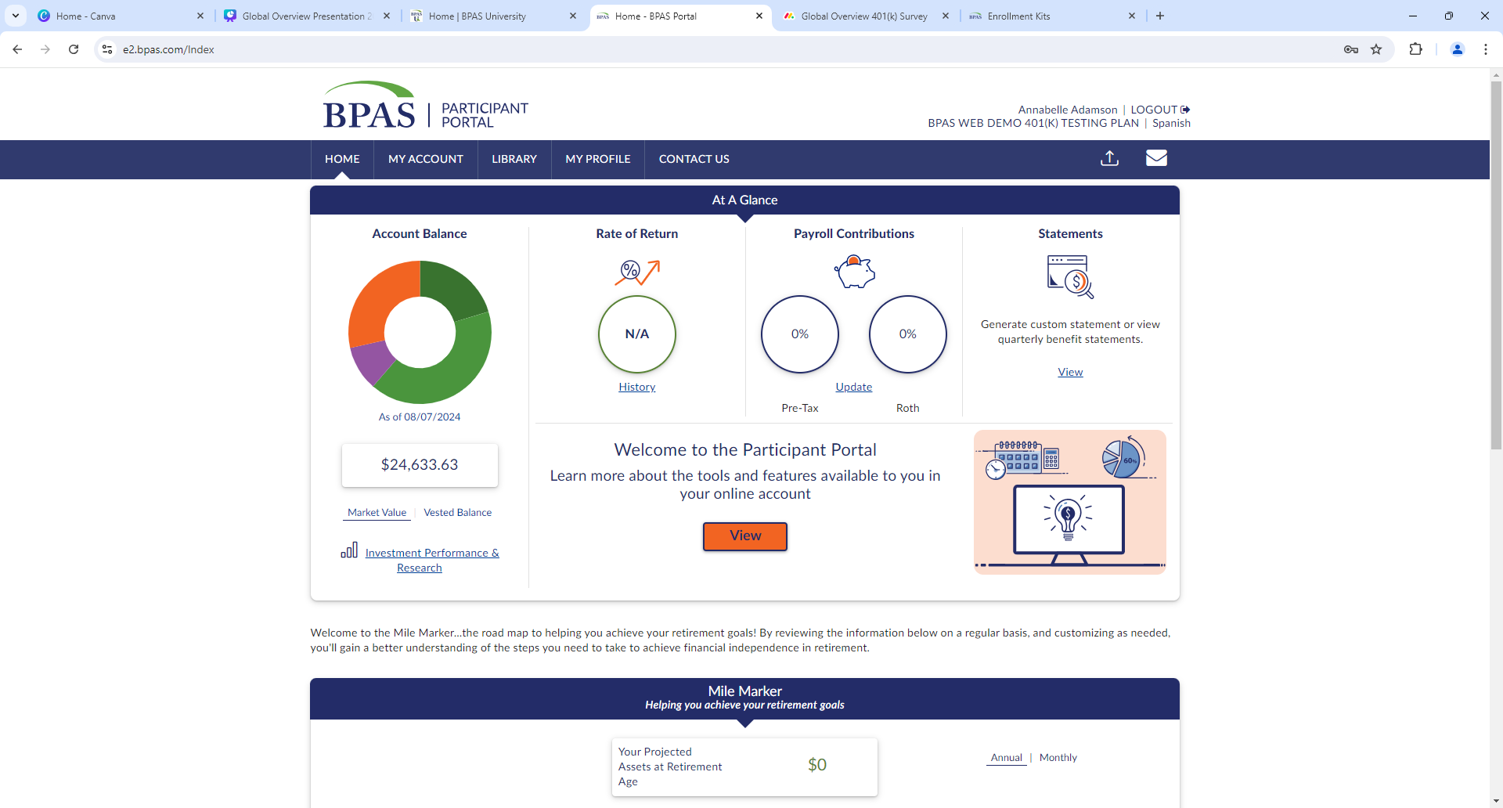
Notes:
When you log into your account, you will see the participant portal's home screen, which includes various tools and options to manage your account.

Slide 35

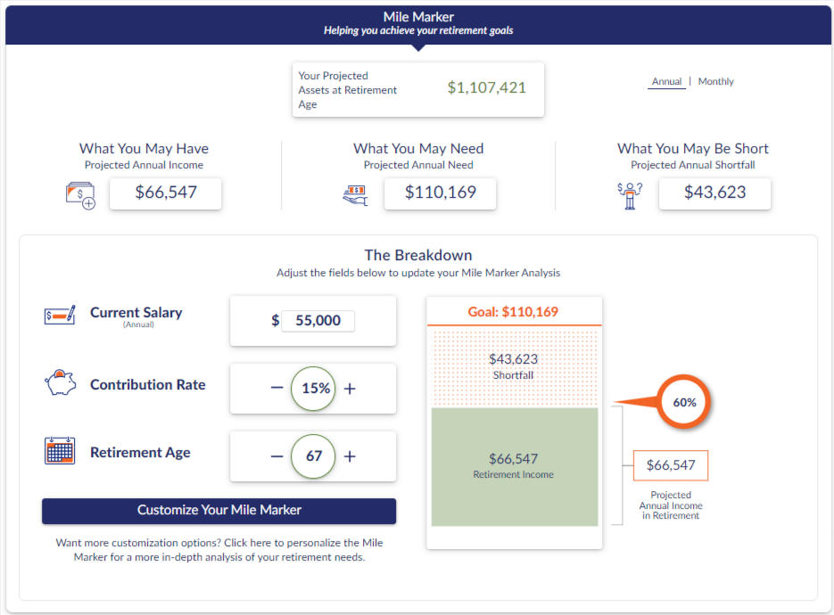







STEPS
Mile Marker
Projected salary, rate of return, & retirement age
Contributions
Social security benefits
Retirement income needs
Additional retirement accounts
Additional assets
Long term debts
Notes:
A great tool available to you and directly tied to your retirement account is the mile marker tool.
This tool allows you to input external financials as well as use the information in your account to help you make informed decisions about where you are on your path to retirement. You can make easy changes to salary, contribution rate, retirement age, and so forth to see how changes to your strategy might affect your account balance over time. You can use this tool to try out ideas without making changes to your account. It’s nice to be able to project what things might look like with the possible changes you can make.
​

Slide 36

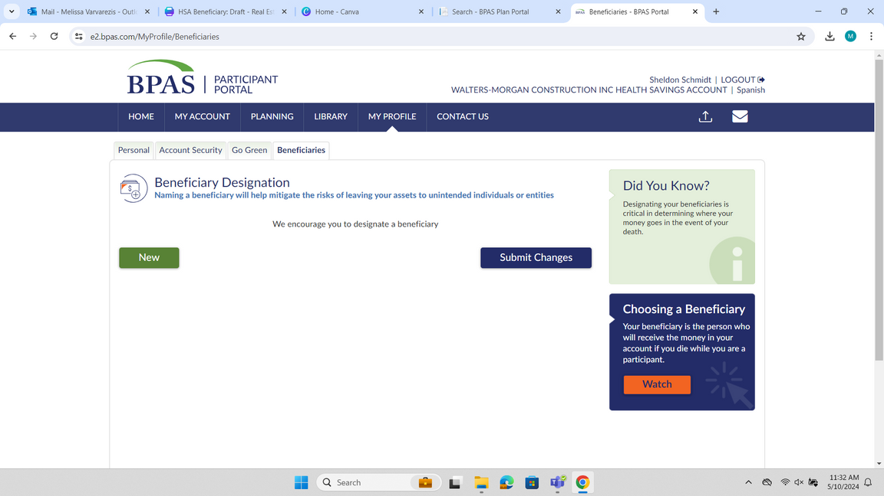
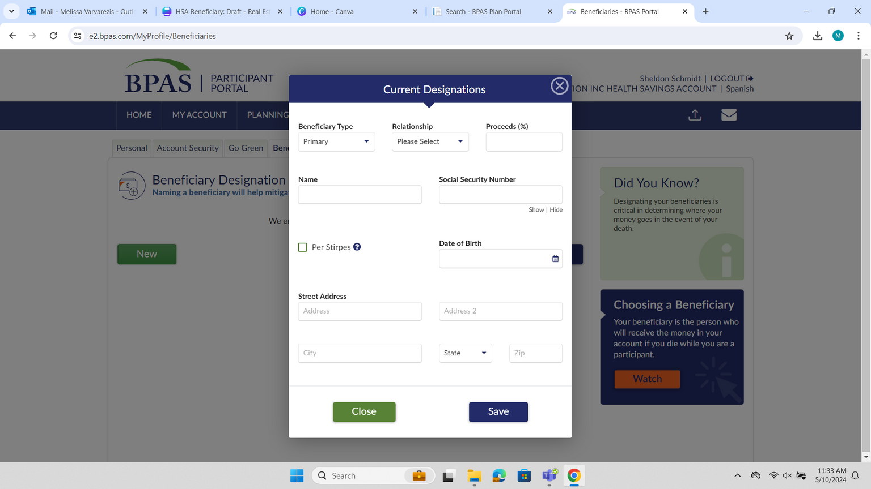

Beneficiaries
Review Your Beneficiaries Often!
After life changes like marriage, divorce, death, or birth in the family to ensure peace of mind for you and your loved ones.
Update your beneficiaries at any time by logging into your account at u.bpas.com
  Navigate to My Profile and choose the Beneficiary tab.
  Add your Primary and Secondary Beneficiaries and submit when finished.
    Remember to list a Beneficiary for each of your BPAS accounts, keep a copy with your estate documents, and consult with an estate attorney for consistency in beneficiary choices.
Notes:
Last but not least: Don’t’ forget to update your beneficiaries! Naming a beneficiary will help mitigate risks of leaving your assets to unintended individuals or entities should something happen to you.
Adding or updating a beneficiary is easy! Simply log in to your account select My profile & then the beneficiaries tab.

Slide 37






BPAS University
866.401.5272 | u.bpas.com
From budgeting tips to investment strategies, BPAS University offers valuable information to assist you in making sound financial decisions!
  Financial Planning Tools
  Blog Articles
  Quick Tips
  Self-study Courses
  Financial Calculators
  Videos & Podcasts
  Questionnaires
  Risk Tolerance Quiz
  And Much More!
Explore BPAS University and manage your account from anywhere, anytime!
Head to u.bpas.com or get the BPAS U App from Google Play or the
App Store.
Notes:
Check out BPAS University for a wide variety of planning tools such as retirement planning calculators, a risk tolerance quiz, retirement progress tracker and tons of videos with helpful tips and tricks to prepare you for your retirement.

Slide 38

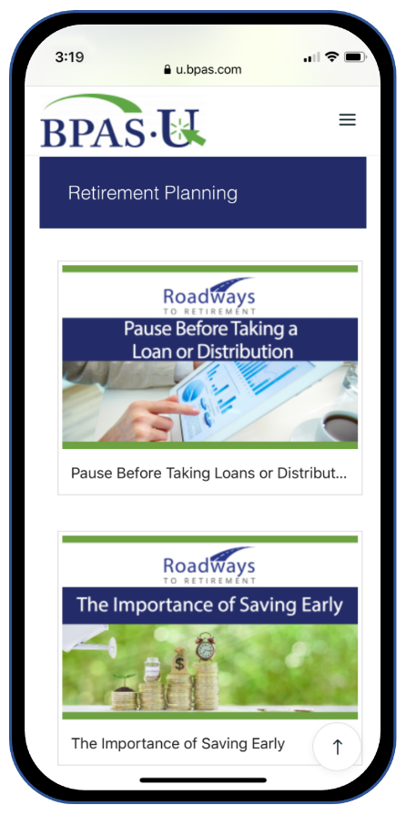

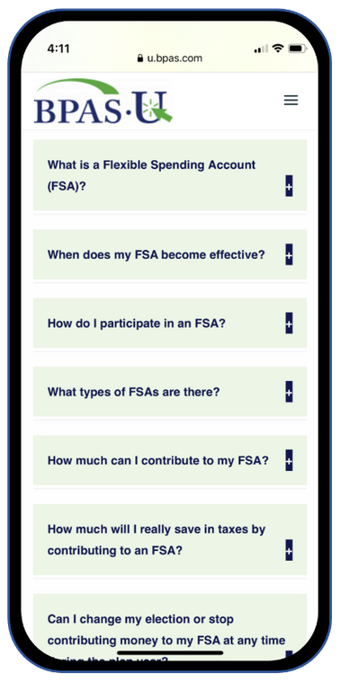


BPAS University Mobile App
Utilize free multimedia tools and resources
Test your knowledge on financial topics
Receive notifications when there’s new content
Securely login to your BPAS account
Notes:
Download our mobile app today for access to your account & retirement resources from anywhere anytime! Available from the App Store or Google Play. Scan QR Codes on your screen to download now.

Slide 39



Participant Services Center
Speak To A Representative
Send A Secure Message
Request A Call Back
Participant Services
866-401-5272
Live representatives are available from Monday to Friday, 8 am to 8 pm EST.
All calls are recorded & archived for quality and educational purposes
Notes:
If at anytime you have questions or need assistance with your account and you need to get in touch with someone at BPAS, you can contact the Participant Services Center. The Participant Services Center is fully staffed with BPAS employees located across the US. You will be able to speak with a live representative Monday through Friday 8am to 8pm EST and you will have a few ways to get in contact with them. You can call them at the number listed on the slide, request a representative calls you, or you can send them a secure message. You will be able to find Participant Services contact information in your online account.

Slide 40


To Do List
Login to your account at u.bpas.com
Adjust contributions or setup automatic increases
Review/update your personal information in My Profile
Review/update/add beneficiaries to your account
Review your investments for tolerance risk
U.BPAS.COM
Go Green
Notes:
Finally, whether you are new just getting started, or have been saving for years, here are some great steps to take while your retirement is at the top of your mind.
Log in to your account or setup your account if you have yet to do so.
Make sure your beneficiaries are up to date, especially if you have had any recent changes in marital or parental status.
Take a look at your current investments and make sure they reflect your time horizon and retirement objectives.
Consider increasing your contribution amount or setting up an automatic increase to help reach your retirement savings goals.
Lastly, opt to "go green" and receive all statements and notices online.

Slide 41








Avoid Getting Stuck
Or increase your contribution.
A little bit is better than nothing.
Continue learning. Review materials at BPAS University.
Read the annual materials provided by your plan.
Start Contributing
Start today!
Your future self will thank you!
Keep contact information up to date.
Review your investments often.
Are they still appropriate?
Do you need to rebalance?
What will your retirement income be?
Run a retirement projection by using the Mile Marker or another planning tool.
Notes:
How do we avoid getting financially stuck? Maybe you are disciplined in moving money to your savings but If you're anything like me, there have been countless times I have not moved money into my savings because I'm short for month but immediately stop at Taco Bell or grab a Starbucks when I feel that pang of hunger. Reality is we make it work. Somehow, I pay the bills AND find a way to feed my cravings -- The same can be true for setting aside money for retirement. Start small, set aside $20/paycheck, increase your contributions overtime. Something is better than nothing! Use the tools available to you at BPAS U and start today!

Slide 42

Questions?
Notes:
Now, I will open it up for any questions you may have.

Slide 43
Thank you
Presenter Name Here
Presenter Title Here
Presenter Company Here
Your logo here
Notes:
Thank you for watching our presentation, if you have further questions, please call our participant services or visit us online. Thank you and have a great rest of your day!

