Slide 1
One-Stop ESOP

Slide 2
About Us
6,100
plans
910,000
participants
$1.3
Trillion
in fund administration
$110 Billion
in trust assets
Established in 1973, national retirement plan service provider
Simplifying ESOPs and kSOPs since 1996
Financially solid subsidiary of Community Financial Systems, Inc. (CFSI; NYSE Ticker: CBU)
Services
Workplace Retirement Plans | Actuarial & Pension | VEBA/115 Trusts
Specialty Practices
Auto Enrollment Plans | ESOP/kSOP | Plans with Employer Securities
Subsidiaries
Hand Benefits & Trust | NRS Trust Product Administration | Global Trust Company
VEBA/115 Trusts | Multiple Employer Trusts/Plans (MET/MEP/PEP)
TPA | Cash Balance Plans | HSA
BPAS Trust Company of Puerto Rico
Fund Administration | Collective Investment Funds | Institutional Trust
Health Benefits Consulting | Health & Welfare Plans | IRA | Fiduciary
Advisor Coaching

Slide 3
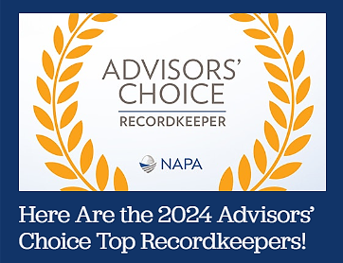
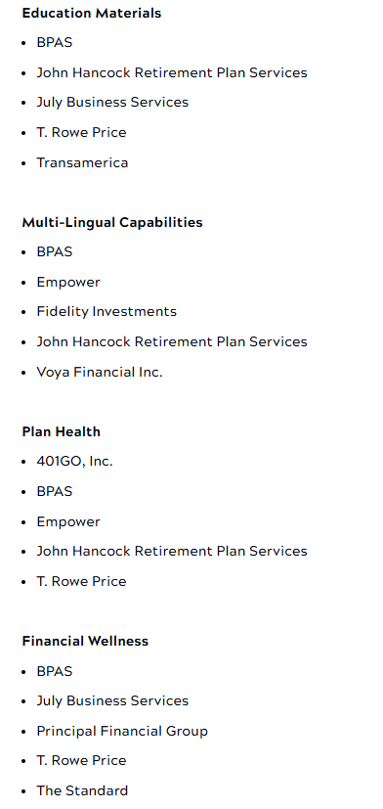
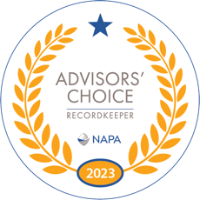
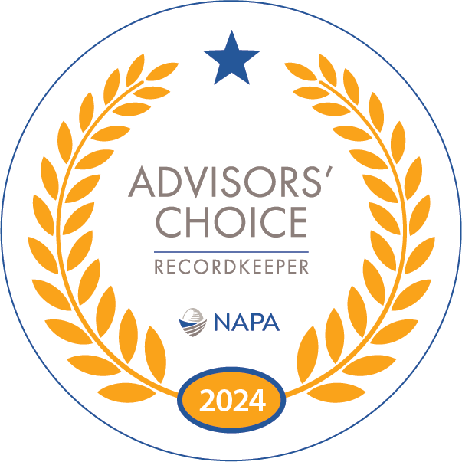
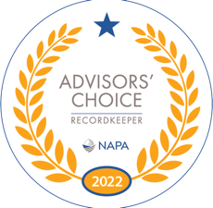
NAPA Advisors’ Choice
National Association of Plan Advisors
BPAS Placed in Top 5 Recordkeepers by NAPA Advisors’ Choice Awards across multiple markets and categories for three consecutive years
“The Advisors’ Choice awards are a means for committed retirement plan advisors to acknowledge best-in-class recordkeepers in a dozen different categories in the target market(s) they service.”

Slide 4
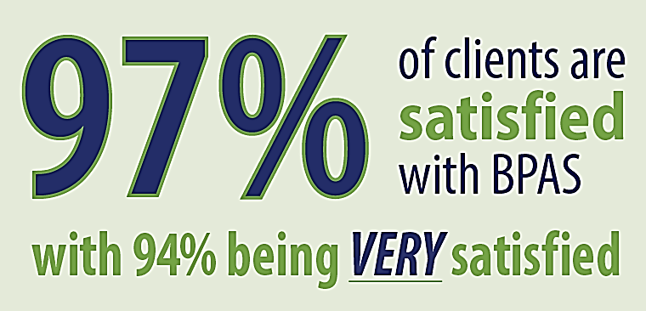
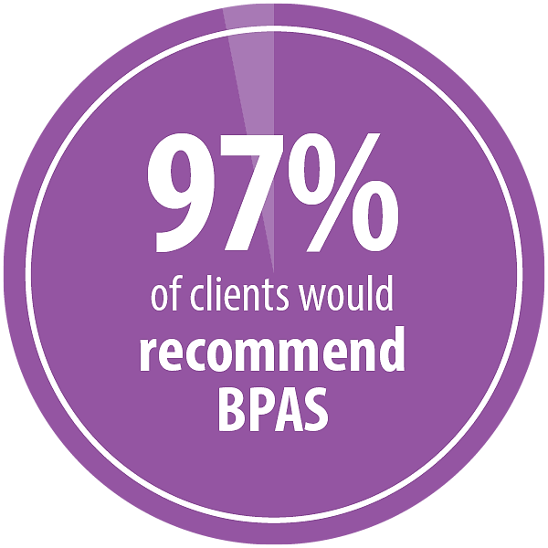
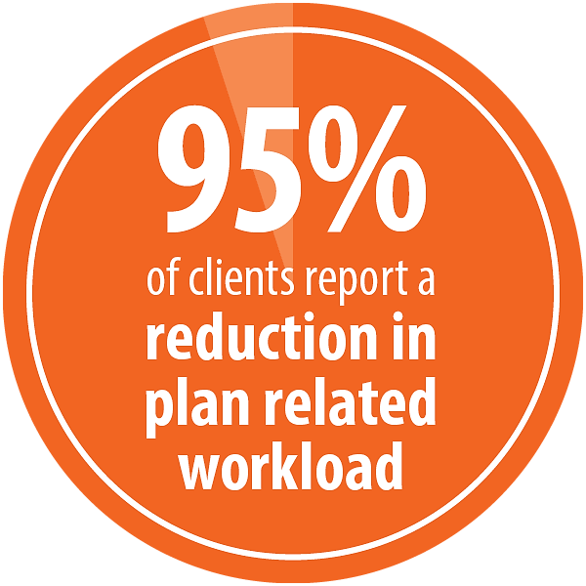
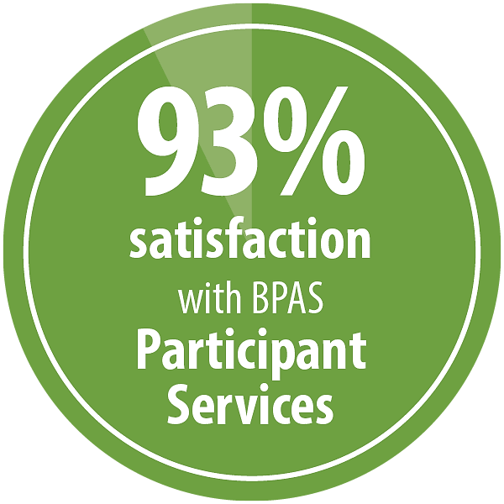
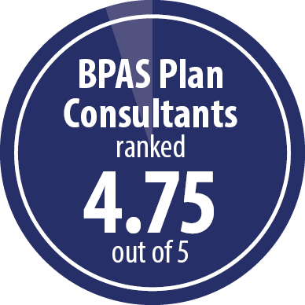
Client Survey Results
"BPAS overall takes ownership of most projects and makes life easier for (us).”
“BPAS helps make the management of our 401k plan a pleasant experience which is greatly appreciated.”
“Made our 401k plan process — enrollments, funding, etc. — so
much easier.
Eliminates a lot of paperwork, simplifies processes, keeps us informed...401k process is way more efficient.”
“Anytime one of our employees has a question, they come to me and we call together. The agents are always friendly, professional, and ready to help.”
"BPAS has always been so helpful and patient with questions. BPAS is a great partner to work with!"
“Very conscientious, very responsive, very helpful and very knowledgeable regarding all regulatory and plan aspects.”
“The best consultant I have worked with over the many years I have done this.”
Survey of 3,698 BPAS clients, December 2024

Slide 5
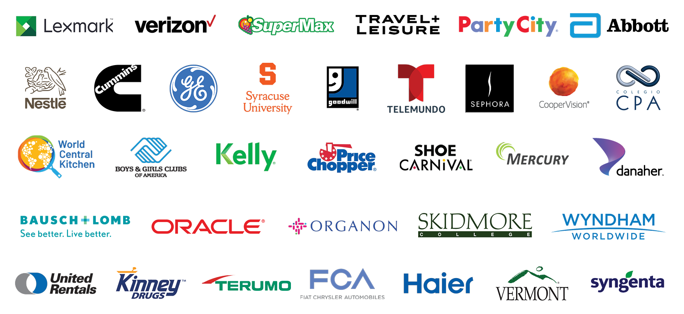




In Good Company
many BPAS clients are common household brand names
And our parent ESOP!

Slide 6


Simplifying the Complicated
Are 401(k) and ESOP separate or combined?
Are ESOP goals leveraged or unleveraged?
How are employer contributions structured?
Is company stock:
    closely held
    thinly traded
    widely traded
    ticker symbol
What is the configuration for valuation frequency, statement frequency, websites, audit?
Who is the recordkeeper? TPA? Custodian? Company Stock Trustee?
What about loans, hardships, distributions?
  distribution rules and process?
  cash, in-kind or both on stock?
Is there a company stock counsel?
Who created the ESOP document? When was it last updated?
Process for handling Section 16 insiders?
Proxy voting of shares?
Does the stock pay a dividend?
Is there a 404k election in place?
How are fees handled?
Any other plan design or investment goals?
We’re about to make your life a lot easier

Slide 7



Uniquely qualified to manage complex administration and trading flexibility of ESOPs/kSOPs
Plan Types:
Closely held, annually valued companies (including S Corp ESOPs)
Publicly traded companies (NASDAQ, NYSE, etc.)
  different methods of trading stock (pended trades, price guarantee, etc.)
Annually valued ESOPs alongside daily valued 401(k) plans (separate plans)
Daily valued combined kSOP arrangements with traded employer securities
  different methods of trading stock (pended trades, price guarantee, etc.)
Daily valued kSOPs with closely held company stock
ESOP Benefits
Tax Advantages
For S Corps, contributions are tax deductible to the extent of ESOP ownership. For C Corps, you have the opportunity to defer taxation indefinitely
Employee Satisfaction
Employees become partial owners in the company with the likelihood of increased morale and production.
Succession Plan
Beneficial opportunities for existing owners and long-term employees--protecting the legacy of your company for years to come.

Slide 8





Recordkeeping, TPA, and Custodial Services
on One System
save time and headaches
Administration
Advanced plan consulting for the full plan
Dedicated, credentialed Plan Consultants who know ESOP/kSOPs and know you
Single point of contact and ONE system
Plan wide reports and trust statements
Custody
One system for recordkeeping and trust/custodial services
No replicating records between plan and trust system
Share accounting of company stock and full transparency of all assets
Recordkeeping
Drive participant outcomes
Ease day-to-day burden for HR
High client satisfaction
Full census file with each payroll submission simplifies the process
Trading
Flexible, open-architecture on funds, institutional funds and share classes; no proprietary funds
Funds from 350+ fund families (20,000+ tickers)
No insurance-based investments, annuities, or separate accounts
Tailored trading approach for your plan
convenient for plan sponsor and participants

Slide 9


Engagements with a Separate ESOP and 401(k)?
We make those easy, too
Same BPAS Plan Consultant for both plans
ESOP is annually valued; 401(k) is daily valued
Participants drill down into either plan and see information online in one account
Allocate employer ESOP contribution (following terms of plan document)
Account for termination distributions (rules based on plan design)
Process forfeitures
Account for new employee purchases/sales involving stock
Account for statutory diversification participants (age 55+ 10 years of service)
Reconcile with plan sponsor for net purchases or redemptions (cash)
Process custodial functions for the plan (distributions, tax reporting, 1099s, etc.)
BPAS delivers a custom, experienced approach plan that will save you time and headaches.

Slide 10

ESOPs and kSOPs are among the most complex plans in the industry
We make them shine
Community Financial Systems, Inc. (CFSI) | kSOP | 3,507 participants, $489M combined assets
GE Retirement Plan, Puerto Rico (company stock) | PR 1081 | 391 participants, $23M assets
Kinney Drugs (now known as KPH Healthcare) | kSOP | 3,654 participants, $621M combined assets
Legend Bank Employees | kSOP | 212 participants, $37M assets
Margaretville Telephone Company | ESOP | 43 participants, $6M assets
The Bank of Richmondville | kSOP | 35 participants, $6M assets
United Bancorp | kSOP | 54 participants, $5M assets
UBT Bancshares | ESOP | 116 participants, $11M assets
Proven success with kSOPs, dividend pass-through elections, proxy voting issues, in-kind distributions, mergers and acquisitions, and related issues

Slide 11

Employer Securities
BPAS is a recognized leader in plans involving employer securities offering more flexibility than other firms
Trade options:
Treasury Shares (book entry trading)
The Price Guaranteed Approach
Stock Unitization
Pended Trades Approach
Schwab PCRA approach
Hybrid approaches (e.g., buy through treasury, sell on open market)
See our company stock trading matrix for details
Six different methodologies for handling company
stock, with a preference for share accounting
Whenever possible

Slide 12
Contribution Workflow
Plan sponsor or payroll provider imports census file into CensusPRO
BPAS receives file, performs edit checks, and sends email to Plan Sponsor
Plan Sponsor logs in to CensusPRO and reviews and/or approves ACH verification
If approved by 3:30 pm ET, BPAS initiates mutual fund purchases at that evening’s prices
Participant sees trades online that evening
BPAS pulls required funds from Sponsor account to settle prior day’s contributions
Data first, money second means BPAS fulfills steps on your behalf

Slide 13

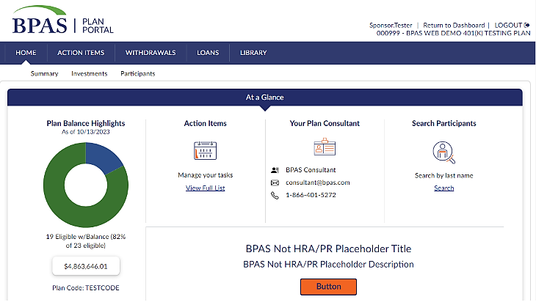
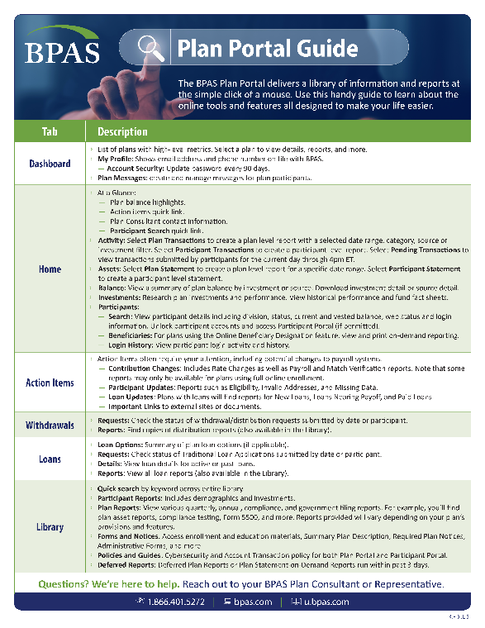
Online Tools and Features Make Your Life Easier
TPA, Recordkeeping, and Custodial services on one system
A secure workstation at your fingertips
Balance and manage all aspects of your plan at the employer and participant level securely online
On-demand analysis and reporting anytime across the entire plan
Online file cabinet for all plan-related documents, like reports, forms and notices, policies and guides, trust statements, compliance tests, and more
Action Items to quickly and easily find things that require your attention like contribution changes, participant updates, and loan updates

Slide 14
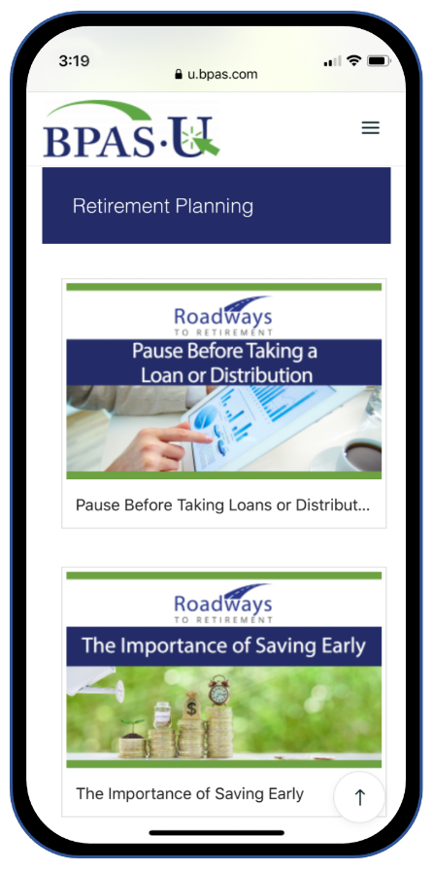
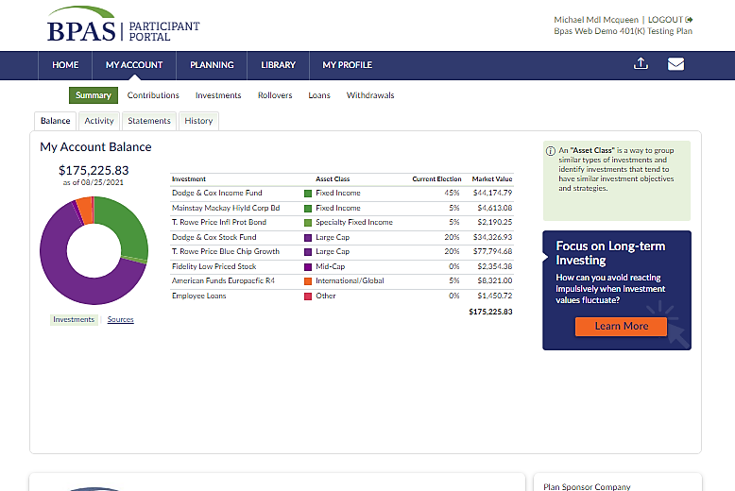
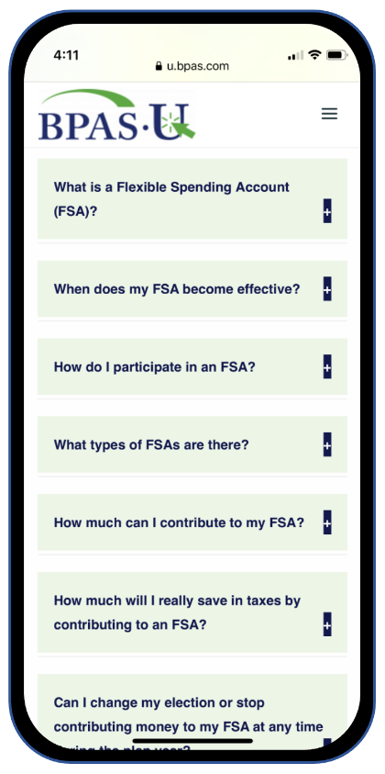
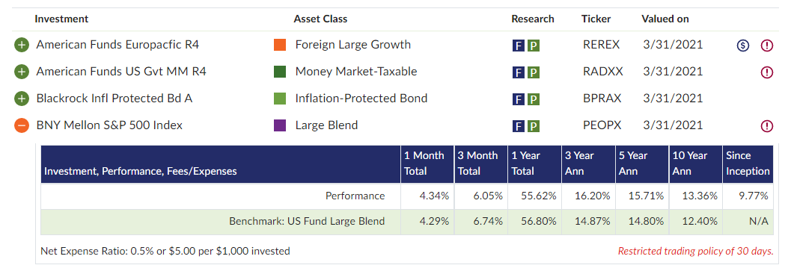
Participant Engagement
Participant Portal & Mobile App
Participants have online access to both their ESOP and 401(k) accounts
One system, one login

Slide 15
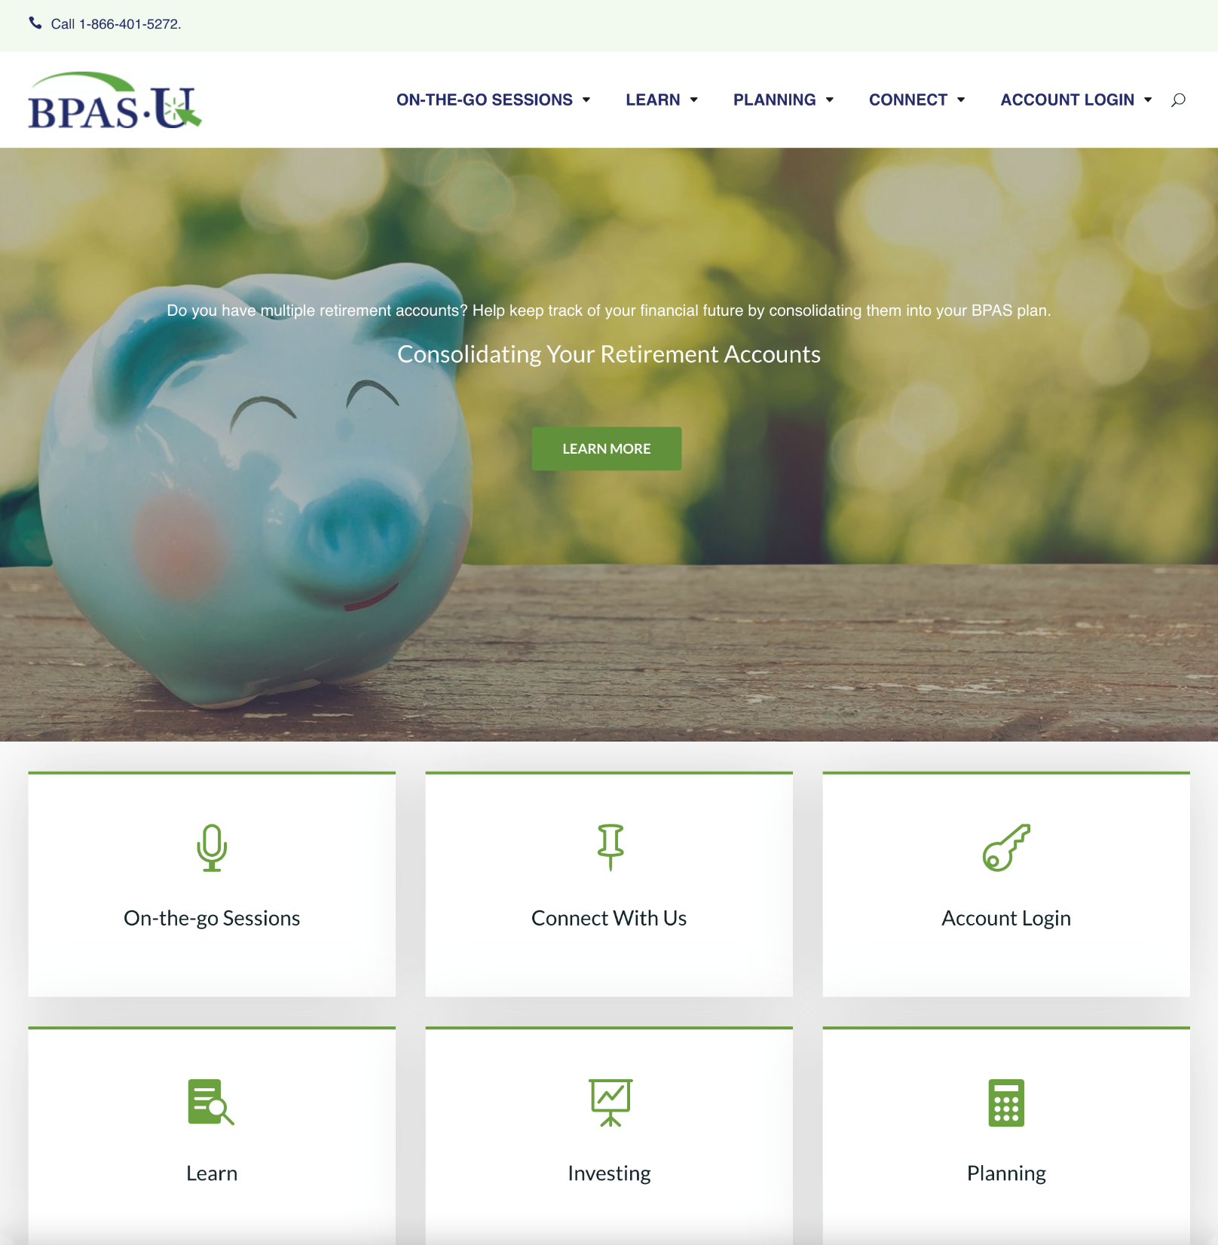
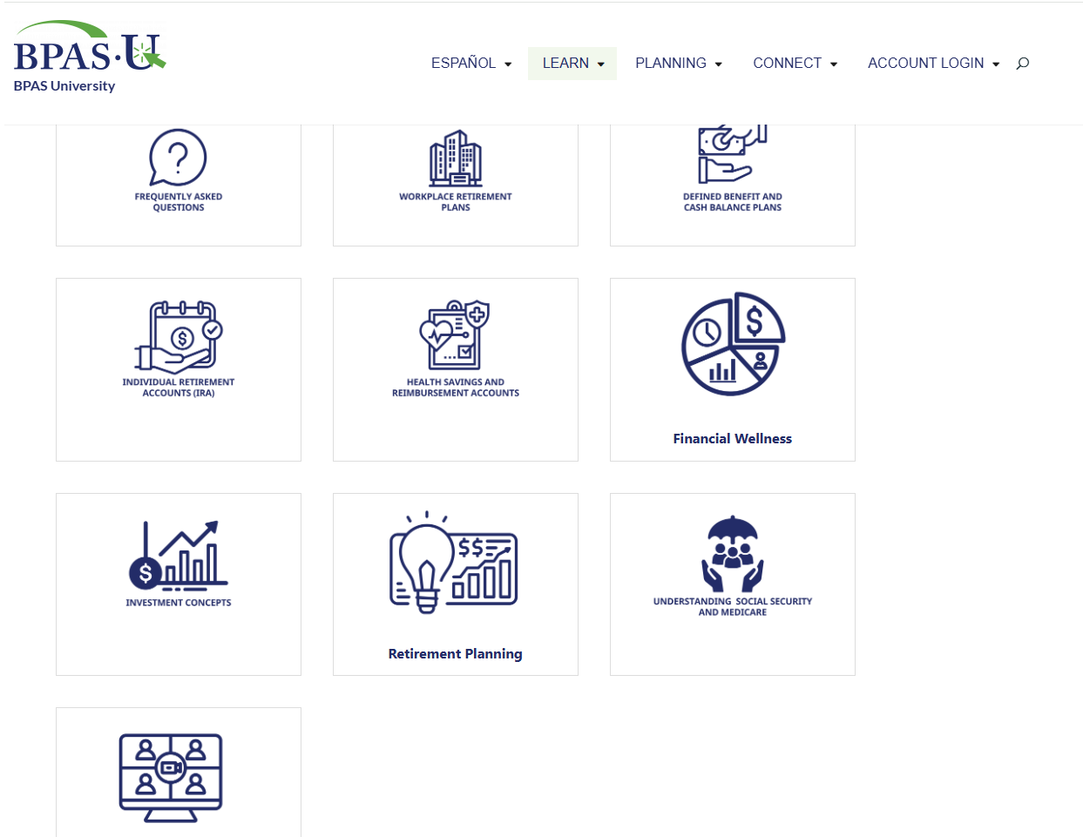
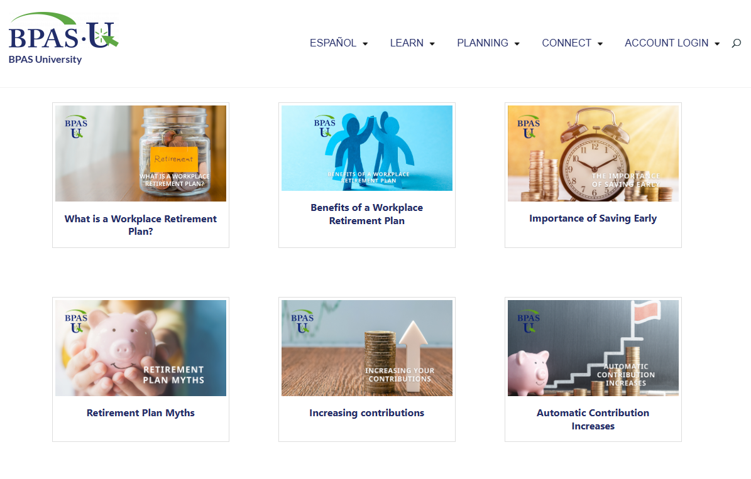
Participant Engagement
BPAS University u.bpas.com

Slide 16
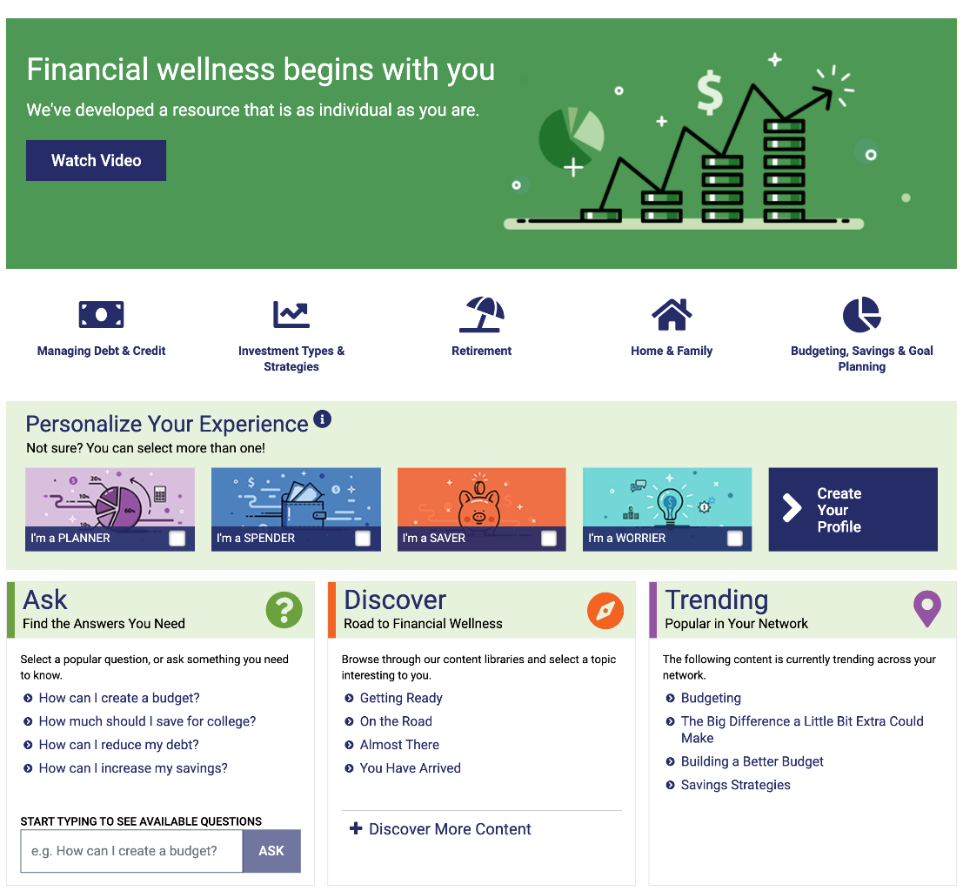


Participant Engagement
Financial Wellness

Slide 17

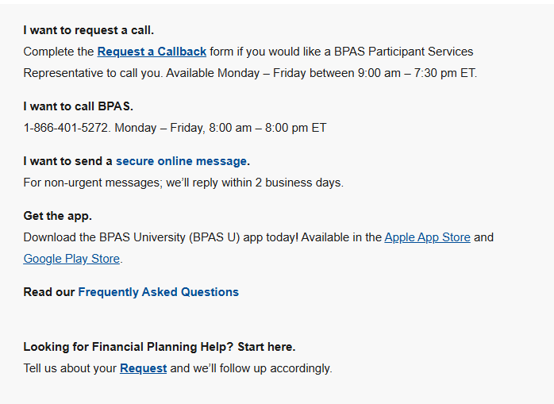
Participant Engagement
Participant Service Center
US-based call center, staffed by highly trained BPAS employees
Monday - Friday
8 a.m. to 8 p.m. ET
English and Spanish speaking representatives, plus translation services
Secure email options
Call-back feature
Online FAQs, forms, and links

Slide 18
Flexible Plan Costs
Fees based on: $ x,xxx,xxx in assets, with xxx participants |  | $ 4,300,000
Base Fee |  | $x,xxx
Per Participant Fee | $xx/year X xx participants | $xxxx
Platform Fee (kSOP) | 0.xx% (xx basis points) | $xx,xxx
 | Total | $xx,xxx
Full fee transparency ── no hidden fees, no surprises

Slide 19
2 months before
1.5 months before
1 month before
Month 1
Easy Onboarding
An experienced, client-dedicated Implementation Consultant manages the process to minimize work for the plan sponsor
submit installation kit
complete fund selections
distribute new provider memo to employees
determine black out period
set enrollment
collect enrollment data
begin processing employee contributions
complete fund map-over/re-registration of shares (typically 1 to 2 business days)
receive file from prior recordkeeper
plan is live
welcome letters mailed to participants
This illustration depicts the typical sequence of events in a map-over process conversion. Actual circumstances of each plan conversion will drive the ultimate outcome, including the timeliness and accuracy of data received from prior recordkeeper.
Notes:
.

Slide 20

Break Free From Multi-Provider ESOPs
One system for recordkeeping, TPA, and custodial services
Robust online services
Dedicated, credentialed Plan Consultants
who know ESOP/kSOPs
Open architecture investments
Flexibility to work with widely traded stock, thinly traded
stock or closely held issuances
Participant education resources
Plan wide reports and trust statements
Proven success in complex ESOP/kSOP
Full fee transparency—no hidden costs or surprises
One company. One call.
Ready to Get Started?

Slide 21




Name
Title phone email address
Let’s talk.

