Slide 1




Nearing Retirement
Key Retirement Planning Considerations
Presenter Name Here
Presenter Title Here

Slide 2







Today’s Discussion
Are you on track to retire when you want to?
Social Security & Medicare Basics
Investing for Retirement
Withdrawal Strategies
Questions
EDUCATION SERIES: This presentation is for informational use only and should not be considered investment advice. Consult with your Financial Consultant or your​ personal advisor for additional information.

Slide 3

Social Security Retirement Age
Age 62
Early Retirement
Age 67
Full Retirement
Age 70
Delayed Retirement

Slide 4
Retirement Age Milestones
59.5
IRS 10% withdrawal penalty no longer applies.
62
Early Retirement. Social Security benefits can start at a reduced amount.
65
Apply for Medicare Parts A & B, if no longer working.
66-67
Eligible for full Social Security benefits - visit ssa.gov for more information.
67
Full Retirement Age for Social Security benefits.
70
Delayed Retirement Age. Social Security maximum age, benefit amount no longer increases.
73
Required Minimum Distributions (RMD) begin.

Slide 5




Purpose of a Retirement Account
30%
40%
100%
For illustrative purposes only. 40% replacement is a general rule of thumb. Actual Social Security Replacement will vary. Source: https://www.ssa.gov/policy/docs/ssb/v68n2/v68n2p1.html
30%

Slide 6



Identifying Your Savings Goals
When Do You Plan to Retire?
The age you plan to retire can have a large impact on the amount you need to save. The longer you postpone retirement, the longer your savings can grow.
Retirement Lifestyle
How do you want to live in retirement? Do you expect your expenses to go up, down or stay the same?
Medical Expenses
Forecast your retiree medical expenses. Research Medicare coverage options and consider contributing to an HSA, if eligible, to save for your medical expenses
How Long Do I Want My Retirement Savings to Last?
Many are outliving their savings--the simplest way to estimate how long your money will last in retirement is to weigh your total savings, plus investment returns over time, against your annual expenses.
Be Patient
Saving for retirement involves a great deal of planning, patience and determination.

Slide 7



Are You On Track?
Income x 1
6x
10x
Age
30
40
50
60
67
3x
8x
Notes:
Calculating your retirement savings multiple. Based on your age, take your current income multiplied by your on target RSM. The goal is by age 67 you have 10 times your income in savings.

Slide 8

Retirement Income Sources
  Pre-Tax: Taxes are deferred, meaning that any withdrawals will be taxed as ordinary income.
Pre-Tax
Roth
  Fixed: Retirement income sources that offer a guaranteed return, such as pensions, Social Security, or fixed annuities.
  Roth: Taxes have already been paid, and qualified withdrawals are tax-free.
Fixed
Variable
  Variable: Retirement sources that offer variable returns, including workplace retirement plans, IRAs, or variable annuities.

Slide 9
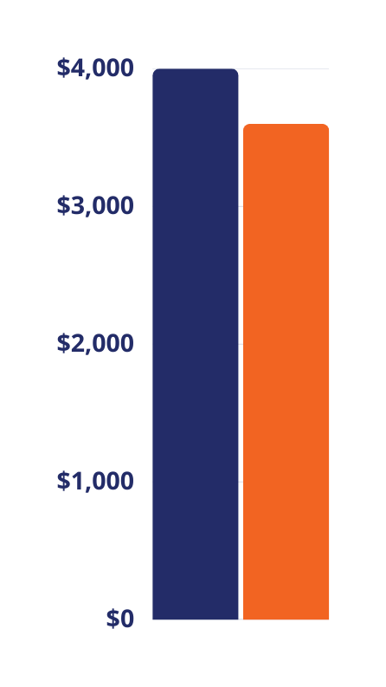

Creating Your Budget
Tips & Tricks:
  Generally, 75%-100% of your pre-retirement income is needed to sustain your current lifestyle in retirement.
Income
Liabilities
Monthly Income | $4,000
Monthly Liabilities | -$3,600
Surplus or Shortage | +$400
  Set a budget and try living on your retirement budget BEFORE you retire to adjust your spending habits and identify any potential shortfalls early on.
  Make more informed decisions about your savings and investments, to ensue a smooth transition into retirement.
All examples are hypothetical and for illustrations purposes only.

Slide 10








Budget Stategy
When developing a retirement budget, it’s essential to take into account both the expenses that might rise in the future...
Healthcare
Charity/Gifts
Travel
Entertainment
And those that are likely to decrease.
Debt
Mortgage
Auto/Communte
Taxes

Slide 11


Maximize Your Budget
TWO ways to maximize your Retirement Budget:
Increase your income
  Increase your contributions leading up to retirement
  Postpone your retirement for as long as you can
  Delay your Social Security payments as much as possible
  Think about taking on a part-time job during retirement
Decrease your spending
  Eliminate debts: Focus on credit cards, mortgage, auto loans, and more.
  Reduce current living expenses.
  Trim discretionary lifestyle expenses.
  Review monthly bills to identify potential savings.

Slide 12

IRS Contribution Limits
2025 Standard Contribution Limit
  $23,500
Age 50+ Catch-Up Contribution Limit
  An additional $7,500
Age 60-63 Enhanced Catch-Up Contribution
  An additional $11,250
Visit u.bpas.com to change your contribution amount

Slide 13
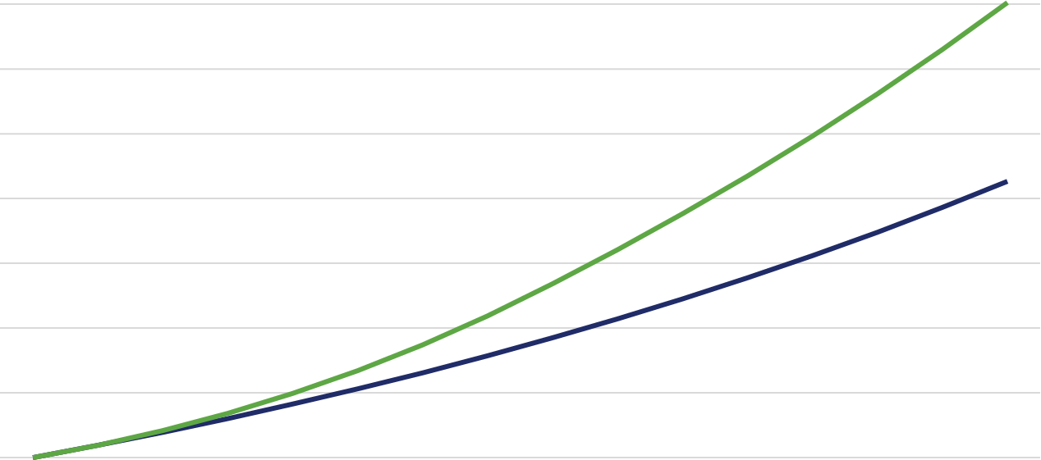
Nearing Retirement
Small Increases Add Up!
$451,344
$400,000
$313,116
$300,000
$200,000
$100,000
50
55
60
65
Hypothetical example for illustrative purposes only. Assumes gross bi-weekly pay of $2,500, starting balance of $100,000, annual rate of return of 5.5%. Blue shows a 6% contribution with no increase and green shows a 6% contribution with a 2% increase each year up to a total of 20%. Calculated using the Retirement Account Contribution Accelerator at u.bpas.com

Slide 14

Social Security
Provides eligible individuals, including retirees, with qualified benefits.
  The funding for these benefits primarily comes from payroll taxes on employees' wages.
  Social Security is important for retirement planning, but additional savings and investments are crucial for a comfortable and secure retirement.

Slide 15

Eligibility
Must be at least 62 years old
Have worked and paid Social Security taxes for at least 10 years
Have earned an average of 40 work credits
Visit ssa.gov for more information on benefit eligibility.

Slide 16
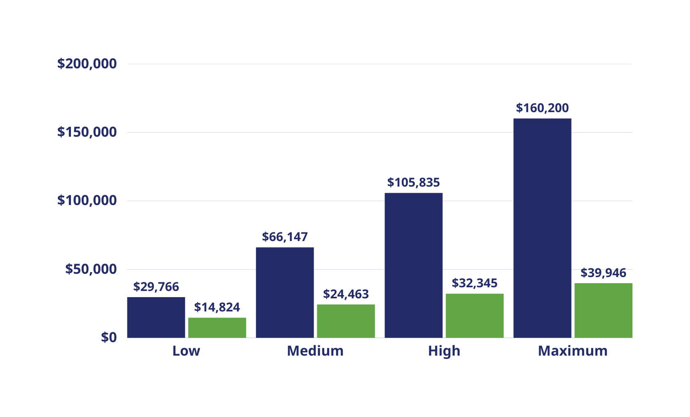
Earnings By Income
Average Earnings
Social Security Benefit
Source: Center on Budget and Policy Priorities and Social Security Administration, 2023 Trustees Report. https://www.cbpp.org/sites/default/files/atoms/files/8-8-16socsec.pdf​

Slide 17
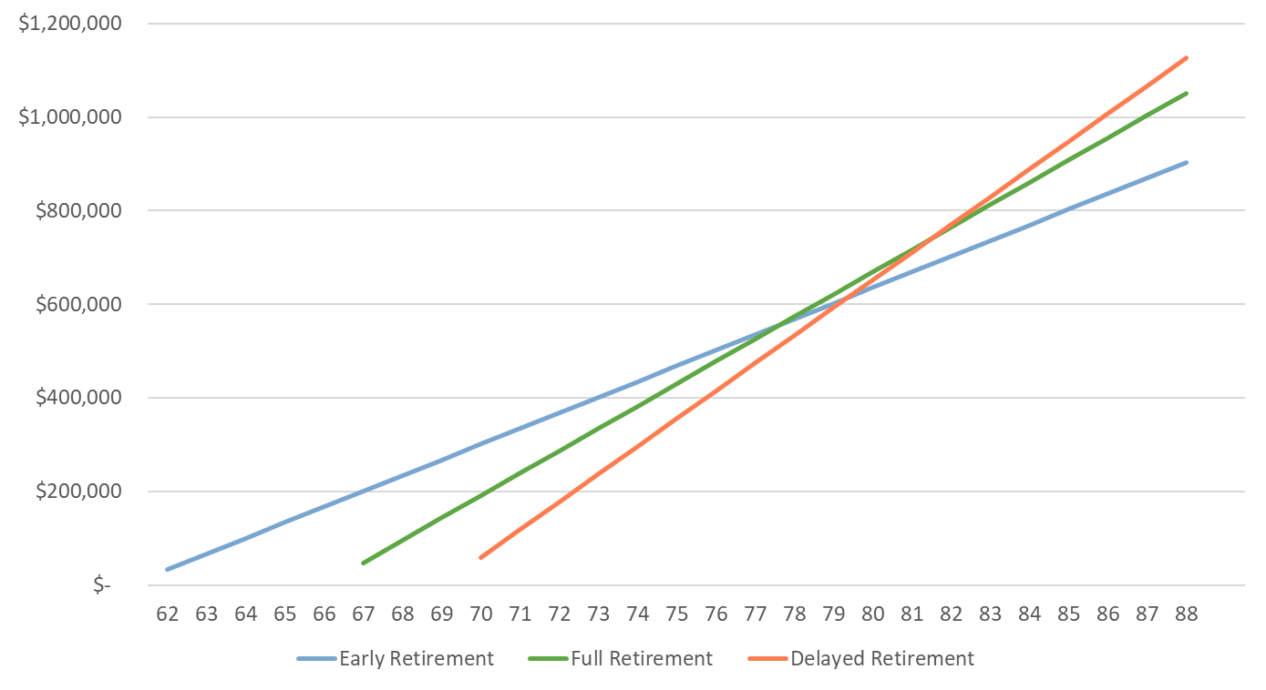
Breaking Even
Example
  Hypothetical $100,000 salary at retirement age
  $33,461 at age 62
  $47,802 at age 67
  $59,275 at age 70
  Does not account for inflation increases.
For illustrative purposes only. Data source: https://smartasset.com/retirement/social-security-break-even-age

Slide 18





Medicare
Hospital Insurance
No additional cost for coverage.
Medical/ Doctor Insurance
Additional monthly cost for coverage.
Private Insurance
Covers Parts A, B, and D. Additional monthly cost varies by plan.
Prescription Drug Insurance
Additional monthly cost for coverage.

Slide 19




Medicare Enrollment
Enroll during the three months leading up to your 65th birthday. Your coverage will begin on the first day of the month in which you turn 65.
Birthday: December 20th
September
October
November
Enrollment Period
Coverage Begins December 1st
If you are currently employed and covered by your employer's health plan, may not need to apply for Medicare Part B at age 65. You may qualify for a Special Enrollment Period and be able to delay signing up for Medicare Part B without a late enrollment penalty

Slide 20

Planning for Healthcare Costs
Healthcare is often the largest expense in retirement.
  Average retiree may need $165,000 in after tax savings to cover health care expenses.
Consider a Health Savings Account.
  Covers qualified medical expenses now and into retirement.
Explore Long-Term Care Insurance.
  With increasing lifespans, taking the initiative to comprehend your future requirements can provide you with reassurance.
Data Source:
https://www.fidelity.com/viewpoints/personal-finance/plan-for-rising-health-care-costs

Slide 21
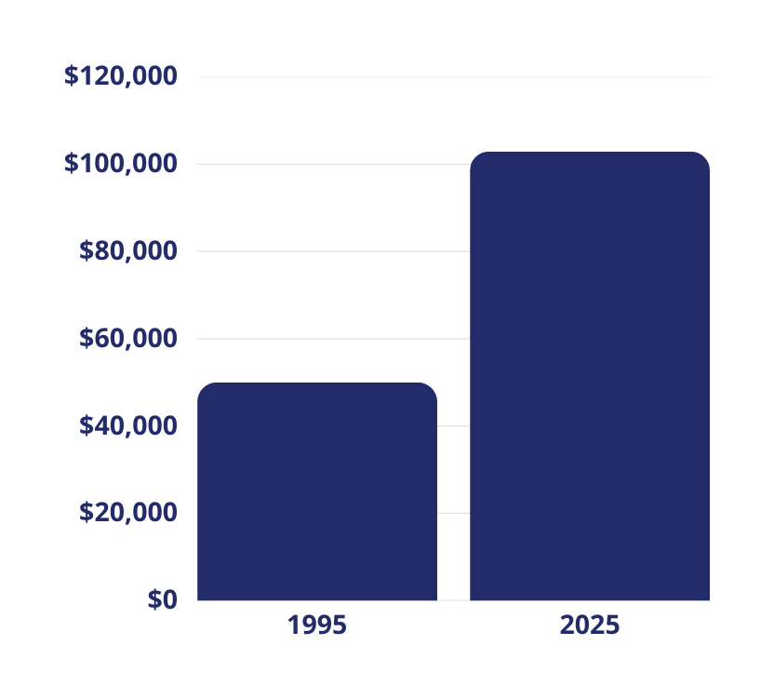


Long-Term Savings Strategy
$102,916
Inflation
$50,000
  If you made a purchase of $50,000 in 1995, that same item would cost $102,916 today.
For illustrative purposes only. Calculated using the US Inflation Calculator: https://www.usinflationcalculator.com/​

Slide 22

Review Your Investments
Take a Risk Tolerance Quiz and compare it to your current asset allocation.
  Do you need to do some rebalancing or make other investment changes?
Calculate your retirement income for a general estimate of annual projections.
  Don’t try to chase returns. An investment downturn in your later working years may impact your planned retirement date.

Slide 23
Basic Types of Investments
Money Market/ Stable Value | Bonds | Stocks
Typically invest in a variety of interest-bearing investments Generally provide a lower return with very little to no stock market risk | Loans from an investor to an institution (corporation or government) for a pre-determined rate-of-return Attributes may include: duration, interest payment, financial strength of the entity | Represents ownership in a company Most susceptible to short-term fluctuations in value. Often classified by the size and style of the company
“Fixed Income”
“Equity”
Lower
Higher
Potential Risk/Potential Return
For Illustrative purposes. General observations only.
Volatility for any given time period can vary from the above.

Slide 24






Time Horizon
Early Career
30,000 Ft.
Mid Career
20,000 Ft.
Late Career
10,000 Ft.
Retirement
Final Destination
For Illustrative purposes only. This suggested risk-based allocation process is not intended to represent investment advice that is appropriate for all investors. Each investor's allocation must be based on their personal goals, time frame, financial resources, risk tolerance and other pertinent factors. Because everyone's situation is different, you should consult a financial advisor to assist with the optimal allocation appropriate for you.

Slide 25





Diversification
Diversification is like a balanced diet.
Spread your investments across different assets to
promote growth and minimize risks.
Diversifying your portfolio is essential for maintaining financial stability.
It acts as a shield against total financial collapse, ensuring long-term wealth.
Regular review of your account is important!​​

Slide 26



What Type of
Investor Are You?
  A well-diversified portfolio, paired with a time horizon of 3 - 5 years, can typically withstand various challenges.
  Accept market fluctuations and short-term losses; don't focus only on returns.
  Consider target date funds for tailored asset allocation based on age.
Scan to take the
Risk Tolerance Quiz!

Slide 27

Estate Planning
Regularly review and update your legal documents to ensure that your estate plan accurately reflects your current wishes.
  Will
    States where your assets will go.
  Durable Power of Attorney
    Names a person to act on your behalf for financial/business matters.
  Healthcare Power of Attorney
    Names a person to ensure your healthcare wishes are followed.
  Account Beneficiary
    A loved one, family member, trust or charity

Slide 28

Required Minimum Distribution
RMDs ensure individuals withdraw funds from retirement accounts and pay taxes rather than indefinitely defer payments.
Withdrawal amount is based on account balance and life expectancy and typically start at age 73, depending on your birth year.
Required Minimum Distributions do not apply to Roth IRA and Roth 401(k) accounts.

Slide 29




Withdrawal Strategy
Fixed Percentage
Withdrawal
Fixed Dollar
Withdrawal
4% Rule
Interest & Dividend
Only Withdrawal
A well-crafted withdrawal strategy should align with your financial goals, lifestyle preferences, and risk tolerance.
Consulting with a financial advisor can offer personalized guidance
tailored to your unique situation.

Slide 30



For Retirement
Use Only
Today's choices may significantly affect your retirement lifestyle, so thoughtfully and strategically make your decisions.
Switching jobs? Don’t cash out your retirement plan to avoid taxes and penalties.
Avoid loans, hardship withdrawals and in-service distributions.

Slide 31

Stay Informed &
Do Your Homework
It's essential to stay proactive when it comes to planning for your future.
Keep an eye on changes in regulations and tax laws that might impact your retirement savings.
Check out the resources at BPAS University

Slide 32






BPAS University
866.401.5272 | u.bpas.com
From budgeting tips to investment strategies, BPAS University offers valuable information to assist you in making sound financial decisions!
  Financial Planning Tools
  Blog Articles
  Quick Tips
  Self-study Courses
  Financial Calculators
  Videos & Podcasts
  Questionnaires
  Risk Tolerance Quiz
  And Much More!
Explore BPAS University and manage your account from anywhere, anytime!
Head to u.bpas.com or get the BPAS U App from Google Play or the
App Store.
Calculations in this presentation were completed with the calculators available u.bpas.com

Slide 33


Questions?

Slide 34





Thank You
866.401.5272
bpas.com
u.bpas.com

