Slide 1
Blank Presentation Template
, 2024
Presented By –

Slide 2
What is your WHY?
What does a comfortable retirement look like for you?
Do I want the flexibility to retire early or pursue other opportunities in my later years?
Think about the lifestyle, activities, and financial security you envision during your retirement.
Explore the idea of early retirement or engaging in different activities during your later years, and assess how savings can facilitate these choices.
What are my priorities in retirement, and how can saving help achieve them?
Identify the key priorities, whether it's travel, hobbies, or supporting family, and link them to your savings plan
How would I feel if I didn't have enough money to support myself during retirement?
Consider the emotional impact of not having sufficient savings and use it as motivation to stay disciplined in your financial planning.
Notes:
We want to get started by talking about your retirement WHY. We will spend most of the presentation talking about that how, but even more important can be the why. You shouldn’t save for retirement just because we tell you it’s important. You should think about your own goals and why saving for the future is important to you. Maybe that’s so that you can spend more time with family, be charitable or create a legacy, maybe travel, live debt free, buy your dream retirement home. It can be as simple as wanting to spend less time working, I’m sure many of you eventually want to retire. The point is, when you think about saving for retirement, keep your WHY in mind so you know the reason it’s important to you.

Slide 3
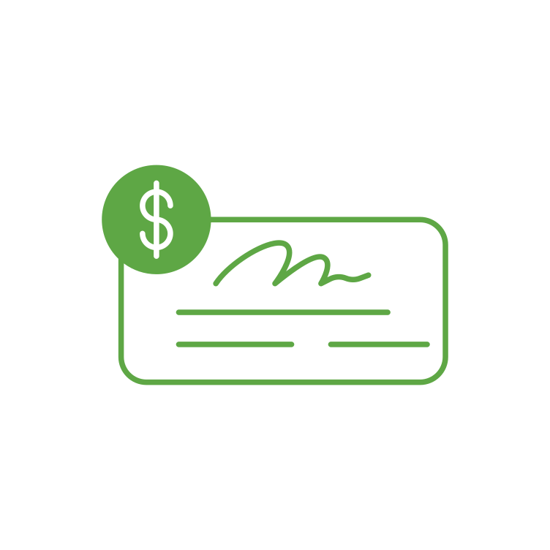
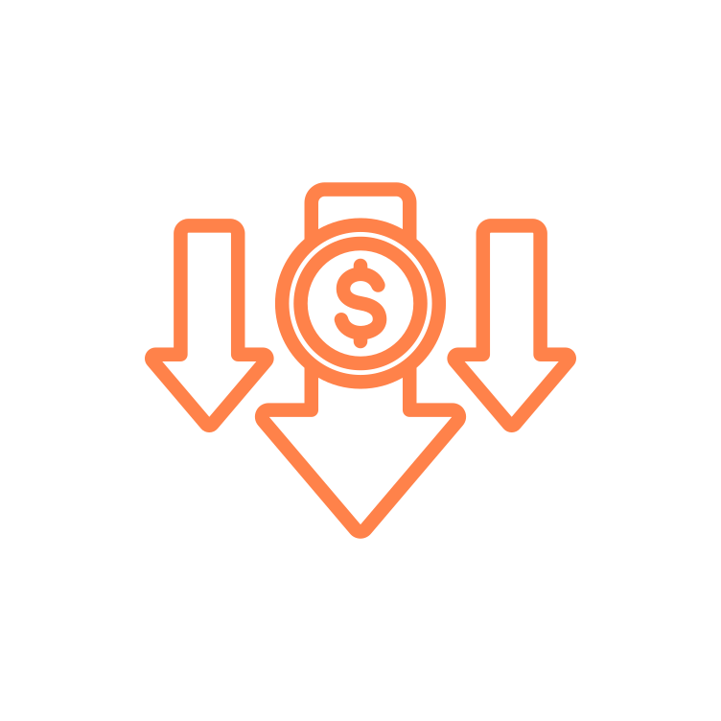
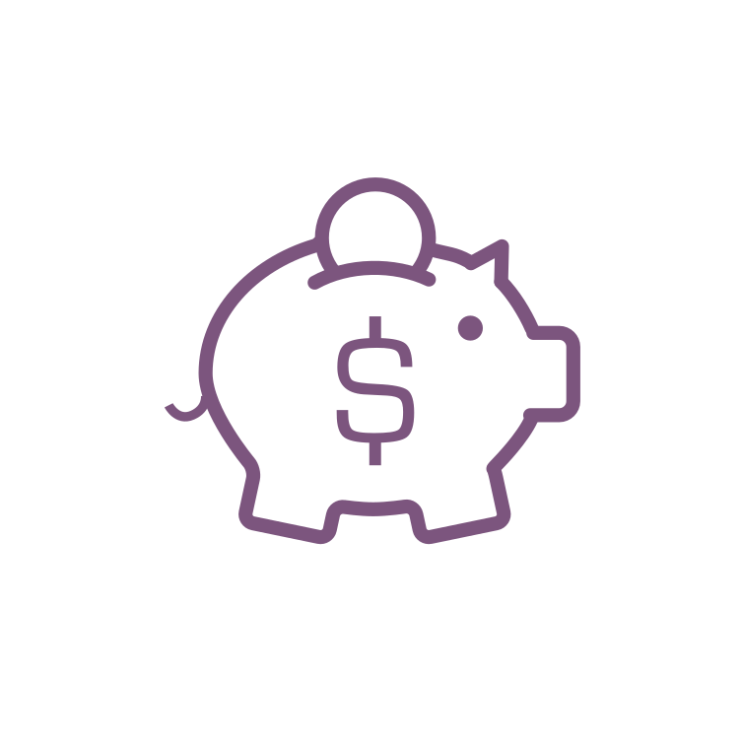
Purpose of a Retirement Account
30%
40%
100%
30%
For illustrative purposes only. 40% replacement is a general rule of thumb. Actual Social Security Replacement will vary. Source: https://www.ssa.gov/policy/docs/ssb/v68n2/v68n2p1.html
Notes:
Now if we look at the numbers, you’ll see the estimations for what we need to retire. The Social Security website estimates that Social Security will replace about 30% of your paycheck when you retire. You also may have about a 30% reduction in what you need once you no longer need to put money into your retirement savings and have hopefully paid off most of your debt. This leaves about 30% gap that we need to make up if we want to completely stop working. This is the purpose of a retirement account.
Before we go any further, I want to address the fact that EVERY one of us is at a different stage in our life, has a slightly different experience, family background, income, etc. A retirement account might sound like a luxury, a no-brainer, both, or anything in-between. No matter what time in your life, and no matter what perspective you’re coming from, having a retirement account ultimately is about having financial security in your later years. Not everyone has that, but we want everyone to have that, and we want you to have the tools to achieve that. So, remember that why that we just talked about, because it really will make contributing to your retirement account feel easier, and make it feel like a given.

Slide 4
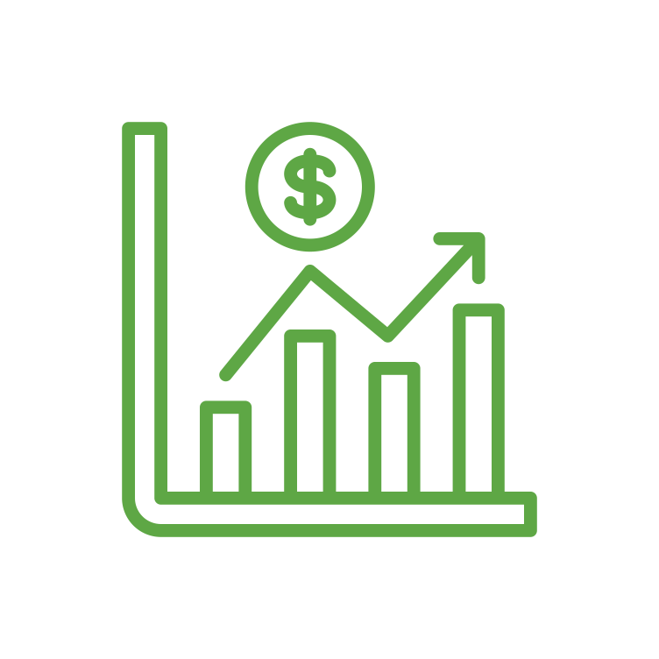
What is a Workplace Retirement Plan?
Money In
Invest
Future Income
Notes:
The specific retirement account that you have is a 401(k) plan. The Workplace Retirement allows you to put money away now, and invest the money so that it grows throughout your working years. This allows you to supplement your income throughout retirement. Think of it like putting money away now to create a paycheck for your future self.

Slide 5
Contributions
You
IRS Maximum - $23,000
Rollover
Employer
Rollover Contributions Accepted
Employer Matching Contribution
50+ Catch-Up - $7,500
Employer Profit Sharing
Employer Non-Discretionary Contribution
Notes:
In regards to contributing to the plan, you may contribute up to the IRS limit which currently is $23,000 and you can make an additional catch-up contribution of $7,500 if you are age 50 or over. The CBSI plan allows participants to make either Pre-Tax or Roth contributions, or a combination thereof.
Your plan does allow for rollover contributions if you had a retirement account from a previous employer, and also allows for Roth conversions. In both cases, we encourage you to contact Participant Services for help with those processes.
Finally, Employer contributions from Community Bank includes a 100% match of the first 3% of compensation and 50% of the next 3% of compensation. Employer Contributions are made into CBSI Stock.

Slide 6
Getting Started
Eligibility
Age 21+ with 1 Month Service
Plan Entry
Monthly
Enrollment
Online at u.bpas.com
Plan Code:

Slide 7
Automatic Enrollment
Target Date Fund
3%
3 Months
Notes:
One feature of your plan

Slide 8
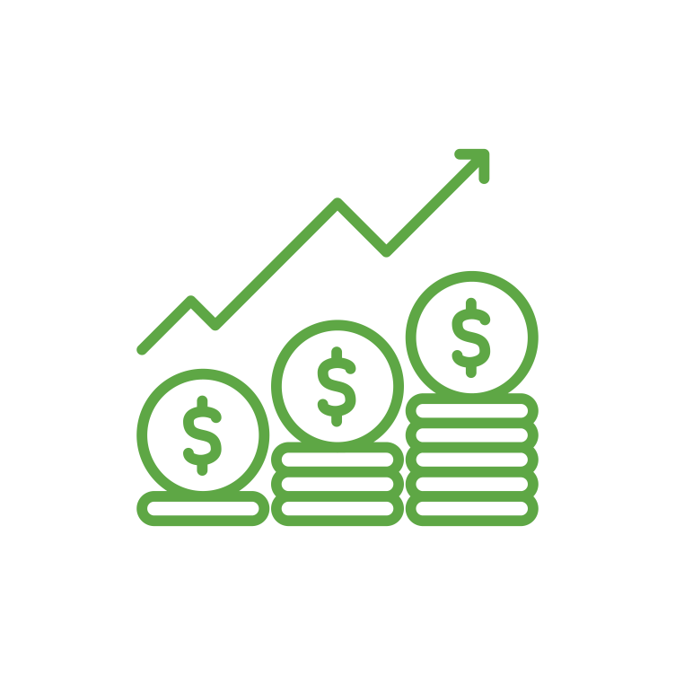
How Much Should I Contribute? 50/30/20 Rule
50% - Needs
30% - Wants
20% - Savings
Of the 20% total savings, retirement experts recommend 10-15% towards retirement.
Notes:
A common question we receive is – how much should I actually be contributing? One commonly-used budgeting rule is called the 50/30/20 rule. This rule tries to break your spending up into three categories: Needs, Wants, and Savings. Try and keep spending for needs such as housing, food, transportation to around 50% of your income. For wants, such as vacation, entertainment, dining out, try to keep this amount at about 30% of you income. This will leave you with 20% of your income for savings. Most experts will recommend savings 10-15% of your income towards retirement savings. If you can do that, and save the other 5-10% to pay debt or create an emergency fund, this should leave you help you get on track for your retirement needs.

Slide 9
Weekly Contribution Amount
Salary | 10% | 12% | 15%
$30,000 | $57 | $69 | $86
$40,000 | $76 | $92 | $115
$50,000 | $96 | $115 | $144
$60,000 | $115 | $138 | $173
$70,000 | $134 | $161 | $201
$80,000 | $153 | $185 | $230
Weekly contribution Rounded to nearest dollar.
Notes:
This slide breaks down the 10-15% goal we just talked about. You can see on a weekly basis was 10-15% would be towards your retirement. For example……

Slide 10
Compounding Growth
Hypothetical example for illustrative purposes only. Calculated using the 403(b)/457/401(k) Savings Calculator at u.bpas.com. Assumptions: annual $3,000 contribution earning 5.5% rate of return annually. Age brackets are approximate, not to exact scale.
Notes:
Our retirement accounts can function much in the same way. We aren’t going to be able to double our money each day, like the penny, but if you look over time, you will see the same effect with retirement. At first, the growth in the account seems very modest, maybe even non-existent. However, over time, as your investments grow and compound on one another, the effect become more impactful. You can see that at about age 49, half the value is investment growth. By age 65, the investment growth is almost 3 times what you have actually contributed over the years.

Slide 11
Contribution Increases
Increasing Ian
$621,251
Consistent Connor
$495,425
Late Larry
$323,087
For illustrative purposes only. Calculated using the Retirement Account Contribution Accelerator at u.bpas.com. Assumptions: $60,000 salary, no annual salary increase, 5.5% annual rate of return, 1% contribution increases.
Notes:
This slide demonstrates the benefits of making contribution increases over time. Increasing Ian begins contributing at age 30 at 1%, but slowly over the course of his career, increases his contribution rate up to 12%
Consistent Connor begins at the same time as Ian, but contributes 8% throughout his career, and Late Larry doesn’t start until he’s 45, but contributes 15% throughout his career. You can see that even starting small early in your career can still lead to large effects in the long term. No matter when you begin, though, contributing to your 401k is going to be helpful for you in the long term.

Slide 12
Pre-Tax Contributions
Tax-Free Contribution
Taxable Withdrawal
Tax-Deferred Growth
Taxes

Slide 13
Roth Contributions
Taxable Contribution
Tax-Free Withdrawal
Tax-Free Growth
Taxes
Must be 59 ½ with the first contribution 5+ years ago

Slide 14
When Pre-Tax May Make Sense
28%
Tax
15%
Tax
Current
Future
(Projected)
Pre-Tax

Slide 15
When Roth May Make Sense
28%
Tax
15%
Tax
Future
(Projected)
Current
Roth

Slide 16
Roth Contributions FAQ
Is there an income limit for contributing Roth?
No, unlike an IRA, there is no income limit for a Workplace Retirement Plan/401(k)/403(b).
Can I contribute Pre-Tax and Roth?
Yes, however the combined amount cannot be more than the IRS limit.
Does contributing Roth open a new account?
No, your Roth contributions will go into the same account, but be accounted for separately for tax purposes.
Are Roth contributions matched?
Yes, Roth contributions are matched, just as Pre-Tax are, however the employer match will be Pre-Tax, even if you are contributing Roth.

Slide 17
Tax Effects on a Paycheck
 | No Contribution | 6% Pre-Tax Contribution | 6% Roth Contribution
Gross Pay | $1,000 | $1,000 | $1,000
Pre-Tax Contribution | - | $60 | -
Taxable Income | $1,000 | $940 | $1,000
Taxes Withheld (Example: 18%) | $180 | $169 | $180
Roth Contribution | - | - | $60
Net Pay | $820 | $771 | $760
Please note that the above assumptions/examples are for illustrative purposes only.
Notes:
We discussed pre-tax and after-tax or Roth contributions. This slide shows the impact on your paycheck. You can see that if your gross pay is $1000 and you contribute to your 403(b) pretax your taxable income is reduced thus less taxes are withheld. If you were to contribute to a Roth 403(b) your taxable icome remains $1000 however, your tax savings comes during retirement as you have already paid tax on your contributions.

Slide 18
Employer Contributions
Employer
Employer Safe Harbor contributions will be made to eligible participants. You need to be contributing to be eligible.
Discretionary contributions may also be made to eligible participant accounts. You need to be employed at year-end to be eligible.
Employer Contributions are subject to a vesting schedule.
You need to be an employee for 6 years to be 100% vested.
Employees between 2 - 6 years of employment are vested at a portion of the account.
Your contributions are always 100% vested.
BPAS keeps track of this information for you! You’ll see your account balance and your vested balance online and in your quarterly statements.
Notes:
In your 401(k), you are able to contribute…..

Slide 19
Employer Contributions
By Contributing 6% you receive the Employer Full Match of 4.5%
Employer Matches 50% of the next 3% you contribute.
Employer Matches 100% of the first 3% you contribute.
Notes:
In your CBSI 401 k plan, I mentioned that you have an employer match, and this benefit of your employment is incredibly valuable! As you can see in order to take full advantage of the Employer Match of 4.5%, you need to contribute 6%.

Slide 20
Employer Non-Elective Contributions
Non-elective contributions are received by eligible employers whether they contribute to the Workplace Retirement Plan or not.
Non-elective contributions are optional and subject to change.
Flat Rate
Contribution
Profit Sharing
Contribution
$500*
4%
* Must have worked for 2 ½ years and be an employee at the end of the year.

Slide 21
Employer Non-Elective Vesting
1 Year
2 Years
3 Years
0%
0%
100%

Slide 22
Employer Contributions Vesting
1 Year
2 Years
3 Years
0%
20%
40%
4 Year
5 Years
6 Years
100%
60%
80%

Slide 23
Benefits of Employer Match
$778,991
$445,138
$144,965
All examples are hypothetical and for illustrations purposes only. Calculations were completed using the 403(b)/457/401(k) Savings Calculator located at BPAS University: u.bpas.com. Assumptions: 6% employee contribution, $40,000 annual income with 2% annual increase, 5.5% annual rate of return. Employer contribution of 4.5% annually.

Slide 24
Pre-Tax Contributions
 | No Contribution | 2% contribution
Bi-Weekly Pay ($45,000 annual) | $1,730 | $1,730
403(b) Contribution | $0 | $35
Taxable Income | $1,730 | $1,695
Federal Income Tax: 22% | $380 | $373
Take-home Pay | $1,350 | $1,322
YOU SAVED $35 IN YOUR WORKPLACE RETIREMENT PLAN
YOUR TAKE HOME PAY WAS REDUCED BY ONLY $28
All examples are hypothetical and for illustrations purposes only.

Slide 25
Investing Terminology
Stock or Equity
Bonds
Fixed Income
Fund
Notes:
Stock Icon – Ownership of a company
Bond Icon – Issued typically by a government typically, but also companies
Fixed Income – Broader category (bonds, stable value, money market)
Fund – Investment into multiple companies or bonds to spread out risk.

Slide 26
Investment Categories
Foreign Stock
Small-Cap Stock
Growth Stock
Balanced Funds
Higher
Money
Market
Expected Return
Lower
Lower
Risk
Higher
For Illustrative purposes. General observations only.
Volatility for any given time period can vary from the above.
Notes:
As I mentioned earlier, one of the benefits of a 403(b) plan is the ability to invest your money, and allow it to grow over time. The investments that you have access to invest in, often fall into one of the categories on this chart. You can see on the left side of the chart are low risk, low return investments such as money market and bond funds. These funds provide low, but often consistent returns, which is great for preserving your account balance.
On the right side of the chart is the higher risk funds such as foreign and small cap funds. Because they are higher risk, we expect over a long time period to have a higher rate of return. That being said, because they are high risk, in any given period they can be much more volatile or have bigger decreases than more conservative investments.
In the middle of the chart, is a balanced fund. Balanced funds include a combination of the higher risk investments, and lower risk investments. A balanced fund seeks to provide good investment returns, while also minimizing the amount of risk in your portfolio.
When investing, we often want to create a diversified balance so that we minimize risk. Investing in just foreign stock may leave you too risk heavy, while investing in just money market may not be a good long term strategy.

Slide 27
Retirement Investment Strategies
The ‘Do-it-Yourself’ Approach
The ‘Hire Someone’ Approach
Asset Allocation
Target Date/Risk Fund
Notes:
There are two investment strategies: Asset Allocation or the “do it yourself” approach and the Target Date/Risk Fun or the “hire someone” approach.
If you are someone who is familiar with and have a solid understanding of terms such as time horizon, stocks, bonds & risk tolerance then asset allocation may be the way to go. Asset allocation is the idea of determining the best asset class mix based on your needs and objectives. There are three important considerations to help determine this.: Time horizon, Risk tolerance, and retirement needs. We won’t go too in depth here, so if you want help with determining personal results to these questions, go to u.bpas.com and take the risk tolerance quiz.
Alternatively, if you're like me and are not a DIY’er the Target Date/Risk fund may be a better solution. Target date funds are a blended fund that automatically adjusts for you, as you get closer to retirement.
In your early working years when you are far from retirement, a target date fund will be heavily invested in equities such as stocks, to allow your account to maximize it’s growth. As you move closer to retirement, the fund will automatically invest in more fixed income options such as bonds and money market funds.
This is meant to reduce risk over time to secure the gains in your account, as you near retirement.

Slide 28
Time Horizon
Early Career (30,000 Ft.)
Mid Career (20,000 Ft.)
Late Career (10,000 Ft.)
Retirement
(0 Ft.)
For Illustrative purposes only.
This suggested risk-based allocation process is not intended to represent investment advice that is appropriate for all investors. Each investor's allocation must be based on their personal goals, time frame, financial resources, risk tolerance and other pertinent factors. Because everyone's situation is different, you should consult a financial advisor to assist with the optimal allocation appropriate for you.
Notes:
Determining your comfort level of Risk can be depicted here. Early in your career or flying comfortably at 30,000 feet your tolerance for turbulence or risk is higher and not as scary. However, the closer you get to landing or retirement the less tolerant of turbulence or risk you become.

Slide 29
Risk Tolerance
Take the risk tolerance quiz at u.bpas.com
Aggressive
Moderately Aggressive
Moderate
Moderately Conservative
Conservative
Portfolio sample returns located at u.bpas.com ‘What Type of Investor are You? (Risk Tolerance). Sample returns are for illustrative purposes only and do not serve as investment advice.

Slide 30
Your Investment Menu
Stable Value/Cash Reserves
Bonds
Blended
Equity
Sector/Specialty
International
Goldman Sachs Stable Value
Columbia High Yield Bond
Vanguard Target Date Funds
See Style Box (Next Slide)
American Funds EuroPacific Growth
DFA Real Estate Securities
Notes:
Now we will discuss your plan’s investment menu. Listed here are the different investments that you have available to you in your 401(k) plan. Also shown are the different categories under which these investments fall. Just like the former slide, the options on the left contain the lowest risk and each option to the right includes more risk, with the opportunity of higher returns.
Being too heavily weighted in any one fund may cause your portfolio to lack diversity and either be too aggressive or too conservative. Using asset allocation and investing in a variety of funds will help increase your account diversity, and protect you in the event that any one fund underperforms.
The blended options, as we mentioned earlier, aim to automatically balance your portfolio using stocks to maximize growth and bonds to minimize risk.

Slide 31
Your Investment Menu
` | Value | Blend | Growth
Large Cap
Mid Cap
Small Cap
Notes:
Listed here are the equity funds which were not listed on the previous slide. Equity funds invest in company stocks and can be sorted by their investment objectives, listed on the chart. Small, mid, and large cap refer to the size of the company, while value, blend, and growth refer to the investment strategy used by the fund.
Because small cap companies are generally less established, they are considered riskier investments. However, because they also have large growth potential, they can outperform mid and large cap funds. Mid Cap and Large cap Funds are conversely less risky and may provide more consistent and stable growth.
With value funds, investors believe the companies are currently undervalued in the marketplace, and their price will eventually reflect that. With Growth funds, investors believe these companies have the potential to grow faster than other companies similar companies. Finally blended funds include both value and growth companies.

Slide 32
Target Date Funds
Expected Retirement
Allocation Percentage
For Illustrative purposes. Not specific to any Target Date Series.
Types of funds held, expected retirement age, and Equity and Fixed Income percentages will vary by fund.
Notes:
A couple of slide ago, I mentioned that blended funds invest in multiple different categories in order to maximize return while minimizing risk. In your 401(k) plan, you have the Vanguard Target Date funds as an available investment option. These target date funds are a blended fund that automatically adjusts for you, as you get closer to retirement.
In your early working years when you are far from retirement, a target date fund will be heavily invested in equities such as stocks, to allow your account to maximize it’s growth. As you move closer to retirement, the fund will automatically invest in more fixed income options such as bonds and money market funds.
This is meant to reduce risk over time to secure the gains in your account, as you near retirement. Each company’s target date funds are different, but the above chart gives an idea of this investment strategy.

Slide 33
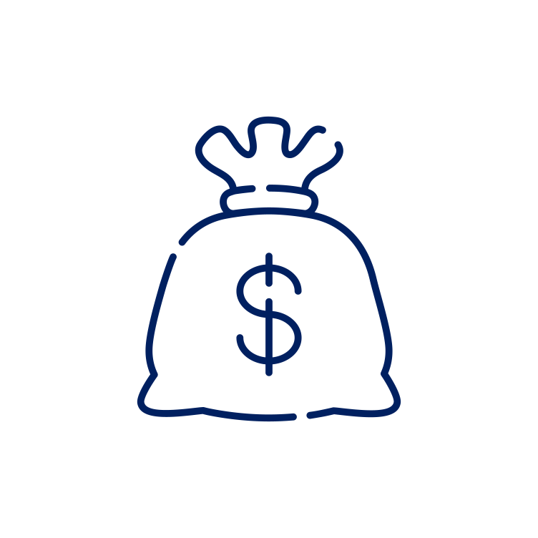
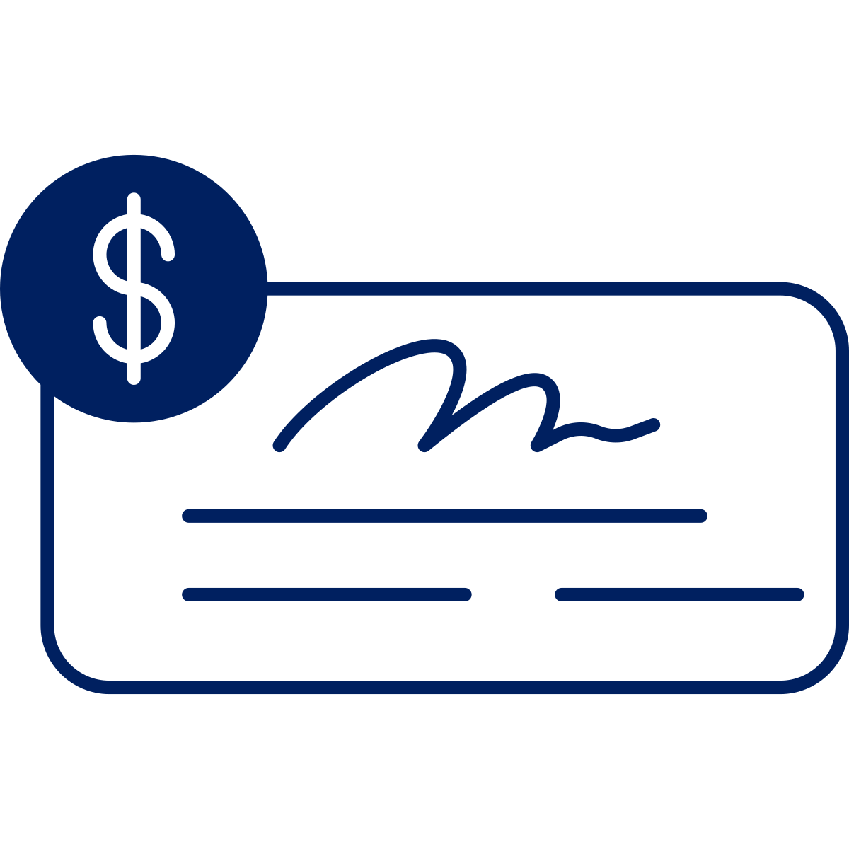
To vs. Through
Retirement Age
To Retirement
More Aggressive
More Conservative
Through Retirement
General observations for illustrative purposes only. Actual allocation of any target date fund series will vary.
Notes:
To retirement manages up to retirement age expecting you will take a lump sum at that point.
Through retirement manages through the retirement age, becoming it’s most conservative at a later date expecting you will continually withdrawal for income throughout.

Slide 34
Target Date Funds
If you were born….. | You might want to consider the …..
Before 1963 | Retirement Fund
1963 - 1967 | 2030 Fund
1968 - 1972 | 2035 Fund
1973 - 1977 | 2040 Fund
1978 - 1982 | 2045 Fund
1983 - 1987 | 2050 Fund
1988 - 1992 | 2055 Fund
1993 - 1997 | 2060 Fund
After 1997 | 2065 Fund
Notes:
Here is a chart showing the different Vanguard Target Date Funds, listed by year, with an estimate of retirement date or date of birth. For example, you can see that if you were born between 1978 and 1982, the default target date fund would be the 2045 fund. You only have to invest in one fund and do not have to make changes, unless your objectives change. The fund will automatically adjust for you over time.
You also do not have to choose the fund that relates to your date of birth. If you would like to be more aggressive or expect to retire later than age 65, you can choose a later target date fund. Conversely, an earlier target date fund could be selected if you would like to be more conservative with your investments

Slide 35
Risk Managed Strategies
Conservative
Moderate
Aggressive
15 – 30%
50 – 70%
85 – 99%
General observations for illustrative purposes only. The percentages represent a typical equity holding for the fund. Name of the fund and percentages will vary by fund company.

Slide 36
Focus on the Long-Term Goals
Notes:
Keep in mind – investing for retirement is playing the long game. If you keep those goals in mind, that should help long-term.
Person in blue – sees that money has doubled over the last 3 years and is thrilled.
Person in green – money also double, however, they are more focused on the fact that last year money was $3,000 and is now $2,000. Focused on short-term which can lead to bad decisions.

Slide 37
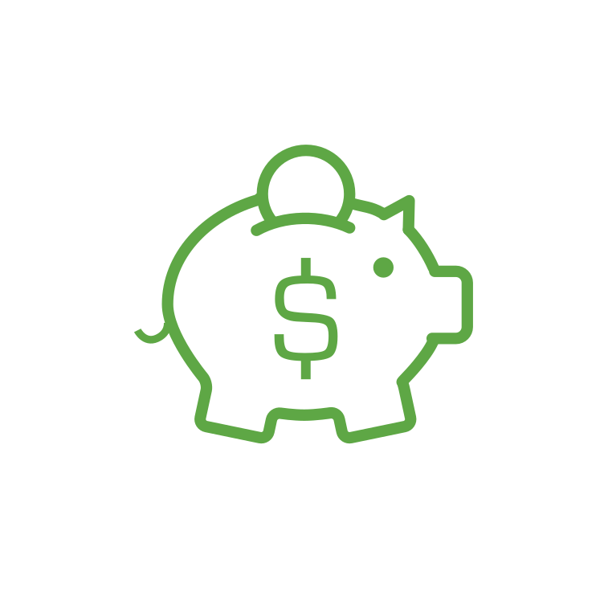
401(k) Plan Loan
Up to 50% of account $1,000 - $50,000
Maximum 1 outstanding loan
Pay back with interest over time
(typically 0-5 years)
Loans and distributions may be subject to fees, taxes and/or penalties. Review all documentation and consult with a financial professional prior to completing a withdrawal
Notes:
Within your 401k plan, you do have the option of borrowing money from yourself if you were to need to do so.
Keep in mind that when you take money out of the account, it’s not there growing for you in the background. It also may make it difficult for you to continue to make contributions as you’re paying back the loan, so do speak with a financial professional if you’re considering taking a loan from your account.

Slide 38
Post-Employment & Distributions
Distributions
Taxable distribution if separate from service
In-Service Distributions at age 59 1/2
Financial Hardship Distributions are available
Rollover to an IRA or new Retirement Plan
Loans and distributions may be subject to fees, taxes and/or penalties. Review all documentation and consult with a financial professional prior to completing a withdrawal
Notes:
Because a 401(k) is meant to help you save for retirement, there are certain restrictions for taking money out of the plan, including an additional tax penalty if you are under the age of 59 ½ when taking the distribution.
That being said, you have the option to take distributions under certain circumstances listed here

Slide 39
Setting Up Your Online Account
Have Your Welcome Letter Handy
Setup Your Account at u.bpas.com
Select Your Contribution Amount
Choose Your Investments
Designate Your Beneficiary
The plan code for enrollment is _______
This will be on your welcome letter.
Note:
Notes:
Ready to start saving for YOUR future!? Getting started with setting up your account is easy!

Slide 40
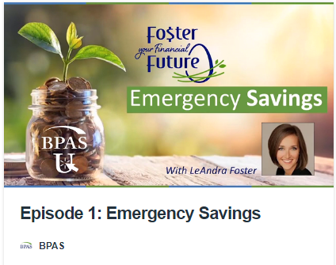
BPAS University (u.bpas.com)
Notes:
Check out BPAS University for resources such as the Savings Calculator and helpful retirement savings tips and tricks!

Slide 41
BPAS Participant Portal
Notes:
We have recently enhanced the functionality of our website. This is what it will look like when you log into your account—the home screen of the participant portal. There are a variety of tools here, as well as the ability to make changes to your account.

Slide 42
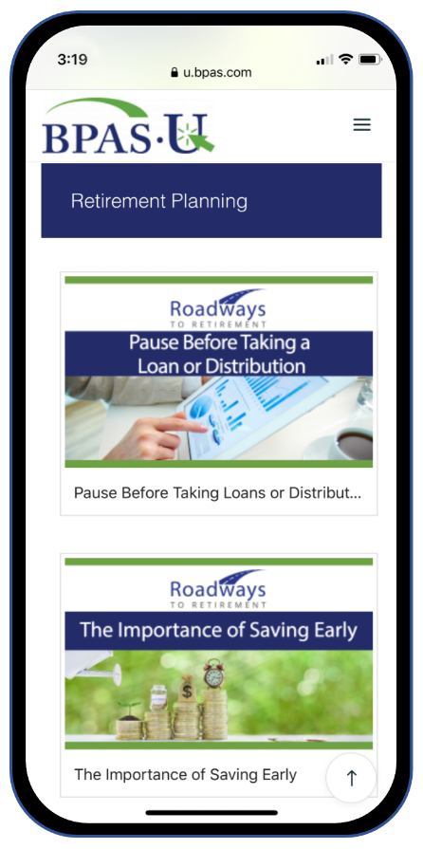
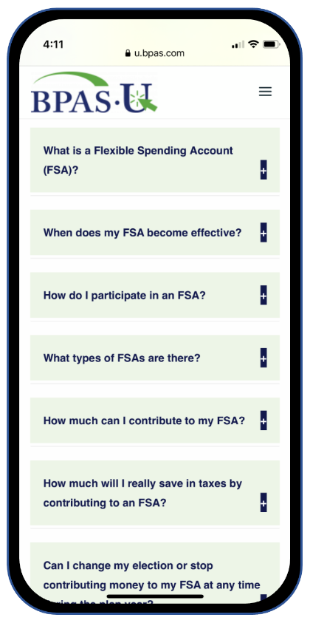
BPAS U Mobile App
Notes:
We also encourage you to download the BPAS mobile app, available in the Google Play Store and Apple App Store for easy access to these tools on the go.

Slide 43
Mile Marker Tool
Notes:
This screen shows the Mile Marker tool within your account which I really like. This tool allows you to input external financials as well as use the information in your account to help you make informed decisions about where you are on your path to retirement. You can make easy changes to salary, contribution rate, retirement age, and so forth to see how changes to your strategy might affect your account balance over time. You can use this tool to try out ideas without making changes to your account. It’s nice to be able to project what things might look like with the possible changes you can make.

Slide 44
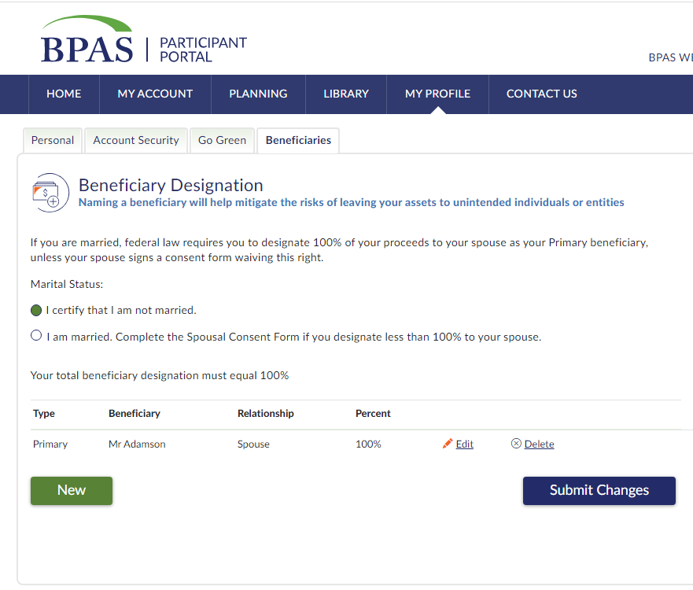
Beneficiary Designation
Notes:
Don’t’ forget to update your beneficiaries! Naming a beneficiary will help mitigate risks of leaving your assets to unintended individuals or entities should something happen to you.

Slide 45
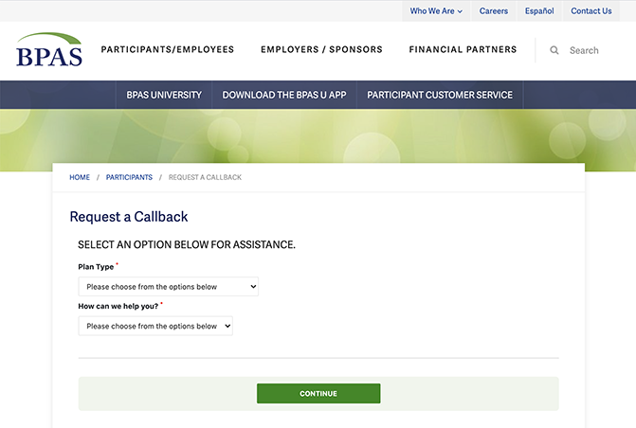
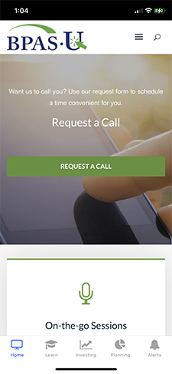
Participant Services
866.401.5272
Monday – Friday
8am-8pm ET

Slide 46
Action Steps
Some key takeaways…
Log in to your online account.
Make sure beneficiaries are up-to-date.
Ensure your investments reflect your risk tolerance.
Consider a contribution increase or setting up automatic increases.
Notes:
Finally, whether you are new just getting started, or have been saving for years, here are some great steps to take while your retirement is at the top of your mind.
Log in to your account or setup your account if you have yet to do so.
Make sure your beneficiaries are up to date, especially if you have had any recent changes in marital or parental status.
Take a look at your current investments and make sure they reflect your time horizon and retirement objectives.
Lastly, consider increasing your contribution amount or setting up an automatic increase to help reach your retirement savings goals.

Slide 47
Questions?
866.401.5272
u.bpas.com
Notes:
Thank you for watching our presentation, if you have further questions please call our participant services or visit us online. Thank you,

