Slide 1




Plan de Retiro
Presentación - 2026
Nombre del Presentador
Título del Presentador
Notes:
Good morning and welcome to this morning’s session on (plan sponsor name’s) (Plan type: 401k) Retirement Plan. My name is (Presenter Name) and I am your presenter. As I move along the presentation, feel free to submit your questions in the chat. At the end I will be answering all your questions, but I will check the chat periodically as I move along.

Slide 2


INSPÍRATE
"El retiro no es el final del camino. Es el comienzo de la carretera abierta."
Desconocido
Notes:
Let's begin our presentation with this inspiring quote: 'Retirement is not the end of the road. It is the beginning of the open highway.' This perfectly captures the essence of retirement. It shouldn't be seen as a finish line, but rather as an exciting new chapter in your life, a chapter filled with travel, hobbies, and spending time with loved ones.
Just like any road trip, a smooth retirement requires preparation. The earlier you start planning, the more time your money has to grow and the more freedom you'll have in your golden years. Whether you’re just getting started in your career, approaching retirement, or are somewhere in between, our goal is that you’ll leave today with the tools and knowledge to get on the right track for a fulfilling retirement journey.

Slide 3



¿Cuál es tu
POR QUÉ?
Notes:
Dreaming about how you envision your life in retirement can be exciting and is one way stay to motivated but making sure you have identified your retirement "Why" is a huge driving force in helping you get to your final destination. Think about your goals and why saving for the future is important to you. For example: You may be thinking about retiring from your job to start your own business, to travel, or pursue hobbies, maybe it's to spend time with family and friends, or volunteer, with your favorite charity.
Your lifestyle decisions will have a big impact on your need for income in retirement. By starting to envision how you’re going to live, you can start putting together a savings plan. And with the right planning, you can avoid a financial cliffhanger and paint a stunning picture of your future. Remember, you are the driver, and the wheel is in your hands. When you think about saving for retirement, keep your eye on the road ahead and focus in on your reasons why retirement is your desired destination.

Slide 4

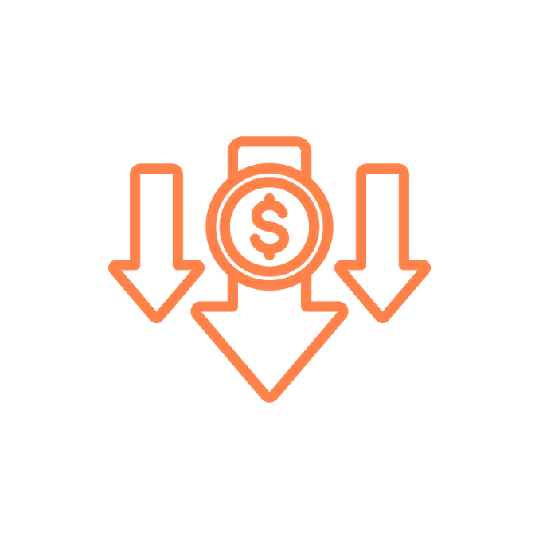


Propósito de una Cuenta de Retiro
30%
30%
100%
Solo con fines ilustrativos. El 40% de reemplazo es una regla general. El reemplazo real del Seguro Social variará. Fuente: https://www.ssa.gov/policy/docs/ssb/v68n2/v68n2p1.html
40%
Notes:
So, what is the purpose of a retirement account? If we look at the numbers, you’ll see the estimations for what we need to retire. This year (2025) the Social Security website estimates that Social Security will replace about 40% of your paycheck when you retire. You also may have about a 30% reduction in what you need once you no longer need to put money into your retirement savings and have hopefully paid off most of your debt. This leaves about 30% gap that we need to make up if we want to completely stop working. This is the purpose of a retirement account.
Before we go any further, I want to address the fact that EVERY one of us is at a different stage in our life, has a slightly different experience, family background, income, etc. A retirement account might sound like a luxury, a no-brainer, both, or anything in-between. No matter what time in your life, and no matter what perspective you’re coming from, having a retirement account ultimately is about having financial security in your later years. Not everyone has that, but we want everyone to have that, and we want you to have the tools to achieve that. So, remember your retirement "why" because it really will make contributing to your retirement account feel easier -- allowing you to pave the way to the retirement you've always dreamed of!

Slide 5
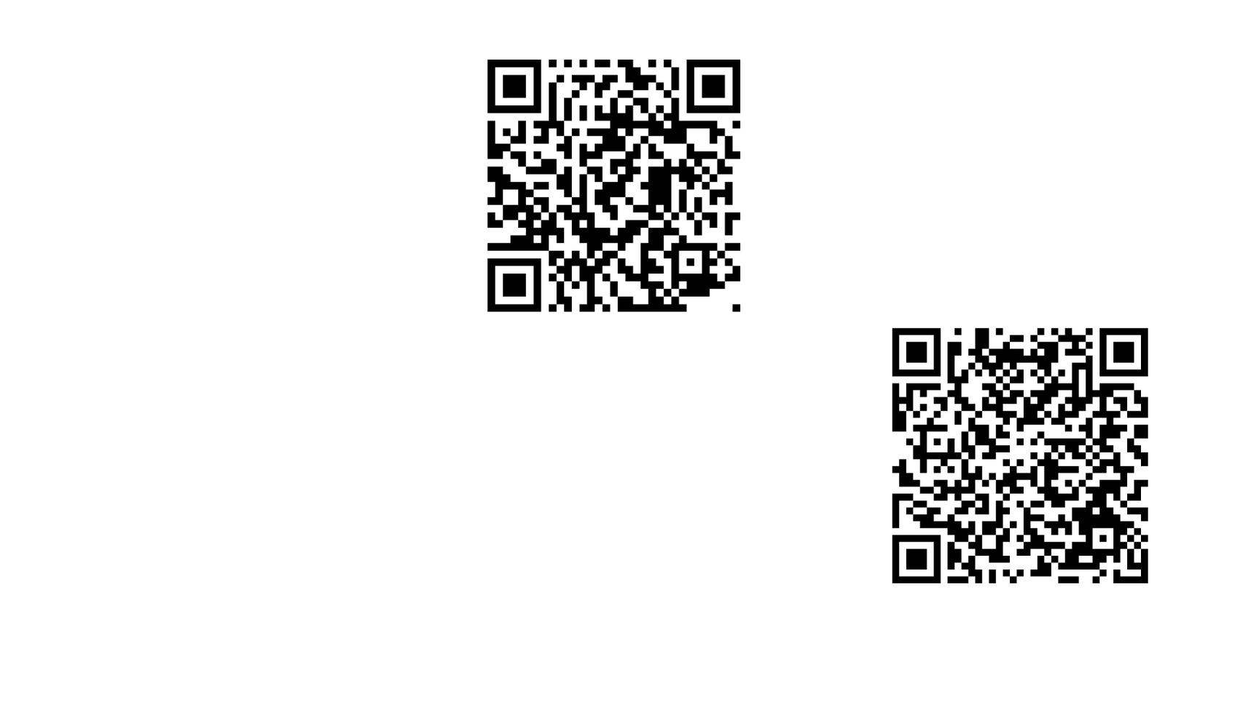


Tu Plan de Retiro
Dinero Entrante
Inversión
Ingresos Futuros
Notes:
Let's now talk about your specific retirement plan. Your (Enter Plan Name) Retirement Plan account is a (plan type: 401(k), 403 (b) etc.) plan. With this plan you can put money away now and invest the money so that it grows throughout your working years. This allows you to supplement your income throughout retirement. Think of it like funding your future business, so when you retire, the business that you created will hire you as a retiree and pay you for you to enjoy life as you wish. Put in even more simple terms, you’re creating a paycheck for your future self.

Slide 6
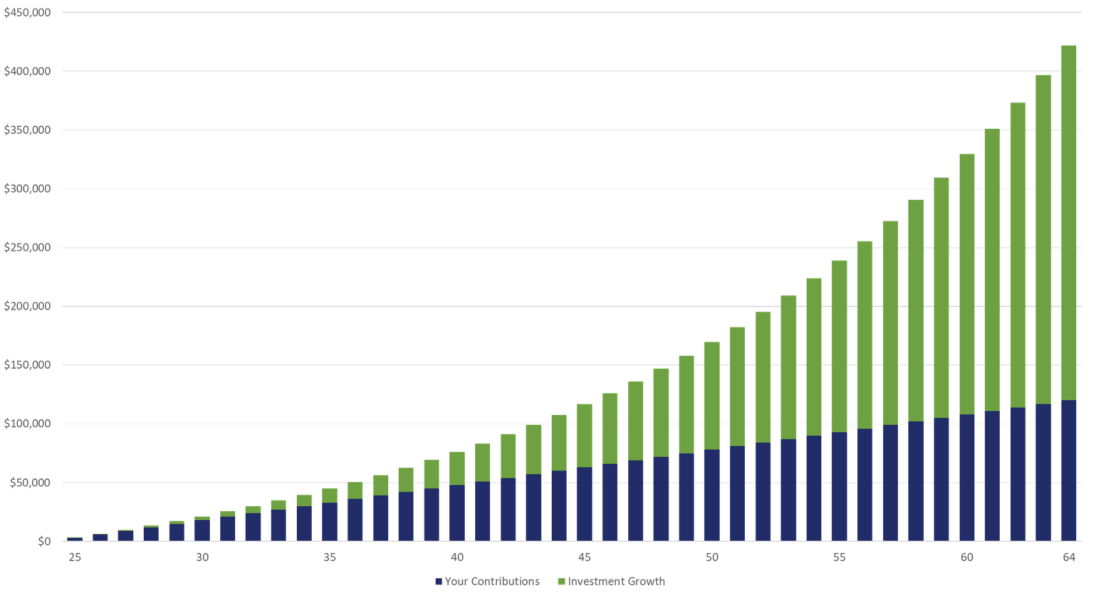
Crecimiento Compuesto
Tus aportaciones
Crecimiento de Inversiones
Ejemplo hipotético solo con fines ilustrativos. Calculado utilizando el Calculador de Ahorros 403(b)/457/401(k) en u.bpas.com. Suposiciones: aportación anual de $3,000 con una tasa de rendimiento anual del 5.5%. Los rangos de edad son aproximados, no a escala exacta.
Notes:
One of the great benefits of a (Plan type: 401(k), 403(b) etc) is the ability to invest your money and allow that to grow over time. Because of the effect of compounding growth, getting started early and being consistent can have great effects over the long term.
On this slide, we show how powerful the effect of compounding interest is. At first, the growth in the account seems very modest, maybe even non-existent. However, over time, as your investments grow and compound on one another, the effect becomes more impactful. You can see that at about age 49, half the value is investment growth (green). By age 65, the investment growth is almost 3 times what you have actually contributed (blue) over the years.
It’s never too late to start, so if you have not started savings for retirement yet, there is no time like the present!

Slide 7

Aportación Antes de Impuestos
Aportación Libre de Impuestos
Retiro
Sujeto a Impuestos
Crecimiento con Impuestos Diferidos
Impuestos
Notes:
There are (REMOVE " Two different ways" if no ROTH) two different ways that you can contribute to your account, each with different tax advantages.
The first, is pre-tax contributions, which is sometimes referred to “traditional”. Pre-tax contributions allow you to defer your taxes until you start taking qualified withdraws. That means, whatever you contribute to your (plan type: 401(k), 403 (b) etc.) account, is tax free now, and taxable when you take those withdraws in retirement. This may be most beneficial if you have a higher tax rate now than what you expect it to be when you start taking withdraws.

Slide 8
Aportación Roth
Aportación Sujeto a Impuestos
Retiro LIBRE
de Impuestos
Crecimiento LIBRE de Impuestos
Impuestos
Las aportaciones Roth no pagan impuestos cuando sacas el dinero; sin embargo, las ganancias pueden estar sujetas a impuestos si la cuenta no ha existido por al menos 5 años y se retiran antes de cumplir 59 años y medio, muerte o discapacidad.
Notes:
Optional: Remove if not applicable
The second way that you can contribute is called a Roth contribution. Roth contributions essentially work in the opposite way as pre-tax contributions. Roth contributions are taxable now, however, when you start taking qualified withdraws, your contributions and the growth within the account, will be tax free.
Roth contributions may be beneficial if your tax rate is lower now than what you expect it to be in the future.
Finally, in order for Roth withdraws to be tax free, you must have the account for 5 years, AND be 59 ½ . Or if the distribution is due to death or disability.
When you decide to contribute, you could do one or the other or both and you can split it however you like.

Slide 9


Efecto de tu aporte en tu Cheque
ANTES DE IMPUESTOS
ROTH
Cheque Semanal: $1000
Ingreso sujeto a impuesto: $1000
Impuestos Retenidos (18%): $180
Pago Neto: $820
Aportación: $60
Ingreso que paga impuestos: $940
Impuestos Retenidos: $169
CHEQUE FINAL:
$771
Aportación: $60
Ingreso que paga impuestos: $1000
Impuestos Retenidos: $180
CHEQUE FINAL:
$760
Jose
ANTES DE IMPUESTOS
ROTH
Cheque Semanal: $500
Ingreso sujeto a impuesto: $500
Impuestos Retenidos (18%): $90
Pago Neto: $410
Aportación: $50
Ingreso que paga impuestos: $450
Impuestos Retenidos: $81
CHEQUE FINAL:
$369
Aportación: $50
Ingreso que paga impuestos: $500
Impuestos Retenidos: $90
CHEQUE FINAL:
$360
Monica
Notes:
Optional: Remove if no ROTH
If you were to start contributing today, this is what it would look like.
Using our friends Larry and Jenny as examples:
Larry's weekly paycheck is $1,000 less taxes his take home pay is $820. If Larry were to contribute $60/week pretax his take home pay will be $771 after income taxes. notice his taxable income is reduced by $60. If he contributed the same amount to his ROTH 401k, his taxable income remains $1000, the same as someone making no contribution. The difference is that all ROTH contributions and any earnings would now be eligible for withdrawal tax free when taking qualified withdrawals after age 59 and 1/2 and after holding the account for at least 5 years. In all, both contribution types offer tax benefits, but you enjoy those benefits at different times.

Slide 10


Identificando tus metas de ahorro
¿Cuándo Planeas Retirarte?
La edad a la que planeas retirarte puede tener un gran impacto en la cantidad que necesitas ahorrar. Cuanto más pospongas el retiro, más tiempo tendrán tus ahorros para crecer.
Estilo de Vida en el Retiro
¿Cómo quieres vivir en el retiro? ¿Esperas que tus gastos suban, bajen o se mantengan igual?
Gastos Médicos
Utiliza una HSA para proyectar y ahorrar para tus gastos médicos
¿Cuánto Tiempo Quiero que Duren Mis Ahorros de Retiro?
Muchos están sobreviviendo a sus ahorros--la forma más sencilla de estimar cuánto durará tu dinero en el retiro es comparar tus ahorros totales, más los rendimientos de inversión a lo largo del tiempo, contra tus gastos anuales.
Ten Paciencia
Ahorrar para el retiro requiere mucha planificación, paciencia y determinación.
Notes:
Determining the right amount to save for retirement can be overwhelming.
Estimating how much to save involves two main challenges. First, predicting your future expenses and income needs for a retirement that may be years or even decades away can be tricky. Secondly, even after setting a target, it can be challenging to determine if you are saving enough to reach that target.
Consider the following when setting your retirement goal:
When do you plan to retire?
What lifestyle do you hope to have in retirement?
Forecast any medical expenses
How long do you hope your retirement savings lasts you?
and last but not least, remember to be patient. Saving for retirement involves a great deal of patience, planning and determination.

Slide 11


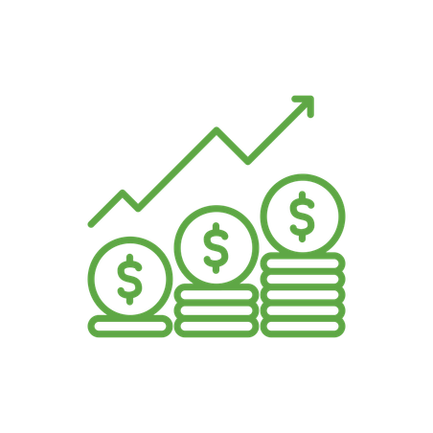







¿Cuánto Debo Aportar?
50% - Necesidades
30% - Deseos
20% - Ahorros
Del 20% total de ahorros, los expertos en retiro recomiendan 10-15% hacia el retiro.
Notes:
A common question we receive is – how much should I actually be contributing? One commonly-used budgeting rule is called the 50/30/20 rule. This rule tries to break your spending up into three categories: Needs, Wants, and Savings. Try and keep spending for needs such as housing, food, transportation to around 50% of your income. For wants, such as vacation, entertainment, dining out, try to keep this amount at about 30% of you income. This will leave you with 20% of your income for savings. Most experts will recommend savings 10-15% of your income towards retirement savings. If you can do that, and save the other 5-10% to pay debt or create an emergency fund, this should leave you help you get on track for your retirement needs.

Slide 12

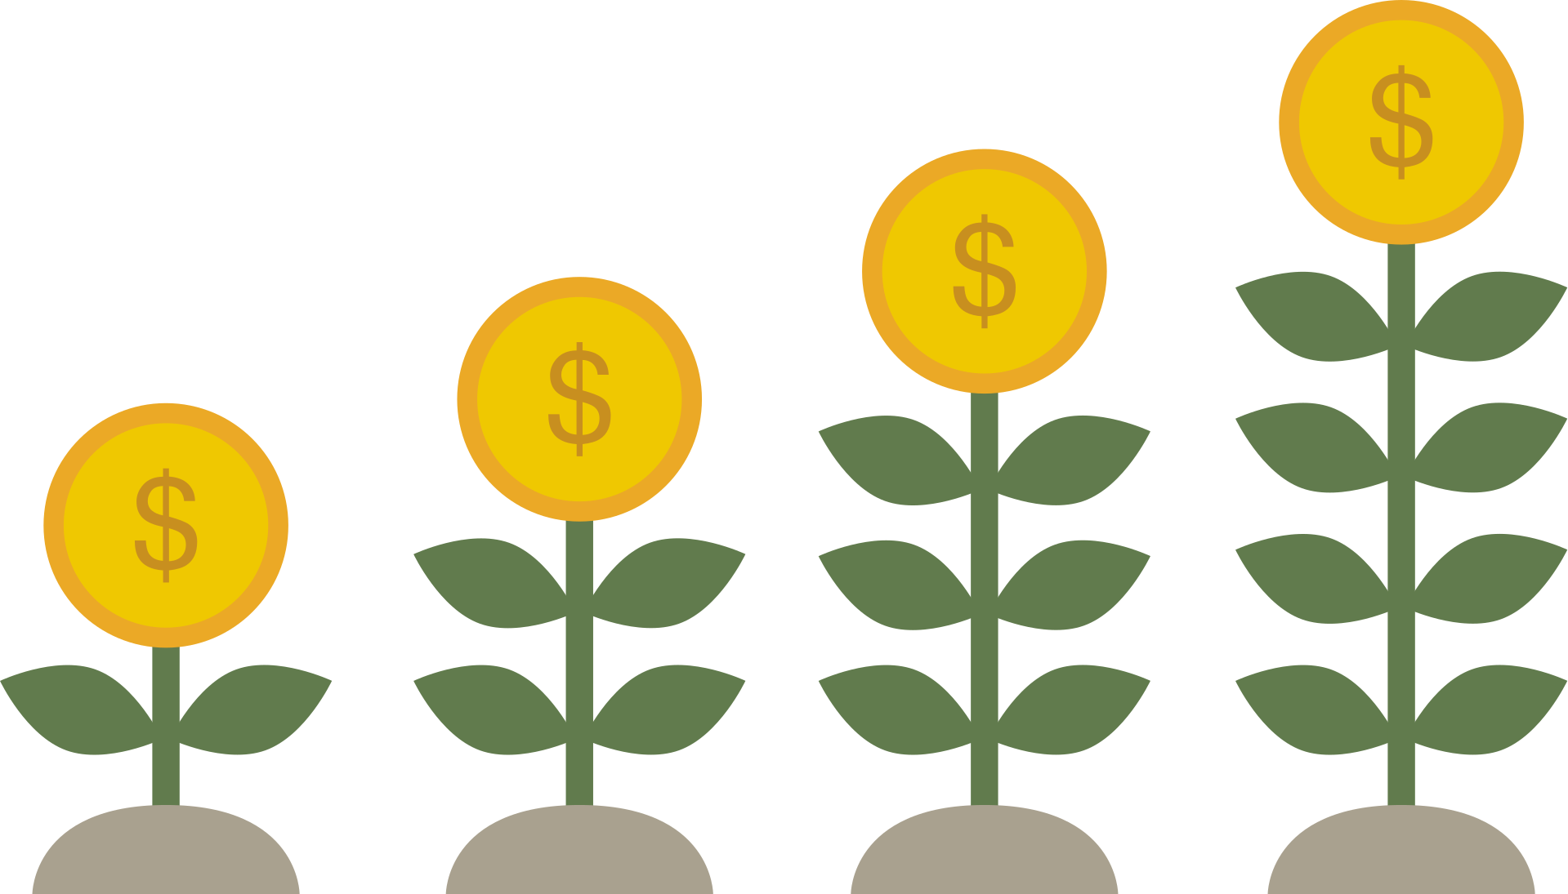
Empieza a Ahorrar Temprano
¡Aprovecha al máximo el crecimiento compuesto y permite que tu dinero genere rendimientos para ti!
Empezar a ahorrar temprano significa menos preocupación por ponerte al día en el futuro.
Consejos y Trucos:
  Una vez que seas elegible, inscríbete en tu plan de inmediato.
  Hacer una pequeña aportación es preferible a no hacer ninguna aportación.
  Si aún no eres elegible, comienza a apartar la cantidad que deseas contribuir ahora.
Notes:
Make the most of compound interest by starting to save now. Experts recommend saving 70 to 80% of your income for retirement. Time is your friend; time allows your money to grow and reduces the stress of reaching your savings target. Even if you think it's too late, remember the proverb: "The best time to plant a tree was 10 years ago, and the second-best time is today." Making small and affordable contributions now is better than making no contribution at all.

Slide 13

Detalles Sobre Tu Plan de Retiro
11
Notes:
Next we will discuss your specific plan details

Slide 14


Para Empezar
Elegibilidad
Ingreso al Plan
Inscripción
Empleado/Empleador:
  agregar disposiciones aquí
Empleado / Empleador:
  agregar disposiciones aquí
En línea en u.bpas.com
El código del plan para la inscripción
se encuentra en su carta de bienvenida.
Notes:
As a (plan sponsor name) employee, you are eligible to participate in the retirement plan (insert eligibility). To Enroll, all you need to do is log into your BPAS retirement account online, select your contribution amount and investments and watch your nest egg grow!
When enrolling, you will need the enrollment code found in the Welcome Letter you should have received mailed to your home address upon eligibility.
Optional: If after a year you are not participating in the plan you will be automatically enrolled.

Slide 15
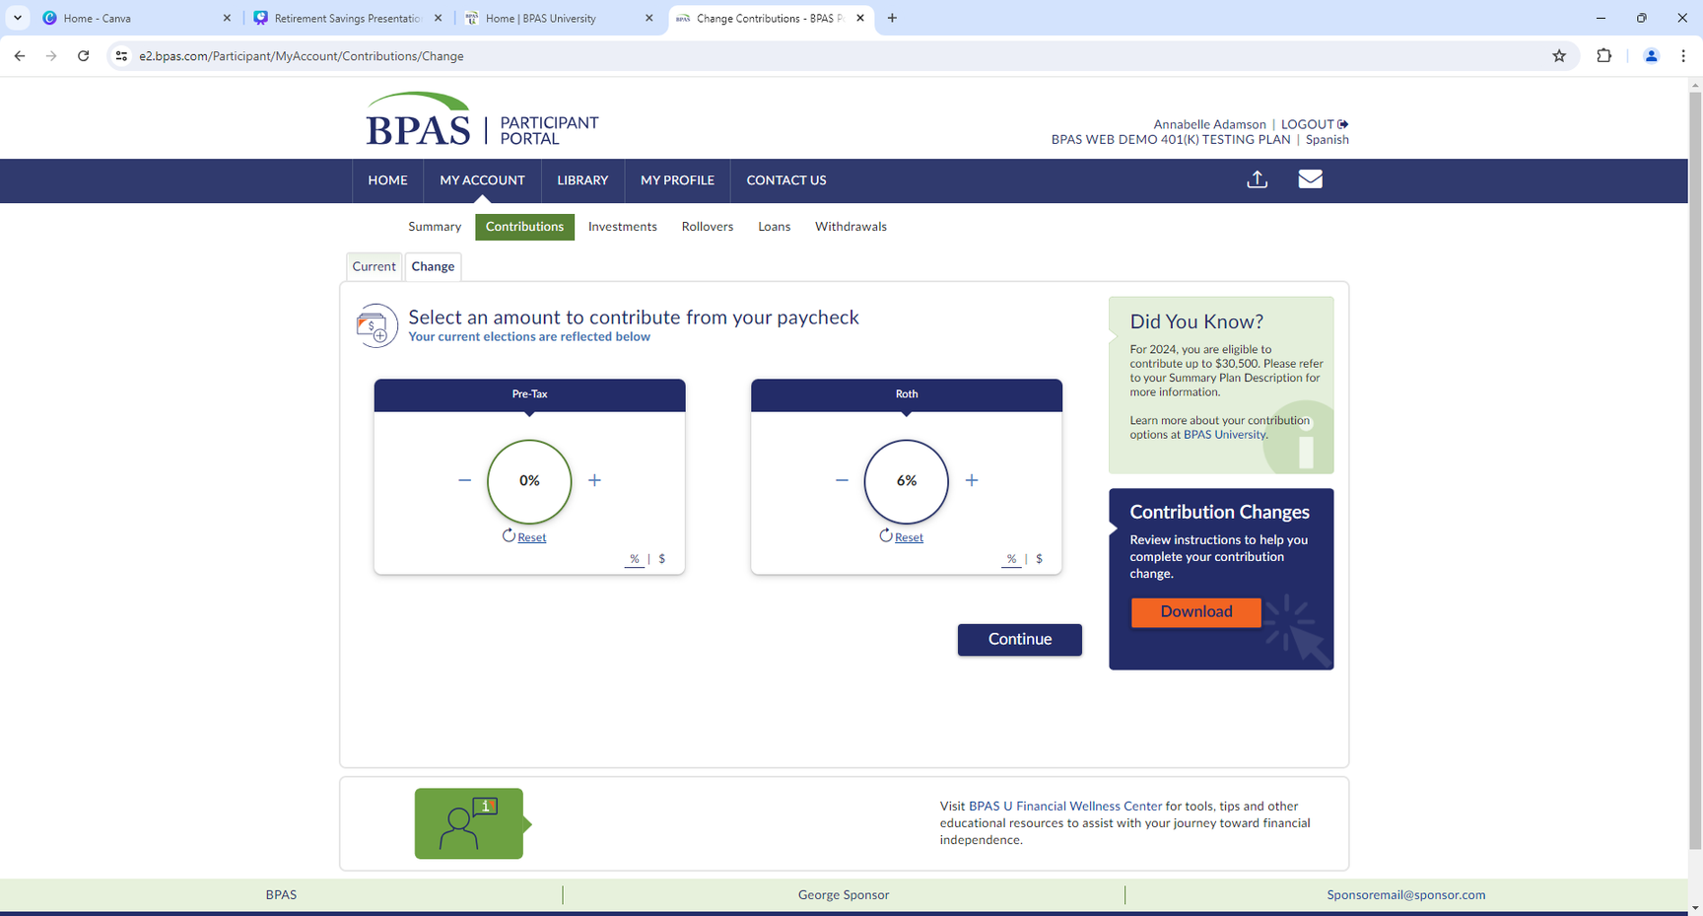
Inscripción Automática y
Re-Inscripción
  Inscrito automáticamente al __% del salario en el _______, según su fecha de nacimiento
    Después de 1 año de servicio, será inscrito automáticamente el primer día del siguiente trimestre calendario: 1/1, 4/1, 7/1 o 10/1
  Recibirá una carta por correo antes de la inscripción automática
  Un aumento automático de ___% ocurrirá cada año en su aniversario hasta alcanzar ___%
  Re-inscripción: Los empleados no inscritos o que contribuyen menos del __% serán re-inscritos
Haga cambios en línea
    Inicie sesión en su cuenta en u.bpas.com
    Elija Aportaciones en la Página Principal o en Mi Cuenta y seleccione Aportaciones
Notes:
Optional: Remove if plan does NOT feature Auto Enrollment
Your plan features automatic enrollment.
If you are automatically enrolled in the plan….
Talk about each of the points on the screen.

Slide 16
Aportaciones al Plan de Retiro
Usted
    Aporta hasta el límite del IRS (2026) – $24,500
    Personas de 50 Años o Más – $8,000 adicionales
    Personas de 60-63 Años – $11,250 adicionales
    Aportaciones antes de impuestos y/o Roth deducidas automáticamente de su cheque de pago
    ¡Puede cambiar el monto de su aportación en cualquier momento!
Empleador
    (Nombre de la Empresa) iguala sus aportaciones: _______________
    Contribución no electiva: ________________________________
    Las contribuciones del empleador se hacen antes de impuestos
    Obtendras el 100% de derecho a las contribuciones del empleador estarán después de _________años de servicio.
Notes:
Let’s look at the different ways money comes into the plan….
Your contributions, your employer's matching contributions or contributions rolled over from another retirement savings account.
Update slide with Plan Info & Talk about each of the points

Slide 17
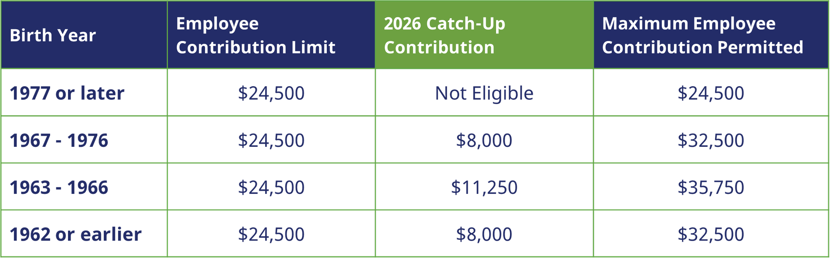
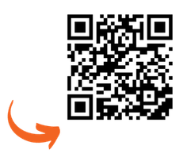
Aportaciones de Catch-Up
Si sus salarios FICA de 2025 superaron $150,000: Sus aportaciones de catch-up deben hacerse como Roth.
Para información adicional, visite u.bpas.com/catch-up-contributions

Slide 18




Transferencias Calificadas
Escanee para Descargar el Formulario de Trasferencia
Conveniente
Fácil: Vista integral de su preparación para el retiro.
Fácil
Conveniente: Un sitio web.
Un estado de cuenta.
Flexibilidad
Flexibilidad: Fácil acceso a su dinero desde una sola cuenta al momento del retiro.
Tranquilidad
Tranquilidad: Reduzca el riesgo de perder de vista sus cuentas de retiro.
Contacte a un Especialista en Transferencias Entrantes al
866-401-5272 Ext. 35007
Notes:
Consolidating your accounts into one place simplifies tracking your overall retirement progress. You can see your total retirement savings at a glance and get a clearer picture of your readiness for retirement. It also gives you the opportunity to manage everything in a single location. No more logging into multiple accounts or sifting through different statements. That also makes it potentially easier to access your funds when you retire ultimately streamlining the process of withdrawing or managing your retirement income. And finally, it can potentially reduce the chance of losing track of retirement accounts you may have left with previous employers.

Slide 19

Aportación Discrecional del Empleador
(Nombre de la Empresa) iguala el 100% del primer 3% que usted aporte
Luego el 50% del siguiente 2% que usted aporte
Al contribuir el 5%, usted recibe la aportación completa de (Nombre de la Empresa) del 4%
Notes:
REMOVE if no match
Let's talk a little more about that Employer match.
Your (Company Name) plan provides for discretionary employer matching contributions on elective deferrals made into your 401(k) plan. (Company Name) will match ___% of the first ___% you contribute. The discretionary matching contribution will be made on both pre-tax and ROTH after-tax contributions. However, contributing both pre-tax and after-tax ROTH deferrals does not increase the match amount a participant can receive.

Slide 20
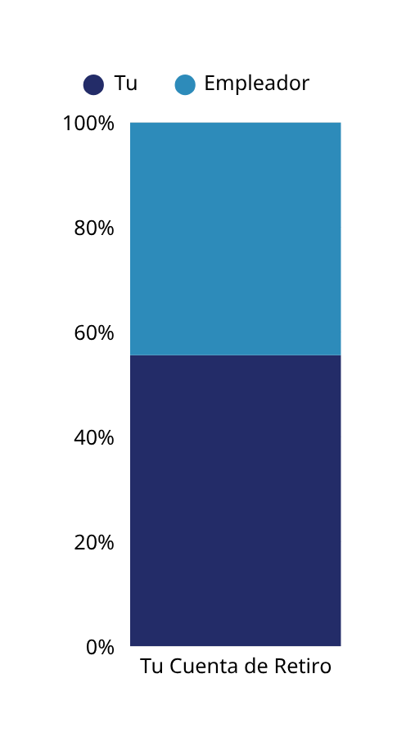
Valor de la Aportación del Empleador
Salario​ | 5% de Aportación | 3% Pareo del Empleador​ | ​Total de tu aportación junto con el de tu empleador​​
$20,000​ | $38​ | $23 | $61
$30,000​ | $57 | $34 | $91
$40,000​ | $76 | $46 | $122
$50,000​ | $96​ | $57 | $153
$60,000​ | $115​ | $69 | $184
$70,000​ | $134​ | $80 | $214
Los cálculos se basan en un ciclo de pago quincenal con 26 períodos de pago por año.
Notes:
Optional: Be sure to customize slide to reflect accurate match percentages.
The chart below shows a better idea of how much the deduction is in each paycheck depending on your annual salary. For example, an employee with a salary of $30,000 per year contributes 5%, taking full advantage of the company's 3% match. This employee has a total pre-tax deferral of $57 per paycheck, an employer matching contribution of $34 for a total biweekly contribution of $91. Start thinking of a dollar amount or percentage you would be comfortable with. Every little bit counts and remember that something is better than nothing!

Slide 21
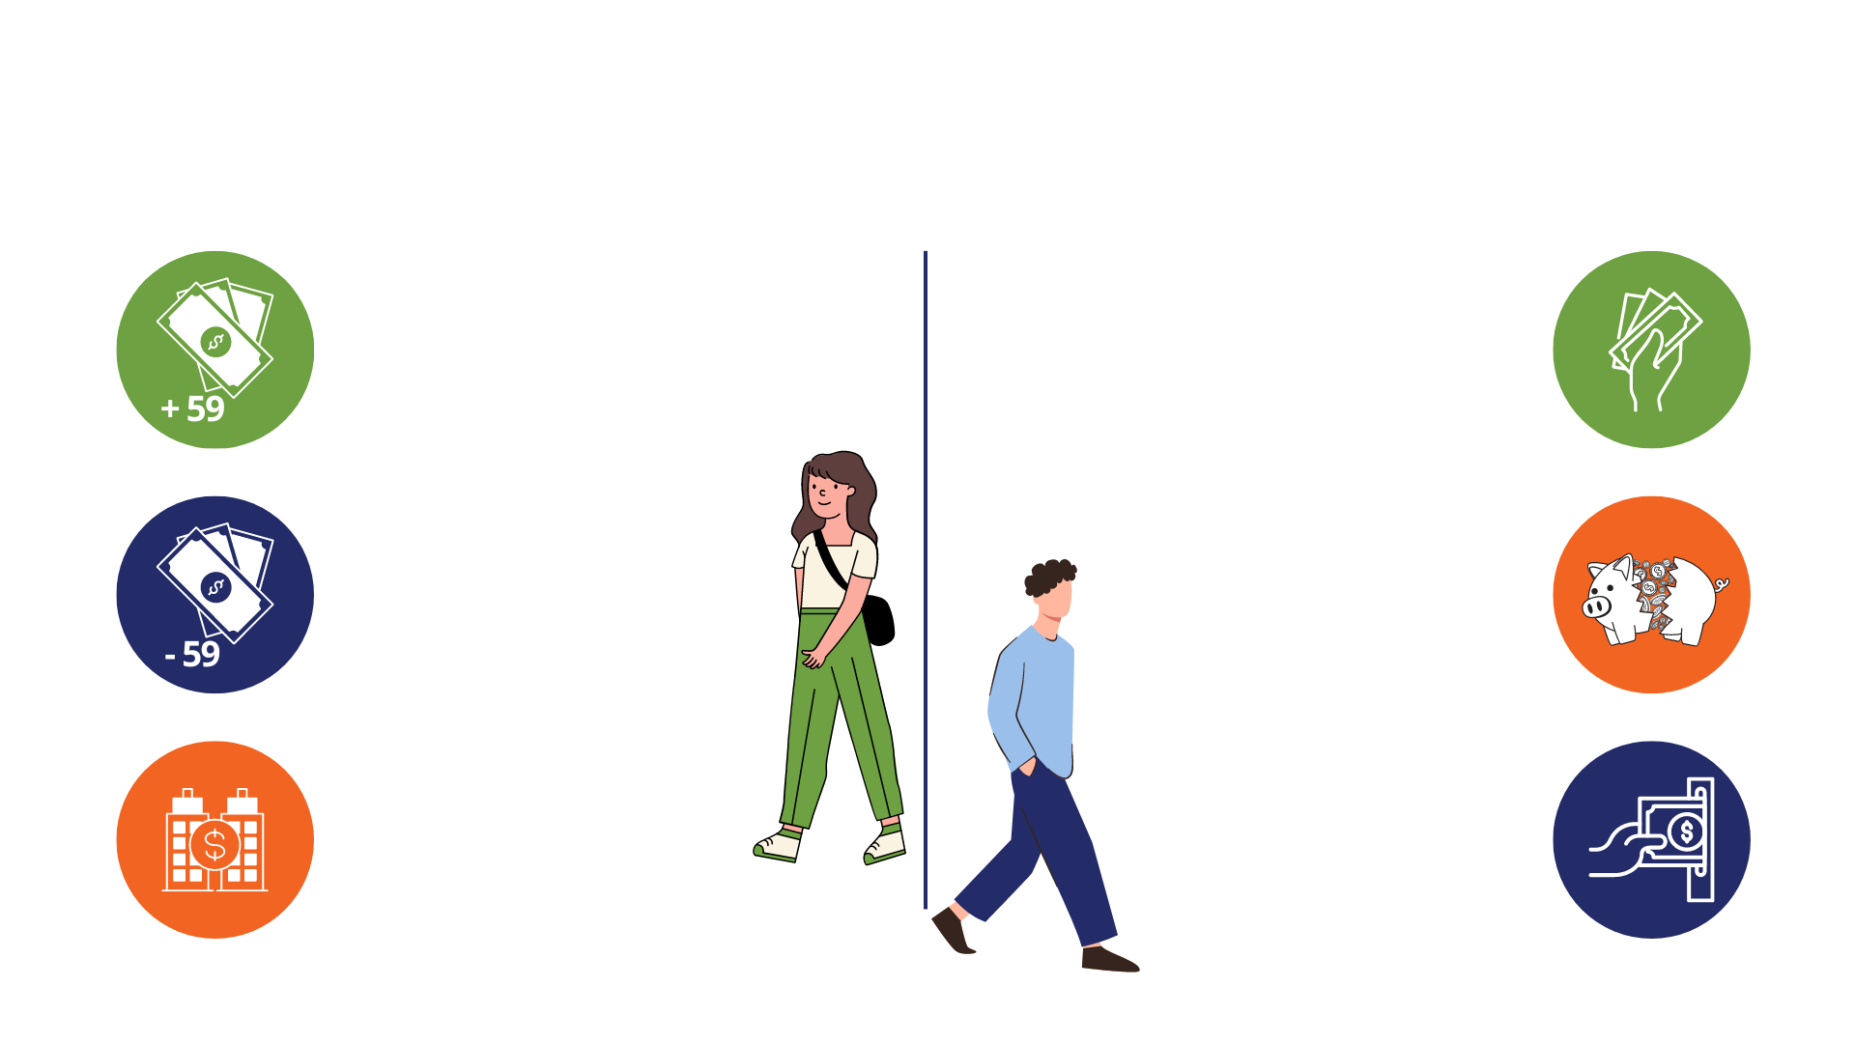
Cómo Retirar Dinero de un 401(k)
CUANDO DEJA SU EMPLEO
CUANDO AÚN ESTÁ EN SU EMPLEO
Retiro Regular del 401(k)
Los retiros pagan impuestos, pero
no hay penalidad después de los 59
Préstamo del Plan 401(k)
Pida prestado fondos con interés. El monto mínimo del préstamo es $1,000 con un préstamo vigente a la vez.
Retiro por Dificultad Económica
Permitido, sujeto a restricciones. Verifique los requisitos de elegibilidad y documentación en línea o llame a Servicios para Participantes de BPAS.
Retiro Anticipado del 401(k)
Se aplican impuestos más una penalidad fiscal del 10%
Transferencia del 401(k)
Transferir a una IRA u
otro plan de retiro
del empleador. Sin impuestos.
Sin penalidades.
Retiro en Servicio
Permitido mientras aún está empleado si tiene más de 55 años
Notes:
Because a Workplace Retirement Plan is meant to help you save for retirement, there are certain restrictions for taking money out of the plan, including an additional tax penalty if you are under the age of 59 ½ when taking the distribution.
That being said, you have the option to take distributions under certain circumstances listed here

Slide 22

Préstamo del Plan
  Puede solicitar hasta el 50% del saldo de su cuenta, desde $1,000 hasta $50,000
  Pague el préstamo con interés durante un período de tiempo, generalmente dentro de 0-5 años
  Número Máximo de Préstamos Vigentes: 1
Los préstamos y distribuciones pueden incurrir en cargos, impuestos y penalidades.
Regla de 30 Días: Después de pagar un préstamo en su totalidad, debe esperar 30 días antes de solicitar uno nuevo.
Antes de hacer un retiro, revise cuidadosamente toda la documentación y consulte a su asesor financiero.
Notes:
OPTIONAL: Remove if plan doesn't allow loans
One nice feature within your plan is the ability to borrow money from yourself through a 401(k) plan loan.
If necessary, you may request up to 50% or $50,000 of your account balance and repay the loan with interest.
However, it is important to remember that withdrawing funds from your account means you're missing out on potential growth. It could also hinder your ability to make contributions while repaying the loan. It's advisable to consult with a financial expert before deciding to take a loan from your account.

Slide 23

Inversiones
Notes:
Next we will discuss investments.

Slide 24

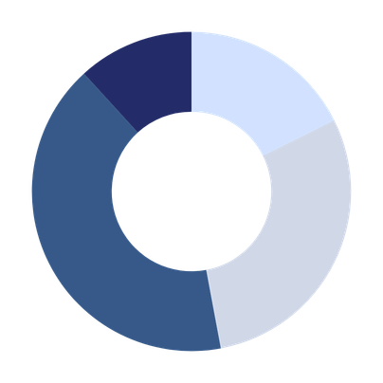

Estrategias de Inversión
Asignación de Activos
Eliges una combinación de fondos que incluyen efectivo, bonos y acciones según tus objetivos, tolerancia al riesgo y horizonte de tiempo.
El enfoque 'Hazlo tú mismo'
Fondo de Fecha Objetivo/Riesgo
Eliges un fondo que ya está diversificado según tu fecha objetivo de retiro o tu tolerancia al riesgo.
El enfoque 'Contratar a alguien'
Notes:
There are two investment strategies: Asset Allocation or the “do it yourself” approach and the Target Date/Risk Fun or the “hire someone” approach.
If you are someone who is familiar with and have a solid understanding of terms such as time horizon, stocks, bonds & risk tolerance then asset allocation may be the way to go. Asset allocation is the idea of determining the best asset class mix based on your needs and objectives.
Alternatively, if you're like me and are not a DIY’er the Target Date/Risk fund may be a better solution. Target date funds are a blended fund that automatically adjusts for you, as you get closer to retirement. In your early working years when you are far from retirement, a target date fund will be heavily invested in equities such as stocks, to allow your account to maximize it’s growth. As you move closer to retirement, the fund will automatically invest in more fixed income options such as bonds and money market funds. This is meant to reduce risk over time to secure the gains in your account, as you near retirement.

Slide 25






Horizonte de Tiempo
Inicio de Carrera
30,000 Pies
Media Carrera
20,000 Pies
Final de Carrera
10,000 Pies
El Retiro
Destino Final
Solo con fines ilustrativos. Este proceso sugerido de asignación basada en riesgo no pretende representar asesoría de inversión apropiada para todos los inversionistas. La asignación de cada inversionista debe basarse en sus metas personales, horizonte de tiempo, recursos financieros, tolerancia al riesgo y otros factores pertinentes. Dado que la situación de cada persona es diferente, debe consultar a un asesor financiero para determinar la asignación óptima apropiada para usted.
Notes:
Determining your comfort level of Risk can be depicted here. Early in your career or flying comfortably at 30,000 feet your tolerance for turbulence or risk is higher and not as scary. However, the closer you get to landing or retirement the less tolerant of turbulence or risk you become.

Slide 26
Tipos Básicos de Inversiones
Mercado Monetario | Bonos | Acciones
Por lo general, invierten en una variedad de inversiones que generan intereses. Generalmente ofrecen un rendimiento más bajo, pero con muy poco o ningún riesgo relacionado con el mercado de valores. | Son préstamos que un inversionista hace a una institución (una empresa o el gobierno) a cambio de una tasa de rendimiento previamente establecida. Sus características pueden incluir: plazo, pagos de intereses y solidez financiera de la entidad. | Representa la propiedad parcial de una empresa. Es la inversión más propensa a cambios de valor a corto plazo. A menudo se clasifica según el tamaño y el estilo de la empresa.
"Renta Fija"
"Acciones"
Menor
Mayor
Riesgo Potencial/Rendimiento Potencial
Solo con fines ilustrativos. Observaciones generales únicamente.
La volatilidad en cualquier período puede variar de lo anterior.
Notes:
There are three basic types of investments: Money market funds, bonds, and stocks.
Bonds are debt securities that entitle the holder to receive interest payments. They're essentially IOUs from companies or governments. You loan them money, and in return, they pay you a steady stream of interest. You also get your original investment back at that point. This predictable income can be a valuable part of your retirement plan, helping you cover your essential expenses.
Stocks (Higher risk/higher return)
A stock is essentially a piece of ownership in a company. When you buy a stock, you're buying a share (like a tiny slice) of that company. Imagine a company cuts up its ownership into millions of pieces of paper, and you buy a few of those pieces. That's kind of how stocks work. This technically means that over the long run, you'll make money from stocks if the business continues to grow and make money. You can also make money off stocks when share prices increase or when the board of directors declares a dividend payment. Same as if the business is not doing so well, then the value of the stock price drops. This is what makes stocks a riskier investment.
Lower risk, lower return – the more money market and stable value.

Slide 27






Asignación de Activos
La asignación de activos es la estrategia de crear un portafolio equilibrado de inversiones de
renta fija (bonos, efectivo, valor estable) e inversiones de acciones (acciones nacionales, acciones extranjeras) basado en el horizonte de tiempo, objetivos, tolerancia al riesgo y más.
No existe una solución única para todos; tu asignación de activos es específica a tus necesidades, metas y preferencias.
Tu asignación de activos debe cambiar con el tiempo a medida que tus metas o necesidades cambien.
Renta Fija
Acciones
Toma el cuestionario de tolerancia al riesgo en u.bpas.com
Tu Portafolio
Notes:
Here’s a little more detailed view of what asset allocation looks like. And it’s the process of dividing an investment portfolio among different asset categories, such as stocks, bonds, real estate, and commodities, in order to achieve a desired risk and return profile. Asset allocation can be a key factor in achieving investment goals, as it helps investors balance risk and reward, and can potentially enhance long-term investment returns. It should be based on an investor's individual risk tolerance, investment goals, and time horizon.
If you want help with determining personal results to what your asset allocation should be, go to u.bpas.com and take the risk tolerance quiz. You may also scan the QR Code shown on the screen

Slide 28



Tu Menú de Inversiones
Mercado Monetario/
Reservas de Efectivo
Bonos
Mixto
Acciones
Internacional
Sector/
Especialidad
    El portal de BPAS tiene una gran cantidad de información sobre las inversiones disponibles en tu plan.
    Para obtener más información, inicia sesión en tu cuenta y navega a la pestaña de Investigación bajo Inversiones.
    Podrás completar la siguiente investigación:
      Enlaces de Fondos: Junto a cada nombre de inversión, puedes ver el prospecto haciendo clic en el ícono P o una hoja informativa del fondo haciendo clic en el ícono F. Es importante revisar cuidadosamente la información de inversión antes de seleccionar tus opciones de inversión.
      Rendimiento de Fondos: Al expandir cada opción de inversión podrás ver Precios Históricos, Datos de Referencia y el Ratio de Gastos Netos.
Notes:
UPDATE SLIDE with Plan specific investments.
Now let’s go over your plan’s investment menu. Listed here are the different investments that you have available to you in your (Plan Type) plan. Also shown are the different categories under which these investments fall. Just like the former slide, the options on the left contain the lowest risk and each option to the right includes more risk, with the opportunity of higher returns.
Being too heavily weighted in any one fund may cause your portfolio to lack diversity and either be too aggressive or too conservative. Using asset allocation and investing in a variety of funds will help increase your account diversity and protect you in the event that any one fund underperforms.
The blended options, aim to automatically balance your portfolio using stocks to maximize growth and bonds to minimize risk.

Slide 29
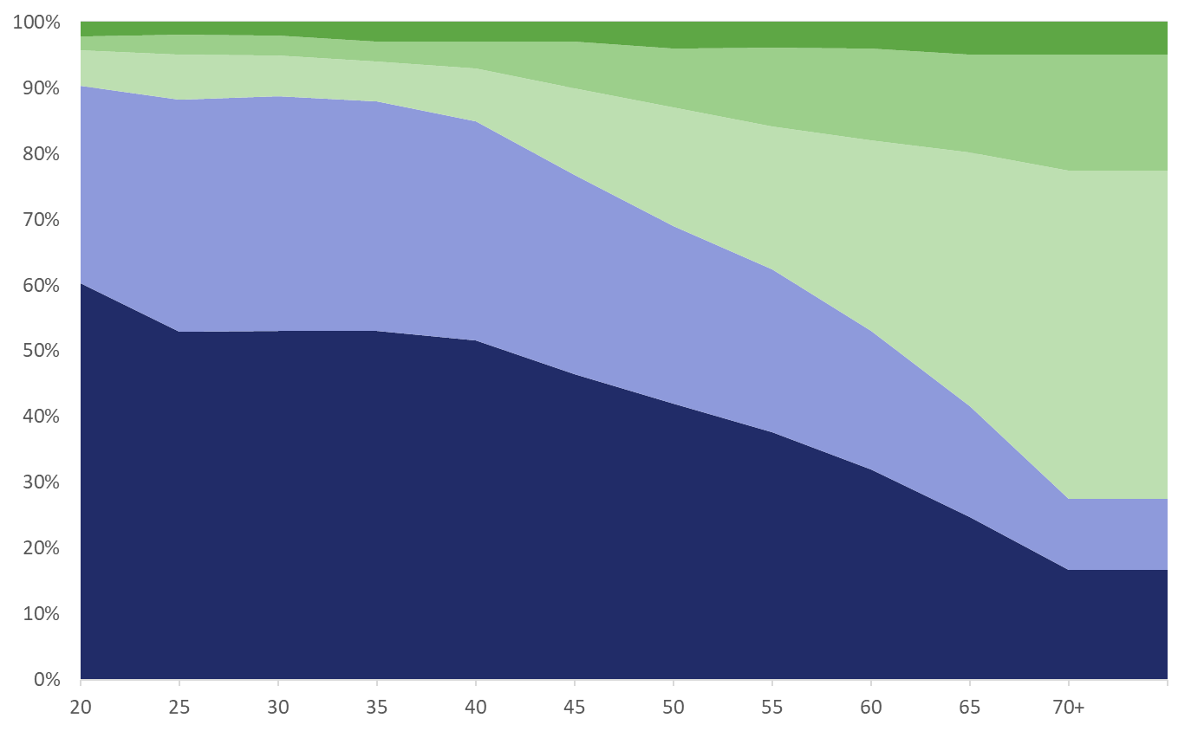

Fondos con Fecha Objetivo
Retiro Esperado
Efectivo
Bonos Extranjeros
Bonos EE.UU.
Acciones Extranjeras
Acciones EE.UU.
Porcentaje de Asignación
Edad
Con fines ilustrativos. No es específico de ninguna serie de Fecha Objetivo.​ Los tipos de fondos, la edad esperada de retiro y los porcentajes de renta variable y renta fija varían según el fondo.
Notes:
A couple of slides ago, I mentioned that blended funds invest in multiple different categories in order to maximize return while minimizing risk. In your (Plan Type), you have Target Date funds as an available investment option. These target date funds are a blended fund that automatically adjusts for you, as you get closer to retirement.
In your early working years when you are far from retirement, a target date fund will be heavily invested in equities such as stocks, to allow your account to maximize its growth. As you move closer to retirement, the fund will automatically invest in more fixed income options such as bonds and money market funds.
This is meant to reduce risk over time to secure the gains in your account, as you near retirement. Each company’s target date funds are different, but the above chart gives an idea of this investment strategy.

Slide 30
Menú de Fondos con Fecha Objetivo
Si Naciste | Fondo que deberias considerar | Numero estimado a tu fecha de retiro
2003-2007 | Target Retirement 2070 | 45 Años
1998-2002 | Target Retirement 2065 | 40 Años
1993-1997 | Target Retirement 2060 | 35 Años
1988-1992 | Target Retirement 2055 | 30 Años
1983-1987 | Target Retirement 2050 | 25 Años
1978-1982 | Target Retirement 2045 | 20 Años
1973-1977 | Target Retirement 2040 | 15 Años
1968-1972 | Target Retirement 2035 | 10 Años
1963-1967 | Target Retirement 2030 | 5 Años
1958-1962 | Target Retirement 2025 | Cerca del Retiro
1953-1957 | Target Retirement 2020 | En Retiro
Antes de 1953 | Target Retirement Income Fund | En Retiro
Fondos con fecha objetivo basados en la edad normal de retiro
Notes:
Here is a chart showing the different Target Date Funds, listed by year, with an estimate of retirement date or date of birth. For example, you can see that if you were born between 1978 and 1982, the default target date fund would be the 2045 fund. You only have to invest in one fund and do not have to make changes, unless your objectives change. The fund will automatically adjust for you over time.
You also do not have to choose the fund that relates to your date of birth. If you would like to be more aggressive or expect to retire later than age 65, you can choose a later target date fund. Conversely, an earlier target date fund could be selected if you would like to be more conservative with your investments

Slide 31





Diversificación
La diversificación es como una dieta balanceada.
Distribuye tus inversiones en diferentes activos para
promover el crecimiento y minimizar los riesgos.
Diversificar tu portafolio es esencial para mantener la estabilidad financiera.
Actúa como un escudo contra el colapso financiero total, asegurando la riqueza a largo plazo.
¡La revisión regular de tu cuenta es importante!​
Notes:
Diversification is the strategy of distributing your money across various investments to foster growth while reducing risk.​ Think of it as a balanced diet. While eating broccoli is a healthy choice, you wouldn't want to eat just broccoli. To have a healthy balanced meal you need broccoli, water, maybe some fruit and a grain. Instead of investing heavily in a single asset and facing potential financial loss, diversifying your portfolio safeguards your financial stability. By diversifying, you shield yourself from complete financial downfall. Diversification is crucial for establishing lasting wealth.
Regular review of your account is important!​​
Monitor the balance, contributions, projected balances, and investment allocations. Often adjustments may be needed
due to changes in investment strategy or performance.

Slide 32


Enfóquese en las metas a largo plazo
$3,500
$2,500
$3,000
$1,500
$700
$500
$1,000
Notes:
Remember, investing for retirement is a long-term strategy. Maintaining a focus on your goals will aid in the long run. It's crucial to maintain a balanced view and consider both short-term fluctuations and long-term trends when evaluating your investments. Emotional reactions to market volatility can often lead to impulsive decisions that might undermine your overall financial goals.
To further illustrate, let's take the example of two investors. The individual in Blue steadily contributes a fixed amount to their retirement fund every month, regardless of market conditions. Over time, this disciplined approach, known as dollar-cost averaging, reduces the impact of market volatility and helps in accumulating wealth consistently. Meanwhile, the individual in green attempts to time the market, buying and selling based on short-term predictions. This strategy, while potentially lucrative, often results in missed opportunities and increased stress.
Ultimately, a well-thought-out and diversified portfolio, paired with a calm and patient mindset, is often the most effective way to secure a prosperous retirement. Regularly reviewing and adjusting your investment strategy to align with your evolving goals and risk tolerance is also key.

Slide 33


Tu Cuenta en Línea
Notes:
Ready to start saving for YOUR future!? Getting started with setting up your account is easy!

Slide 34






Crea Tu
Cuenta en Línea
Aunque no estés aportando hoy, deberías seguir estos pasos para proteger tu identidad.
Ten Tu Carta de Bienvenida a Mano
Configura Tu Cuenta en u.bpas.com
Selecciona Tu
Monto de
Aportación
Elige
Tus Inversiones
Designa a Tu Beneficiario
El código del plan para inscripción se encuentra en tu carta de bienvenida.
Notes:
Visit u.bpas.com and have your plan code and welcome letter handy! Your plan code can be found on your Welcome Letter. Once logged in you will need to select your contribution amount, choose your investments and designate your beneficiaries.

Slide 35
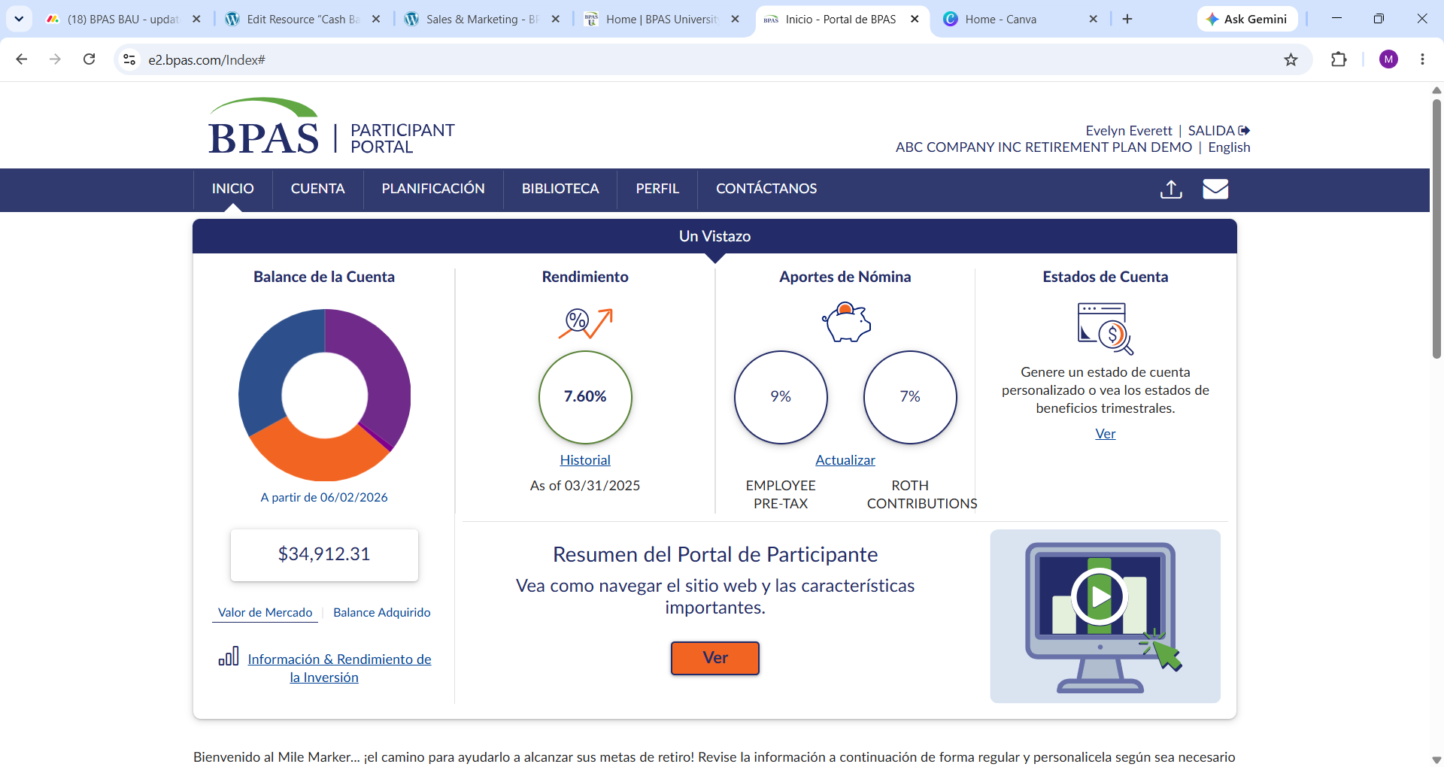
Notes:
When you log into your account, you will see the participant portal's home screen, which includes various tools and options to manage your account.

Slide 36

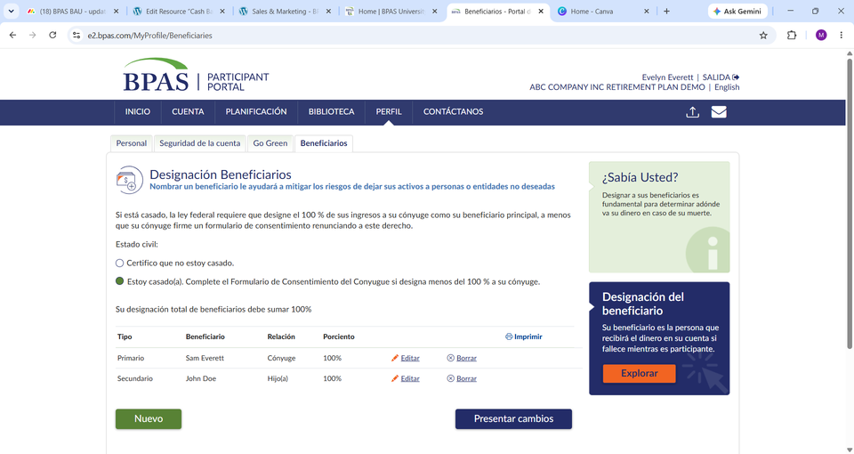

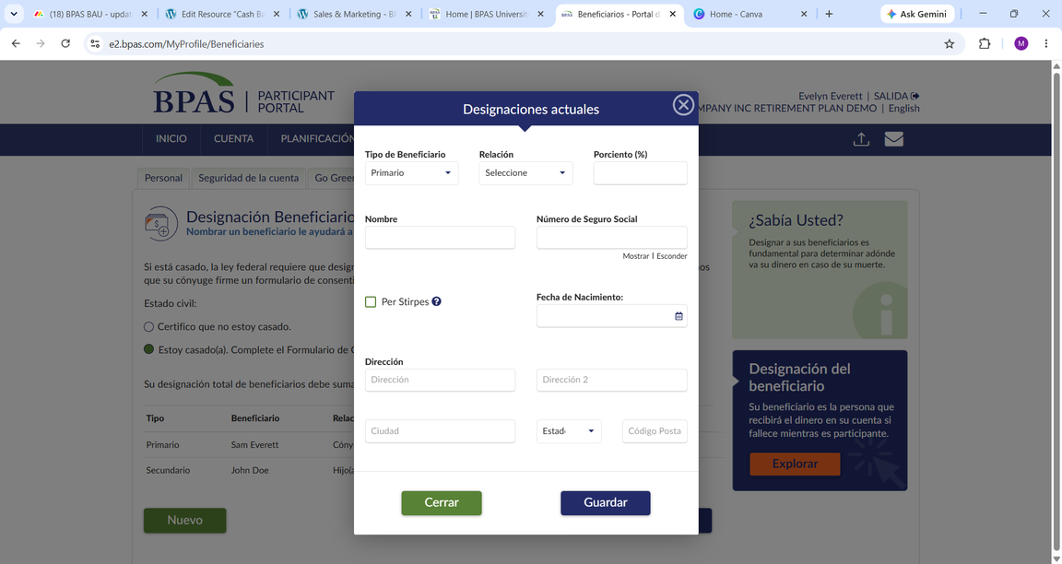
Beneficiarios
¡Revisa Tus Beneficiarios Frecuentemente!
Después de cambios de vida como matrimonio, divorcio, fallecimiento o nacimiento en la familia para asegurar tranquilidad para ti y tus seres queridos.
Actualiza tus beneficiarios en cualquier momento iniciando sesión en tu cuenta en u.bpas.com
Navega a Mi Perfil y elige la pestaña de Beneficiarios.
Agrega tus Beneficiarios Primarios y Secundarios y guarda cuando termines.
Recuerda designar un beneficiario para cada una de tus cuentas BPAS, guarda una copia con tus documentos de patrimonio y consulta con un abogado de patrimonio para consistencia en las elecciones de beneficiarios.
Notes:
Last but not least: Don’t’ forget to update your beneficiaries! Naming a beneficiary will help mitigate risks of leaving your assets to unintended individuals or entities should something happen to you.
Adding or updating a beneficiary is easy! Simply log in to your account select My profile & then the beneficiaries tab.

Slide 37

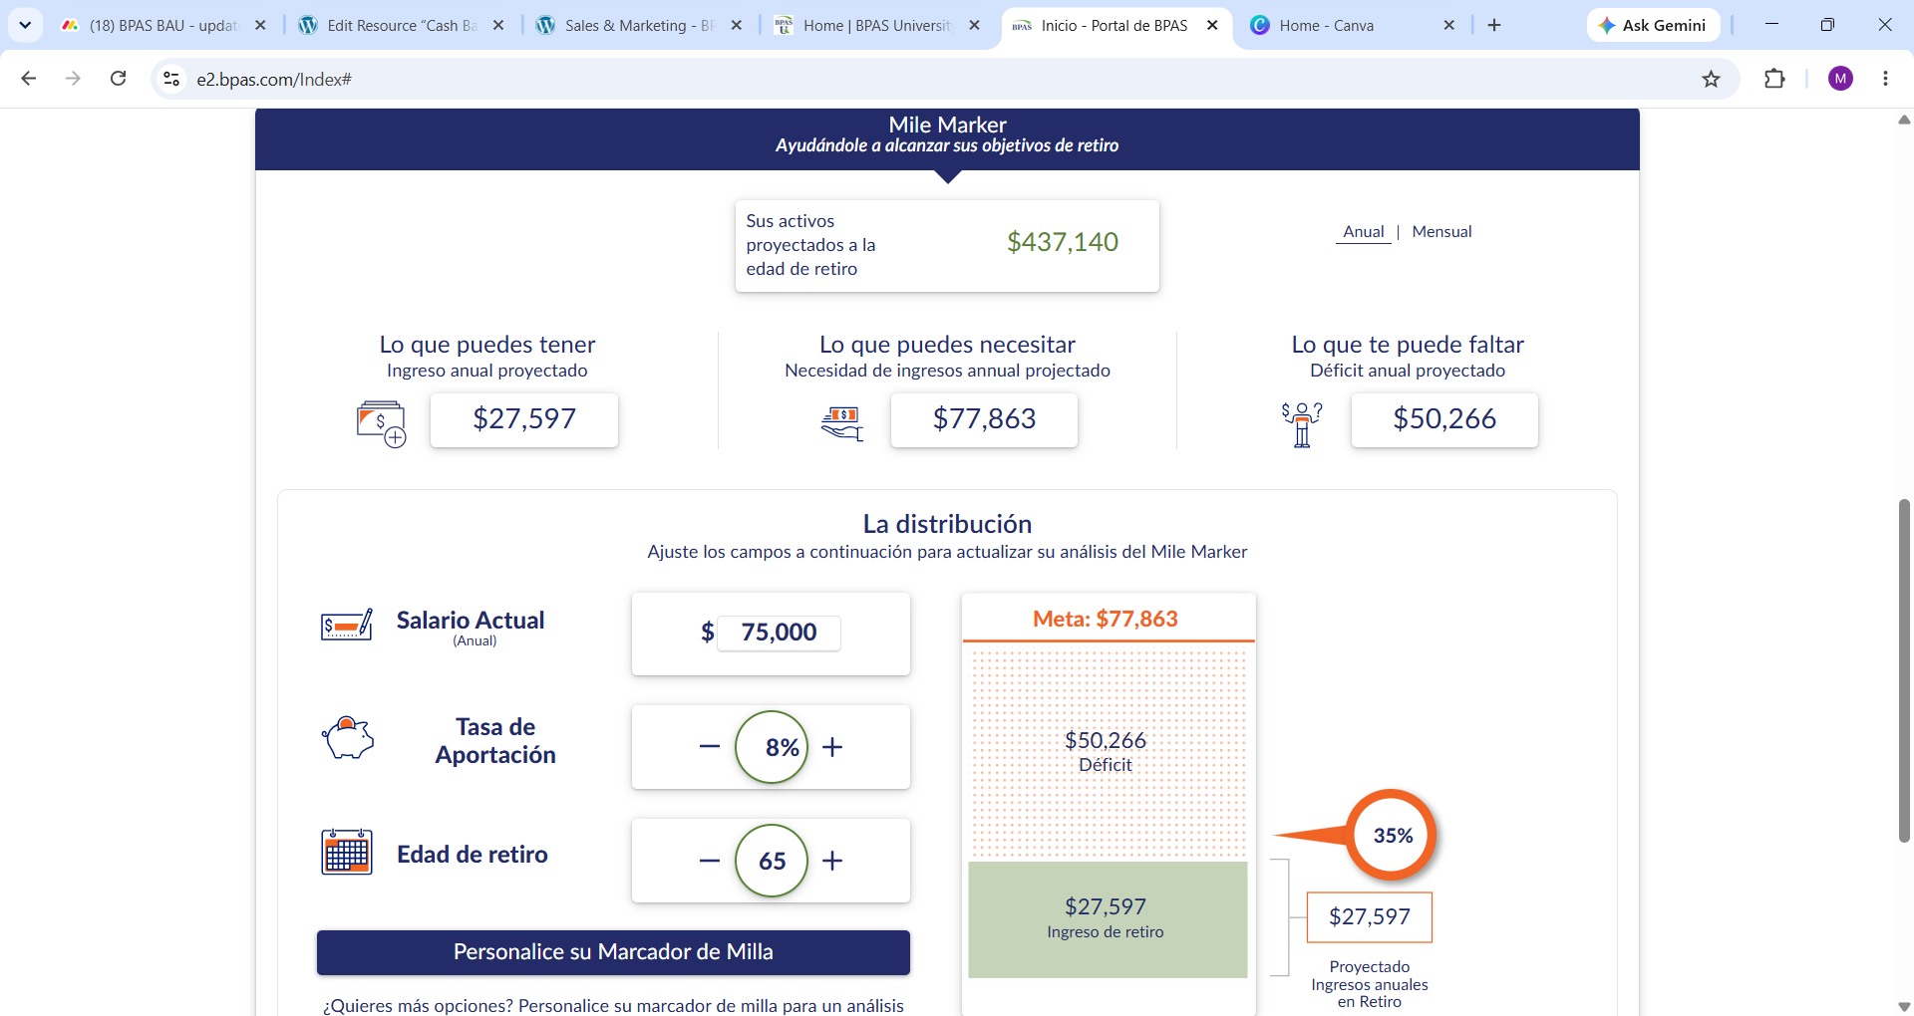







PASOS
Calculadora de Proyección
Salario proyectado, tasa de rendimiento y edad de retiro
Aportaciones
Beneficios del Seguro Social
Necesidades de ingreso en el retiro
Cuentas de retiro adicionales
Activos adicionales
Deudas a largo plazo
Notes:
A great tool available to you and directly tied to your retirement account is the mile marker tool.
This tool allows you to input external financials as well as use the information in your account to help you make informed decisions about where you are on your path to retirement. You can make easy changes to salary, contribution rate, retirement age, and so forth to see how changes to your strategy might affect your account balance over time. You can use this tool to try out ideas without making changes to your account. It’s nice to be able to project what things might look like with the possible changes you can make.
​

Slide 38






Universidad BPAS
866.401.5272 | u.bpas.com
Desde consejos de presupuesto hasta estrategias de inversión, BPAS University ofrece información valiosa para ayudarte a tomar decisiones financieras acertadas.
  Herramientas de Planificación Financiera
  Artículos del Blog
  Consejos Rápidos
  Cursos de Autoestudio
  Calculadoras Financieras
  Videos y Podcasts
  Cuestionarios
  Cuestionario de Tolerancia al Riesgo
  ¡Y Mucho Más!
Explora BPAS University y administra tu cuenta desde cualquier lugar, en cualquier momento.
Visita u.bpas.com o descarga la App BPAS U en Google Play o la App Store.
Notes:
Check out BPAS University for a wide variety of planning tools such as retirement planning calculators, a risk tolerance quiz, retirement progress tracker and tons of videos with helpful tips and tricks to prepare you for your retirement.

Slide 39

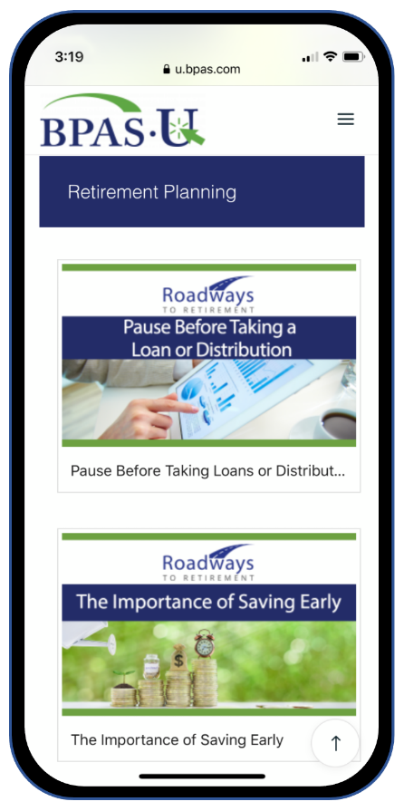

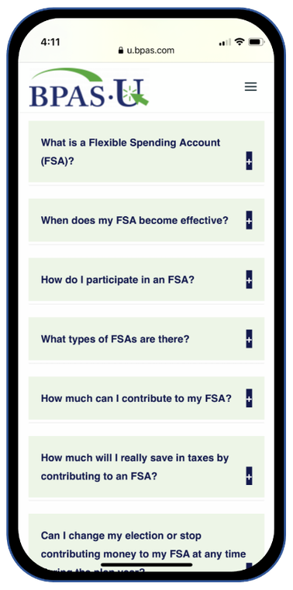


Aplicación Móvil BPAS University
Utiliza herramientas y recursos multimedia gratuitos
Pon a prueba tus conocimientos sobre temas financieros
Recibe notificaciones cuando haya contenido nuevo
Inicia sesión de forma segura en tu cuenta BPAS
Notes:
Download our mobile app today for access to your account & retirement resources from anywhere anytime! Available from the App Store or Google Play. Scan QR Codes on your screen to download now.

Slide 40



Centro de Servicios al Participante
Servicios al Participante
866-401-5272
Hay representantes disponibles de lunes a viernes, 8 am a 8 pm EST.
Todas las llamadas son grabadas y archivadas con fines de calidad y educación
Notes:
If at anytime you have questions or need assistance with your account and you need to get in touch with someone at BPAS, you can contact the Participant Services Center. The Participant Services Center is fully staffed with BPAS employees located across the US. You will be able to speak with a live representative Monday through Friday 8am to 8pm EST and you will have a few ways to get in contact with them. You can call them at the number listed on the slide, request a representative calls you, or you can send them a secure message. You will be able to find Participant Services contact information in your online account.

Slide 41


Lista de Tareas
Inicia sesión en tu cuenta en u.bpas.com
Ajusta tus aportaciones o configura aumentos automáticos
Revisa/actualiza tu información personal en Mi Perfil
Revisa/actualiza/agrega beneficiarios a tu cuenta
Revisa tus inversiones según tu tolerancia al riesgo
Opte por estados de cuenta y notificaciones electrónicos
Notes:
Finally, whether you are new just getting started, or have been saving for years, here are some great steps to take while your retirement is at the top of your mind.
Log in to your account or setup your account if you have yet to do so.
Make sure your beneficiaries are up to date, especially if you have had any recent changes in marital or parental status.
Take a look at your current investments and make sure they reflect your time horizon and retirement objectives.
Consider increasing your contribution amount or setting up an automatic increase to help reach your retirement savings goals.
Lastly, opt to "go green" and receive all statements and notices online.

Slide 42








Evita Quedarte Estancado
Aumenta tu Aportación.
Un poco es mejor que nada.
Sigue aprendiendo. Revisa los materiales en BPAS University.
Lee los materiales anuales proporcionados por tu plan.
¡Empieza hoy!
¡Tu yo del futuro te lo agradecerá!
Empieza a Contribuir
Mantén tu información de contacto actualizada.
Revisa tus inversiones con frecuencia.
¿Siguen siendo apropiadas?
¿Necesitas rebalancear?
¿Cuál será tu ingreso de retiro?
Haz una proyección de retiro usando Mile Marker u otra herramienta de planificación.
Notes:
How do we avoid getting financially stuck? Maybe you are disciplined in moving money to your savings but If you're anything like me, there have been countless times I have not moved money into my savings because I'm short for month but immediately stop at Taco Bell or grab a Starbucks when I feel that pang of hunger. Reality is we make it work. Somehow, I pay the bills AND find a way to feed my cravings -- The same can be true for setting aside money for retirement. Start small, set aside $20/paycheck, increase your contributions overtime. Something is better than nothing! Use the tools available to you at BPAS U and start today!

Slide 43

¿Preguntas?
Notes:
Now, I will open it up for any questions you may have.

Slide 44
Gracias
Notes:
Thank you for watching our presentation, if you have further questions, please call our participant services or visit us online. Thank you and have a great rest of your day!

