Slide 1




Your
ESOP Plan
Presentation - 2025
Presenter Name Here
Presenter Title Here

Slide 2

What’s an ESOP?
  Employee Stock Ownership Plan (ESOP) is a tax-advantaged retirement plan.
  Contributions are made into company stock allowing employees to hold shares in the company they work for.
  Employer contributions only
Notes:
Employee Stock Ownership Plan (ESOP):
a retirement plan where your employer makes contributions of employer stock for retirement on your behalf.
an extra benefit, in addition to your compensation and other benefits
contribution are made by the employer into company stock

Slide 3


ESOP Highlights
Easy Enrollment
Eligibility
Plan Entry
Add Provisions Here
Add Provisions Here
As soon as you meet the eligibility requirements, BPAS and your employer will automatically create your account.
Notes:
Enrollment
BPAS works closely with your employer to track eligibility. Once you are eligible, BPAS will enroll you, setting up your account for the future contributions. While it is important that you understand when you are eligible, you do not need to compute your hours or enroll in the plan.

Slide 4

Stock Details
If publicly traded, include Ticker Symbol
The stock in your account is valued: (select one or create your own)
  Daily, with the close of the stock market
  Annually
Only employer contributions are made into an ESOP. You cannot purchase stock or contribute to this account.
You can make changes to your ESOP: (select one or create your own)
  At any time
  Annually
  Upon attainment of age ___ and ___ years of service
  Upon termination of employment

Slide 5

Contributions
Customize for Your Plan’s Contribution
Once you meet the eligibility criteria, ABC Company will contribute x% of your annual salary into an ESOP.
These contributions will be made on an annual basis.
Notes:
Contributions
ESOP contributions are made by the employer only and are made into company stock, whether publicly traded or privately held. The amount of stocks contributed are based upon a company formula, typically using your years of service and compensation as part of the calculation.

Slide 6
Vesting Schedule: 3 Year Cliff
1 Year
2 Years
3 Years
0%
0%
100%

Slide 7





Vesting Schedule: 6 Year Graded
1 Year
2 Years
3 Years
20%
40%
0%
4 Years
5 Years
6 Years
60%
100%
80%

Slide 8

Withdrawals
You are eligible to withdraw the vested balance if you:
    Retired
    Left employment
    Are age 59.5 or older
  Withdrawals may be rolled into a Workplace Retirement Plan, IRA, or an annuity with no taxes due at that time.
  Amounts withdrawn and paid directly to you will be subject to income tax.
In the event of your passing, your ESOP account will be accessible to your beneficiaries. Be sure to review and update your beneficiaries regularly!

Slide 9


Employee Responsibilities with an ESOP

Slide 10


Create Your Online Account
Have Your Welcome Letter Handy
Setup Your Account at u.bpas.com
Create a user ID and password
Add your email and phone number
Designate Your Beneficiary
Plan code for enrollment can be found on your welcome letter.

Slide 11

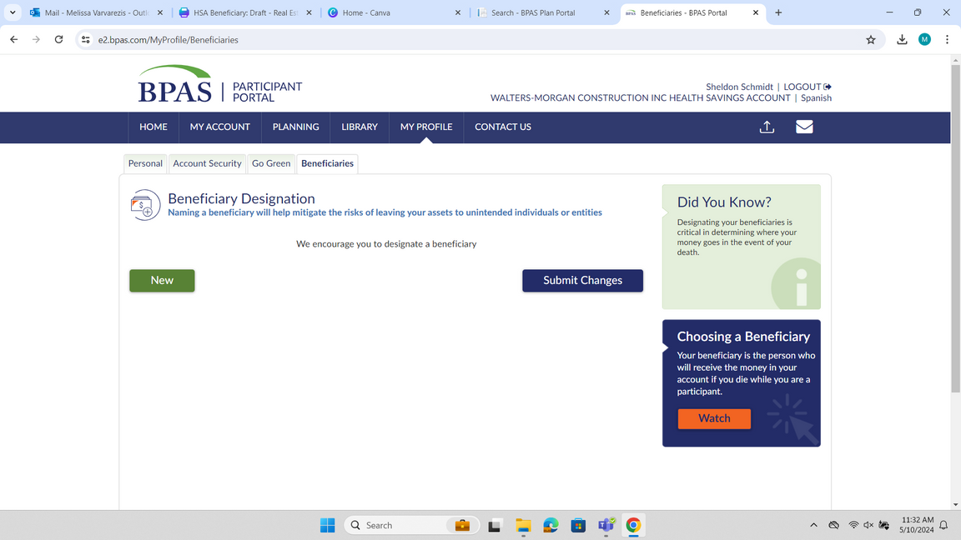
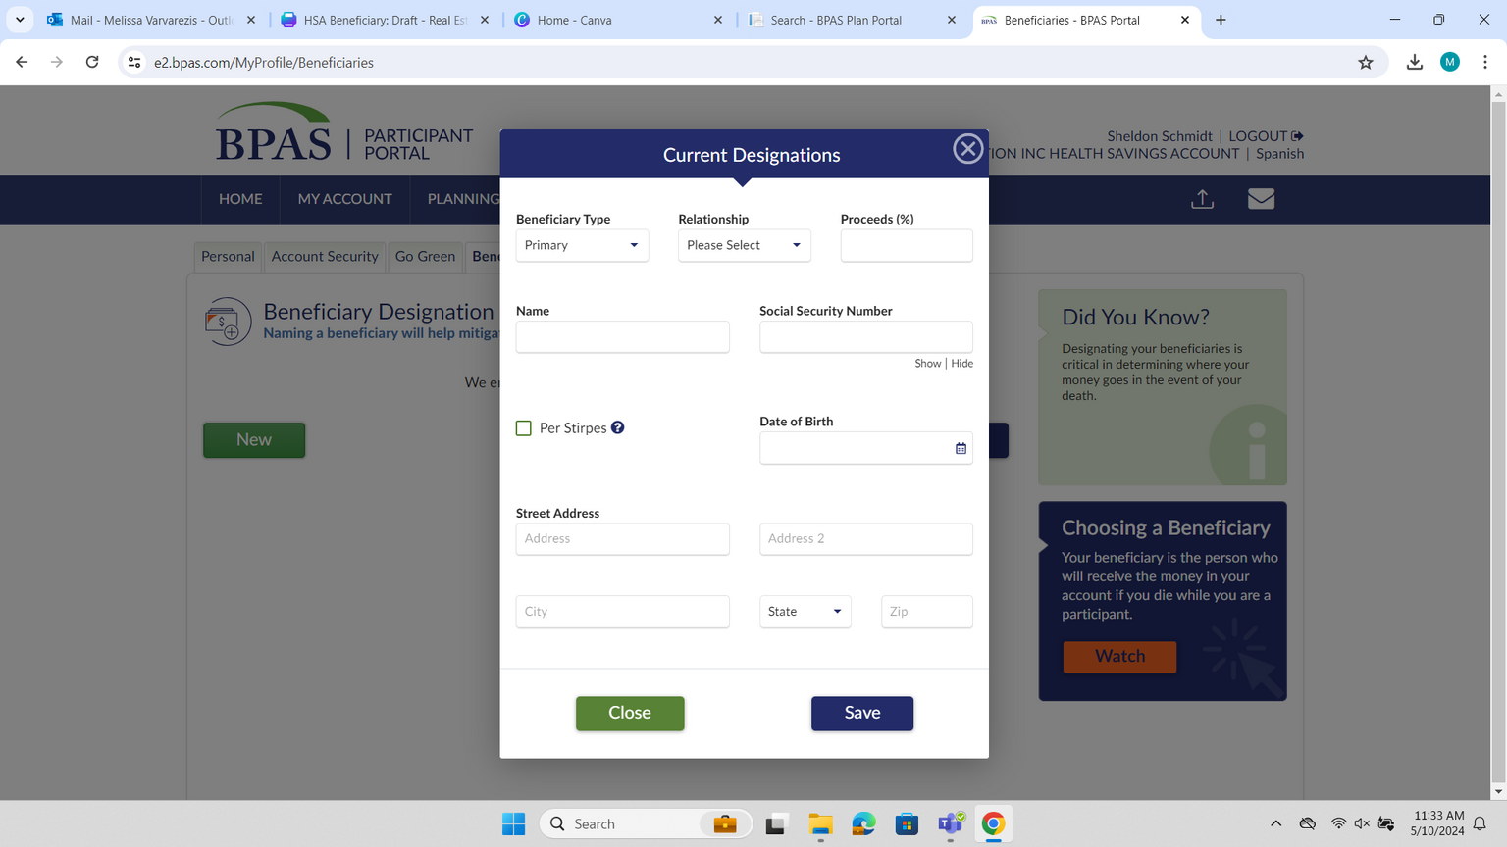

Designate Your Beneficiaries
Update your beneficiaries at any time by logging into your account at u.bpas.com
  Navigate to My Profile and choose the Beneficiary tab.
  Add your Primary and Secondary Beneficiaries and submit when finished.
    Remember to list a Beneficiary for each of your BPAS accounts, keep a copy with your estate documents, and consult with an estate attorney for consistency in beneficiary choices.
Review Your Beneficiaries Often!
After life changes like marriage, divorce, death, or birth in the family to ensure peace of mind for you and your loved ones.

Slide 12

Maximize Your ESOP
When the company does well, the value of your stock shares increase, making your ESOP account value increase.
How can you help the company profit?
  Increase sales
  Lower costs
  Increased customer satisfaction
  Following safety guidelines
Notes:
By focusing on the overall success of the company, you’re also investing in yourself—gaining both job satisfaction today and the potential for a more profitable ESOP account in the future.

Slide 13



Learn more about your 401(k)
Even though you can’t contribute to an ESOP...
You can still contribute to your 401(k) Plan!
401(k) Benefits
  Tax advantages
  Flexible payroll contributions - contribute what you can afford to do
  Participant-directed investments
  Loan and withdrawal features
Notes:
ESOPs and 401(k) Plans are both types of workplace retirement plans, but they differ in how contributions are made. A 401(k) Plan allows for both employee and employer contributions, giving you the opportunity to select investments that align with your retirement strategy. Additionally, 401(k) Plans may offer flexibility in accessing funds through loans or in-service distributions, if permitted. On the other hand, ESOPs are funded solely by employer contributions, providing employees with ownership in the company.
The good news? You don’t have to choose between them! Once eligible, you can contribute to your 401(k) Plan while also benefiting from your employer’s contributions to the ESOP. This combination can help you build a stronger foundation for a secure retirement.
To get started with your 401(k) Plan, you’ll need to enroll, decide on your contribution amount, choose your investment options, and designate your beneficiaries. Keep in mind that your 401(k) Plan is typically separate from your ESOP account.

Slide 14


Accessing Your Account

Slide 15

Account Statements
  Your ESOP statement will be mailed to your home address
    Statements are also saved in your Participant Portal, by logging into your account at u.bpas.com
  If you move, be sure to contact your employer to update the address on your ESOP

Slide 16






BPAS University
866.401.5272 | u.bpas.com
From budgeting tips to investment strategies, BPAS University offers valuable information to assist you in making sound financial decisions!
  Financial Planning Tools
  Blog Articles
  Quick Tips
  Self-study Courses
  Financial Calculators
  Videos & Podcasts
  Questionnaires
  Risk Tolerance Quiz
  And Much More!
Explore BPAS University and manage your account from anywhere, anytime!
Head to u.bpas.com or get the BPAS U App from Google Play or the
App Store.
Notes:
Check out BPAS University for a wide variety of planning tools such as retirement planning calculators, a risk tolerance quiz, retirement progress tracker and tons of videos with helpful tips and tricks to prepare you for your retirement.

Slide 17

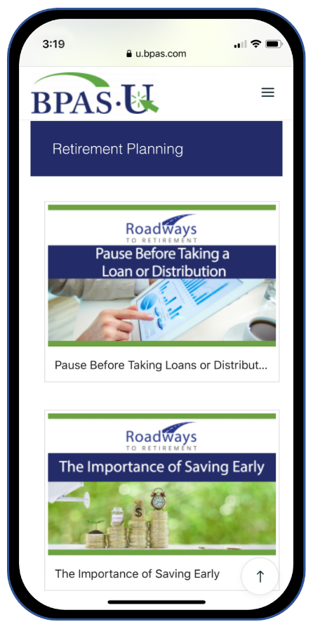

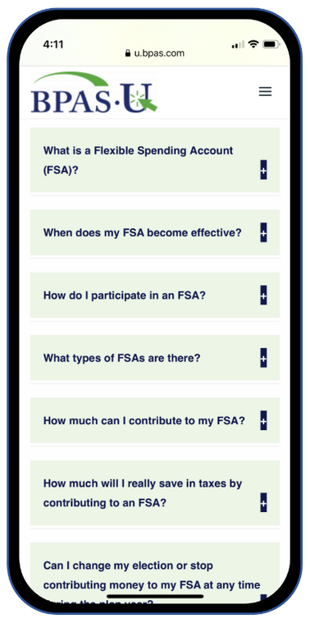


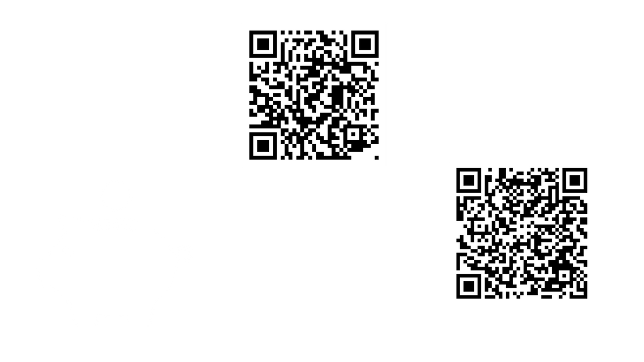
BPAS University Mobile App
Utilize free multimedia tools and resources
Test your knowledge on financial topics
Receive notifications when there’s new content
Securely login to your BPAS account
Notes:
Download our mobile app today for access to your account & retirement resources from anywhere anytime! Available from the App Store or Google Play. Scan QR Codes on your screen to download now.

Slide 18
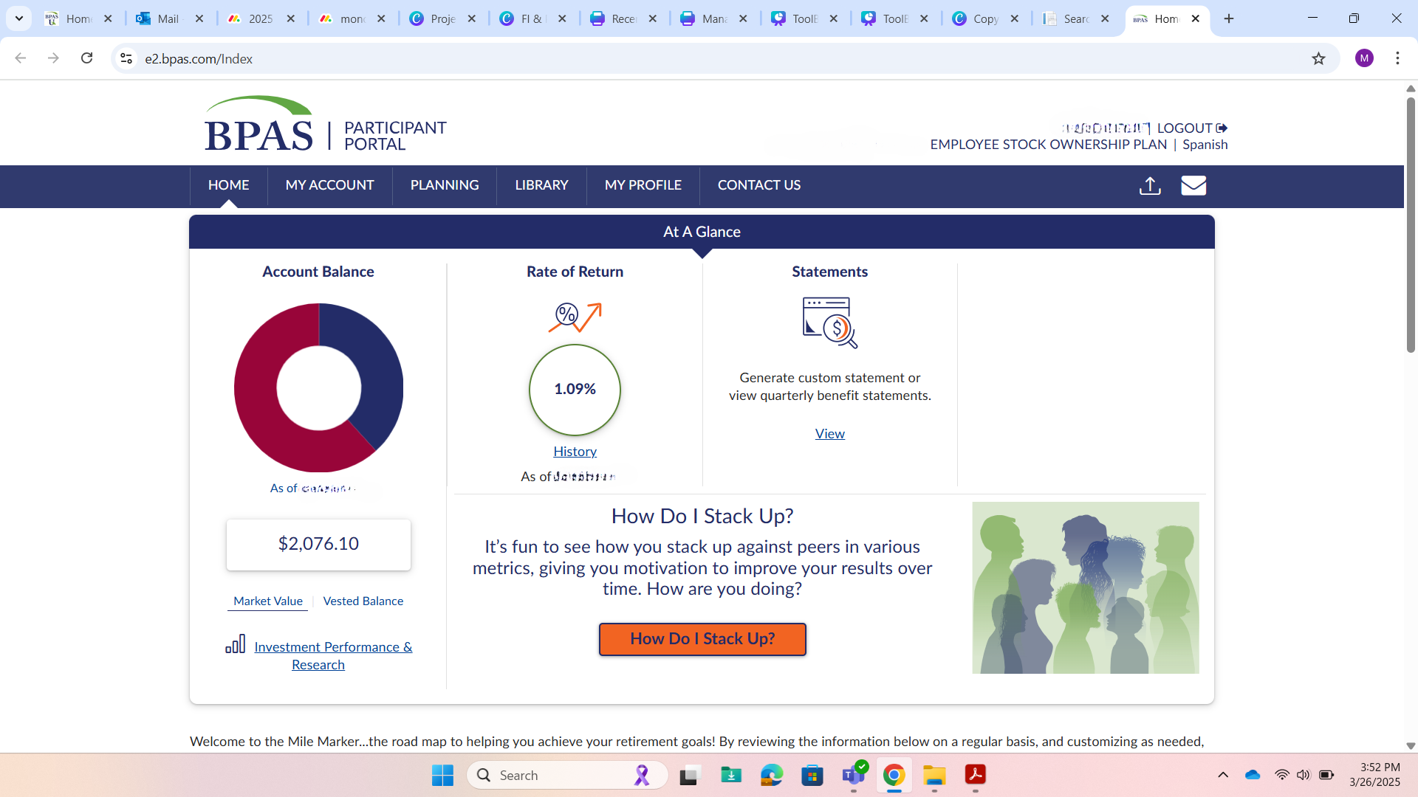
If your ESOP and 401(k) Plan are both at BPAS, you can toggle between the plans at any time.
Notes:
When you log into your account, you will see the participant portal's home screen, which includes various tools and options to manage your account.

Slide 19



Participant Services Center
Speak To A Representative
Send A Secure Message
Request A Call Back
Participant Services
866-401-5272
Live representatives are available from Monday to Friday, 8 am to 8 pm EST.
All calls are recorded & archived for quality and educational purposes
Notes:
If at anytime you have questions or need assistance with your account and you need to get in touch with someone at BPAS, you can contact the Participant Services Center. The Participant Services Center is fully staffed with BPAS employees located across the US. You will be able to speak with a live representative Monday through Friday 8am to 8pm EST and you will have a few ways to get in contact with them. You can call them at the number listed on the slide, request a representative calls you, or you can send them a secure message. You will be able to find Participant Services contact information in your online account.

Slide 20


Questions?
Notes:
Now, I will open it up for any questions you may have.

Slide 21


Thank you
Presenter Name Here
Presenter Title Here
Presenter Company Here
Your logo here
©2025 BENEFIT PLANS ADMINISTRATIVE SERVICES, INC.

