Slide 1




Your
KSOP Plan
Presentation - 2025
Presenter Name Here
Presenter Title Here

Slide 2


What’s a KSOP?
A kSOP is a type of workplace retirement plan that combines an
Employee Stock Ownership Plan (ESOP) and a 401(k) Retirement Plan. You’ll be able to view and access your account all in one location.
ESOP:
  Employer contributions only
  Contributions are made into company stock
  Trading & withdrawal options may be limited
401(k) Plan:
  Employee & employer contributions
  Participant directed investment options
  Flexible withdrawal & loan options
Notes:
Employee Stock Ownership Plan (ESOP):
a retirement plan where your employer makes contributions of employer stock for retirement on your behalf.
an extra benefit, in addition to your compensation and other benefits
contribution are made by the employer into company stock

Slide 3

Your ESOP Account
11

Slide 4

Your ESOP Highlights
Easy Enrollment
Eligibility
Plan Entry
Add Provisions Here
Add Provisions Here
Once you meet eligibility, BPAS & your employer will set up your ESOP up. It will be listed as a separate source in your KSOP account.
Notes:
Enrollment for your ESOP:
BPAS works closely with your employer to track eligibility. Once you are eligible, BPAS will enroll you, setting up your account for the future contributions. While it is important that you understand when you are eligible, you do not need to compute your hours or enroll in the plan.
Enrollment for the 401(k) portion of your account is slightly different. We'll cover that a bit later in the presentation.

Slide 5

Stock Details
If publicly traded, include Ticker Symbol
The stock in your account is valued: (select one or create your own)
  Daily, with the close of the stock market
  Annually
Only employer contributions are made into an ESOP, you cannot purchase any stock or contribute to this account.
You can make changes to your ESOP: (select one or create your own)
  at any time
  annually
  upon attainment of age ___ and ___ years of service
  upon termination of employment

Slide 6

Contributions
Customize for Your Plan’s Contribution
Once you meet the eligibility criteria, ABC Company will contribute x% of your annual salary into an ESOP.
These contributions will be made on an annual basis.

Slide 7
ESOP Vesting Schedule: 3 Year Cliff
1 Year
2 Years
3 Years
0%
0%
100%

Slide 8





ESOP Vesting Schedule:
6 Year Graded
1 Year
2 Years
3 Years
20%
40%
0%
4 Years
5 Years
6 Years
60%
100%
80%

Slide 9

ESOP Withdrawals
You are eligible to withdraw the vested balance if you:
    Retired
    Left employment
    Are age 59.5 or older
  Withdrawals may be rolled into a Workplace Retirement Plan, IRA, or an annuity with no taxes due at that time.
  Amounts withdrawn and paid directly to you will be subject to income tax.
In the event of your passing, your ESOP account will be accessible to your beneficiaries. Be sure to review and update your beneficiaries regularly!

Slide 10

Maximize Your ESOP
When the company does well, the value of your stock shares increase, making your ESOP account value increase.
How can you help the company profit?
  Increase sales
  Lower costs
  Increased customer satisfaction
  Following safety guidelines

Slide 11

Your 401(k) Plan
11

Slide 12


Start Saving Early
Make the most of compounding growth and allow your money to generate returns for you!
Starting to save early means less concern about catching up in the future.
Tips & Tricks:
  Once you become eligible, enroll in your plan promptly.
  Making a small contribution is preferable to making no contribution at all.
  If you are not eligible yet, begin setting aside the intended deferral amount now.

Slide 13


Contribution Effect On Paycheck
PRE-TAX
ROTH
Weekly Paycheck: $1000
Taxable Income: $1000
Taxes Withheld (18%): $180
Take home Pay: $820
Contribution: $60
Taxable Income: $940
Taxes Withheld: $169
FINAL PAYCHECK:
$771
Contribution: $60
Taxable Income: $1000
Taxes Withheld: $180
FINAL PAYCHECK:
$760
Larry
PRE-TAX
ROTH
Weekly Paycheck: $500
Taxable Income: $500
Taxes Withheld (18%): $90
Take home Pay: $410
Contribution: $50
Taxable Income: $450
Taxes Withheld: $81
FINAL PAYCHECK:
$369
Contribution: $50
Taxable Income: $500
Taxes Withheld: $90
FINAL PAYCHECK:
$360
Jenny
Notes:
Optional: Remove if no ROTH
If you were to start contributing today, this is what it would look like.
Using our friends Larry and Jenny as examples:
Larry's weekly paycheck is $1,000 less taxes his take home pay is $820. If Larry were to contribute $60/week pretax his take home pay will be $771 after income taxes. notice his taxable income is reduced by $60. If he contributed the same amount to his ROTH 401k, his taxable income remains $1000, the same as someone making no contribution. The difference is that all ROTH contributions and any earnings would now be eligible for withdrawal tax free when taking qualified withdrawals after age 59 and 1/2 and after holding the account for at least 5 years. In all, both contribution types offer tax benefits, but you enjoy those benefits at different times.

Slide 14

Pre-Tax/Traditional Contribution
Tax-Free Contribution
Taxable
Withdrawal
Tax-Deferred Growth
Taxes
Notes:
There are (REMOVE " Two different ways" if no ROTH) two different ways that you can contribute to your account, each with different tax advantages.
The first, is pre-tax contributions, which is sometimes referred to “traditional”. Pre-tax contributions allow you to defer your taxes until you start taking qualified withdraws. That means, whatever you contribute to your (plan type: 401(k), 403 (b) etc.) account, is tax free now, and taxable when you take those withdraws in retirement. This may be most beneficial if you have a higher tax rate now than what you expect it to be when you start taking withdraws.

Slide 15
Roth Contribution
Taxable Contribution
Tax FREE
Withdrawal
Tax-FREE Growth
Taxes
Roth contributions are not taxed at distribution; however, earnings may be subject to taxation if the account has not been in existence for at least
5 years and taken prior to attainment of age 59 ½ , death or disability.
Notes:
Optional: Remove if not applicable
The second way that you can contribute is called a Roth contribution. Roth contributions essentially work in the opposite way as pre-tax contributions. Roth contributions are taxable now, however, when you start taking qualified withdraws, your contributions and the growth within the account, will be tax free.
Roth contributions may be beneficial if your tax rate is lower now than what you expect it to be in the future.
Finally, in order for Roth withdraws to be tax free, you must have the account for 5 years, AND be 59 ½ . Or if the distribution is due to death or disability.
When you decide to contribute, you could do one or the other or both and you can split it however you like.

Slide 16


401(k) Plan Highlights
Eligibility
Plan Entry
Enrollment
Employee Contributions:
  add provisions here
Employee Contributions:
  add provisions here
Online at u.bpas.com
Automatic Enrollment:
  After 1 year of service & 1,000 hours worked within a 12 month period
Plan code for enrollment is found on your welcome letter.
Notes:
As a (plan sponsor name) employee, you are eligible to participate in the retirement plan (insert eligibility). To Enroll, all you need to do is log into your BPAS retirement account online, select your contribution amount and investments and watch your nest egg grow!
When enrolling, you will need the enrollment code found in the Welcome Letter you should have received mailed to your home address upon eligibility.
Optional: If after a year you are not participating in the plan you will be automatically enrolled.

Slide 17
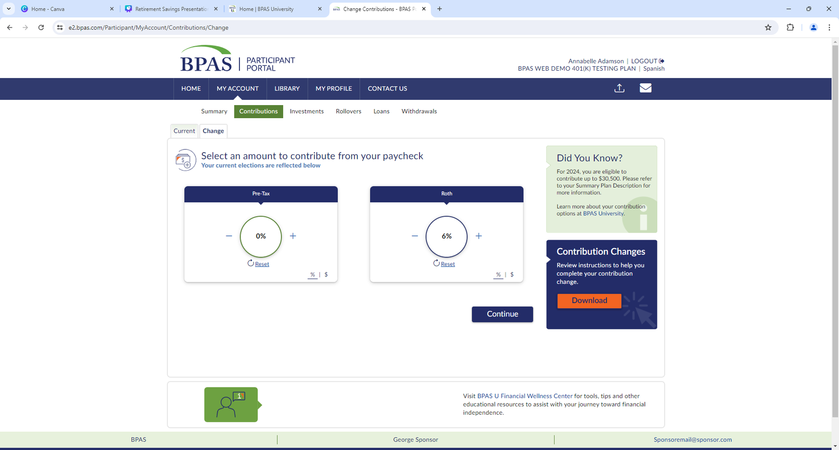
Automatic Enrollment &
Re-Enrollment
Automatically enrolled at __% of pay in the _______, based on your date of birth
    After 1 year of service, you will be auto enrolled on the first day of the next calendar quarter: 1/1, 4/1, 7/1 or 10/1
  You will receive a letter in the mail before automatic enrollment
  An automatic increase of ___% will occur each year on anniversary until it reaches ___%
  Re-enrollment: Employees not enrolled or contributing less than __% will be re-enrolled
Make changes online
    Log in to your account at u.bpas.com
    Choose Payroll Contributions on the Home Page or under My Account and select Contributions
Notes:
Optional: Remove if plan does NOT feature Auto Enrollment
Your plan features automatic enrollment.
If you are automatically enrolled in the plan….
Talk about each of the points on the screen.

Slide 18




Scan to Download Rollover Form
Qualified Rollovers
Easy: Holistic view of your retirement readiness.
Easy
Convenient: One website.
One statement.
Convenient
Flexibility
Flexibility: Easy access to money from a single account at retirement.
Peace of Mind
Peace of mind: Reduce the risk of loosing sight of retirement accounts.
Contact an Incoming Rollover Specialist at 866-401-5272 Ext. 35007
Notes:
Consolidating your accounts into one place simplifies tracking your overall retirement progress. You can see your total retirement savings at a glance and get a clearer picture of your readiness for retirement. It also gives you the opportunity to manage everything in a single location. No more logging into multiple accounts or sifting through different statements. That also makes it potentially easier to access your funds when you retire ultimately streamlining the process of withdrawing or managing your retirement income. And finally, it can potentially reduce the chance of losing track of retirement accounts you may have left with previous employers.

Slide 19

Employer Discretionary Match
(Company Name) Matches 100% of the first 3% you contribute
Then 50% of the next 2% you contribute
By contributing 5%, you receive the (Company Name) full match of 4%
Notes:
REMOVE if no match
Let's talk a little more about that Employer match.
Your (Company Name) plan provides for discretionary employer matching contributions on elective deferrals made into your 401(k) plan. (Company Name) will match ___% of the first ___% you contribute. The discretionary matching contribution will be made on both pre-tax and ROTH after-tax contributions. However, contributing both pre-tax and after-tax ROTH deferrals does not increase the match amount a participant can receive.

Slide 20

Taking Money Out of a 401(k)
WHEN YOU LEAVE YOUR JOB
WHEN YOU ARE STILL IN YOUR JOB
Regular 401(k) Withdrawal
Withdrawals are taxed, but there is no penalty after 59
401(k) Plan loan
Borrow funds with interest. Check your plan documents for eligibility
Hardship withdrawal
Subject to restrictions, check eligibility and paperwork requirements online or call BPAS Participant Services.
Early 401(k) withdrawal
Taxes apply plus subject to a
10% tax penalty
401(k) Rollover
Transfer to IRA or other employer retirement plan.
No taxes. No Penalties.
In-Service Withdrawal
Allowed, while still employed
if over 55
Note: Withdrawal options for the ESOP assets in your account may vary. Review your Summary Plan Description for more information
Notes:
Because a Workplace Retirement Plan is meant to help you save for retirement, there are certain restrictions for taking money out of the plan, including an additional tax penalty if you are under the age of 59 ½ when taking the distribution.
That being said, you have the option to take distributions under certain circumstances listed here

Slide 21








Taking Money Out of a 401(k)
WHEN YOU LEAVE YOUR JOB
WHEN YOU ARE STILL WORKING
Regular 401(k) Withdrawal
Withdrawals are taxed, but there is no penalty after 59
401(k) Plan loan
Borrow funds with interest. Check your plan documents for eligibility
Hardship withdrawal
Subject to restrictions, check eligibility and paperwork requirements online or call BPAS Participant Services.
Early 401(k) withdrawal
Taxes apply plus subject to a
10% tax penalty
401(k) Rollover
Transfer to IRA or other employer retirement plan. No taxes. No Penalties.
In-Service Withdrawal
Allowed, while still employed
if over 55
Note: Withdrawal options for the ESOP assets in your account may vary.
Review your Summary Plan Description for more information
Notes:
Because a Workplace Retirement Plan is meant to help you save for retirement, there are certain restrictions for taking money out of the plan, including an additional tax penalty if you are under the age of 59 ½ when taking the distribution.
That being said, you have the option to take distributions under certain circumstances listed here

Slide 22

Investments
Notes:
Next we will discuss investments.

Slide 23






Take the Risk Tolerance Quiz
at u.bpas.com
Asset Allocation
Asset allocation is the strategy of creating a balanced portfolio of
fixed income investments (bonds, cash, stable value) and equity investments (domestic stock, foreign stock) based on time horizon, objectives, risk tolerance and more.
There is no one-size fits all, your asset allocation is specific to your needs, goals, and preferences.
Your asset allocation should change over time as your goals or needs change.
Fixed Income
Equity
Your Portfolio
Notes:
Here’s a little more detailed view of what asset allocation looks like. And it’s the process of dividing an investment portfolio among different asset categories, such as stocks, bonds, real estate, and commodities, in order to achieve a desired risk and return profile. Asset allocation can be a key factor in achieving investment goals, as it helps investors balance risk and reward, and can potentially enhance long-term investment returns. It should be based on an investor's individual risk tolerance, investment goals, and time horizon.
If you want help with determining personal results to what your asset allocation should be, go to u.bpas.com and take the risk tolerance quiz. You may also scan the QR Code shown on the screen

Slide 24



Your Investment Menu
Money Market/Cash Reserves
Bonds
Blended
Equity
International
Sector/
Specialty
The BPAS portal has a wealth of information about the investments available in your plan.
To learn more, log into your account and then navigate to the Research Tab under Investments.
You’ll be able to complete the following research:
  Fund Links: Next to each investment name, you may view the prospectus by clicking the P icon or a fund fact sheet by clicking the
F icon. It’s important to carefully review the investment information prior to selecting your investment options.
  Fund Performance: Expanding each investment option will allow you to view Historical Prices, Benchmark Data, and
the Net Expense Ratio.
Notes:
UPDATE SLIDE with Plan specific investments.
Now let’s go over your plan’s investment menu. Listed here are the different investments that you have available to you in your (Plan Type) plan. Also shown are the different categories under which these investments fall. Just like the former slide, the options on the left contain the lowest risk and each option to the right includes more risk, with the opportunity of higher returns.
Being too heavily weighted in any one fund may cause your portfolio to lack diversity and either be too aggressive or too conservative. Using asset allocation and investing in a variety of funds will help increase your account diversity and protect you in the event that any one fund underperforms.
The blended options, aim to automatically balance your portfolio using stocks to maximize growth and bonds to minimize risk.

Slide 25
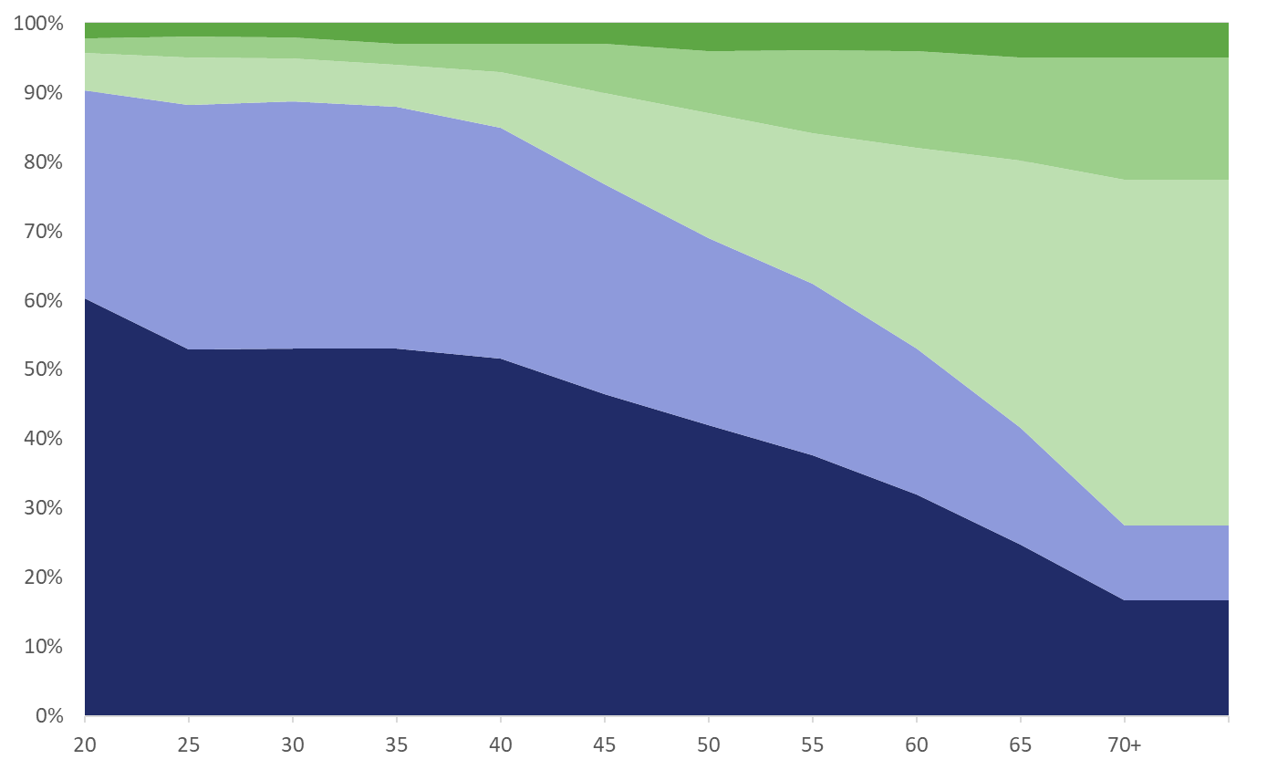

Target Date Funds
Expected Retirement
Cash
Foreign Bonds
U.S. Bonds
Foreign Stocks
Allocation Percentage
U.S. Stocks
Age
For Illustrative purposes. Not specific to any Target Date Series.​ Types of funds held, expected retirement age, and Equity and Fixed Income percentages will vary by fund.
Notes:
A couple of slides ago, I mentioned that blended funds invest in multiple different categories in order to maximize return while minimizing risk. In your (Plan Type), you have Target Date funds as an available investment option. These target date funds are a blended fund that automatically adjusts for you, as you get closer to retirement.
In your early working years when you are far from retirement, a target date fund will be heavily invested in equities such as stocks, to allow your account to maximize its growth. As you move closer to retirement, the fund will automatically invest in more fixed income options such as bonds and money market funds.
This is meant to reduce risk over time to secure the gains in your account, as you near retirement. Each company’s target date funds are different, but the above chart gives an idea of this investment strategy.

Slide 26

Target Date Fund Menu
If You Were Born In | Target Date Investment to Consider | Estimated Number of Years to Retirement
2003-2007 | Target Retirement 2070 | 45 Years
1998-2002 | Target Retirement 2065 | 40 Years
1993-1997 | Target Retirement 2060 | 35 Years
1988-1992 | Target Retirement 2055 | 30 Years
1983-1987 | Target Retirement 2050 | 25 Years
1978-1982 | Target Retirement 2045 | 20 Years
1973-1977 | Target Retirement 2040 | 15 Years
1968-1972 | Target Retirement 2035 | 10 Years
1963-1967 | Target Retirement 2030 | 5 Years
1958-1962 | Target Retirement 2025 | Approaching retirement
1953-1957 | Target Retirement 2020 | In retirement
Before 1953 | Target Retirement Income Fund | In retirement
Age based target date funds based
on normal retirement age
Notes:
Here is a chart showing the different Target Date Funds, listed by year, with an estimate of retirement date or date of birth. For example, you can see that if you were born between 1978 and 1982, the default target date fund would be the 2045 fund. You only have to invest in one fund and do not have to make changes, unless your objectives change. The fund will automatically adjust for you over time.
You also do not have to choose the fund that relates to your date of birth. If you would like to be more aggressive or expect to retire later than age 65, you can choose a later target date fund. Conversely, an earlier target date fund could be selected if you would like to be more conservative with your investments

Slide 27





Diversification
Diversification is like a balanced diet.
Spread your investments across different assets to
promote growth and minimize risks.
Diversifying your portfolio is essential for maintaining financial stability.
It acts as a shield against total financial collapse, ensuring long-term wealth.
Regular review of your account is important!​​
Notes:
Diversification is the strategy of distributing your money across various investments to foster growth while reducing risk.​ Think of it as a balanced diet. While eating broccoli is a healthy choice, you wouldn't want to eat just broccoli. To have a healthy balanced meal you need broccoli, water, maybe some fruit and a grain. Instead of investing heavily in a single asset and facing potential financial loss, diversifying your portfolio safeguards your financial stability. By diversifying, you shield yourself from complete financial downfall. Diversification is crucial for establishing lasting wealth.
Regular review of your account is important!​​
Monitor the balance, contributions, projected balances, and investment allocations. Often adjustments may be needed
due to changes in investment strategy or performance.

Slide 28


Accessing Your Account
Notes:
Ready to start saving for YOUR future!? Getting started with setting up your account is easy!

Slide 29






BPAS University
866.401.5272 | u.bpas.com
From budgeting tips to investment strategies, BPAS University offers valuable information to assist you in making sound financial decisions!
  Financial Planning Tools
  Blog Articles
  Quick Tips
  Self-study Courses
  Financial Calculators
  Videos & Podcasts
  Questionnaires
  Risk Tolerance Quiz
  And Much More!
Explore BPAS University and manage your account from anywhere, anytime!
Head to u.bpas.com or get the BPAS U App from Google Play or the
App Store.
Notes:
Check out BPAS University for a wide variety of planning tools such as retirement planning calculators, a risk tolerance quiz, retirement progress tracker and tons of videos with helpful tips and tricks to prepare you for your retirement.

Slide 30

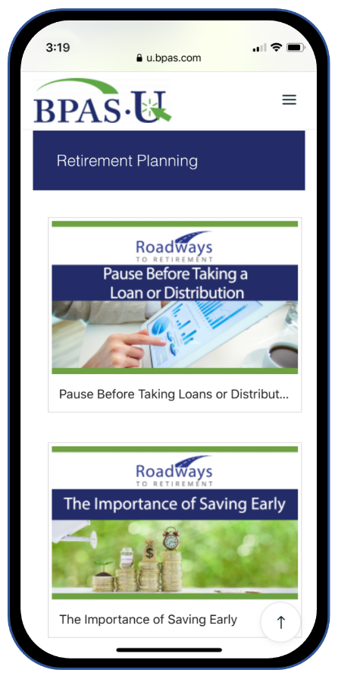

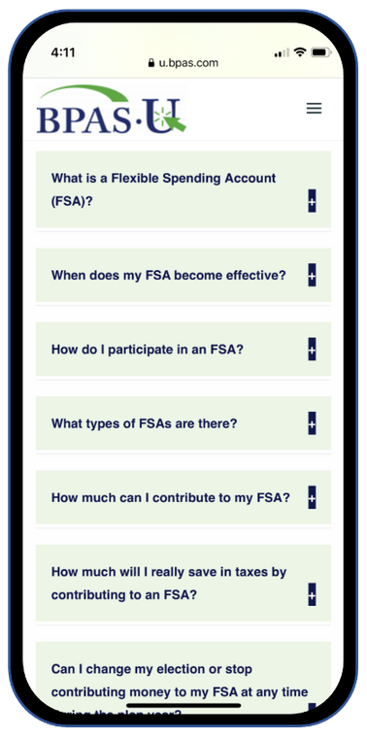



BPAS University Mobile App
Utilize free multimedia tools and resources
Test your knowledge on financial topics
Receive notifications when there’s new content
Securely login to your BPAS account
Notes:
Download our mobile app today for access to your account & retirement resources from anywhere anytime! Available from the App Store or Google Play. Scan QR Codes on your screen to download now.

Slide 31


Create Your Online Account
Have Your Welcome Letter Handy
Setup Your Account at u.bpas.com
Create a user ID and password
Add your email and phone number
Designate Your Beneficiary
Plan code for enrollment can be found on your welcome letter.

Slide 32
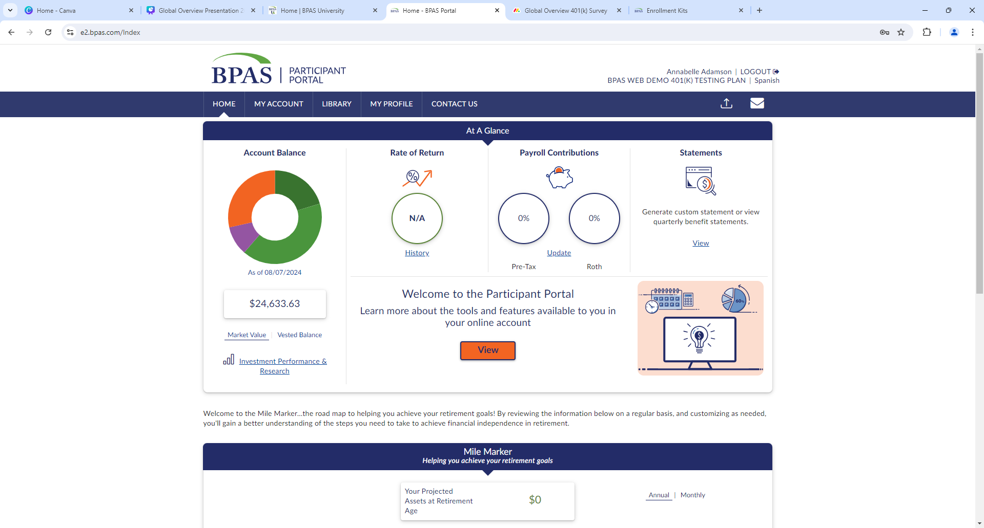
  When you have a kSOP, your total account balance will be displayed in the Participant Portal.
  Navigate to My Account to see your account balance by source. You will be able to see how much is in your ESOP at any time.
  If your ESOP portion has trade restrictions, no problem! Any transactions completed will impact only the 401(k) side of your account.
Notes:
When you log into your account, you will see the participant portal's home screen, which includes various tools and options to manage your account.

Slide 33

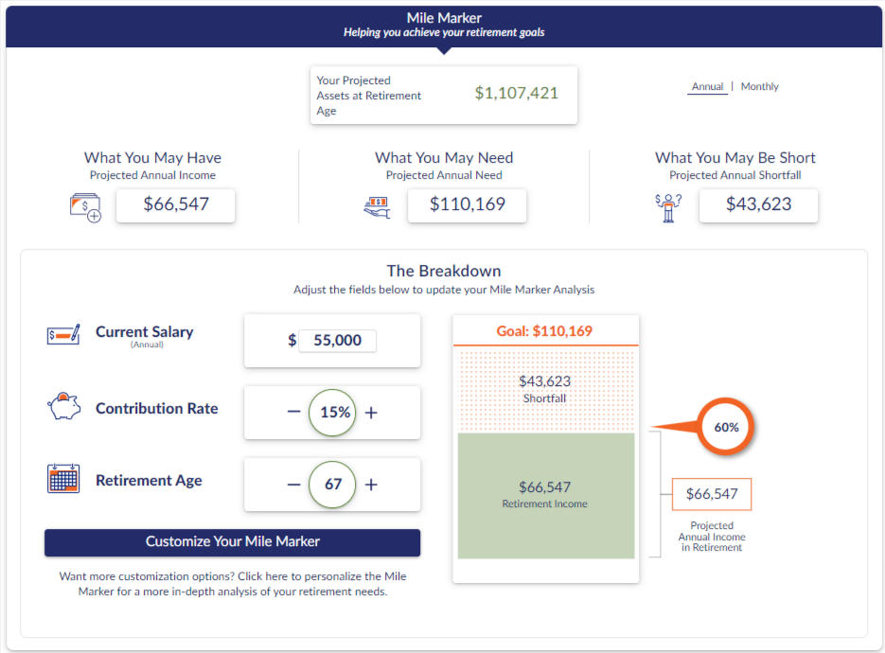







STEPS
Mile Marker
Projected salary, rate of return, & retirement age
Contributions
Social security benefits
Retirement income needs
Additional retirement accounts
Additional assets
Long term debts
Notes:
A great tool available to you and directly tied to your retirement account is the mile marker tool.
This tool allows you to input external financials as well as use the information in your account to help you make informed decisions about where you are on your path to retirement. You can make easy changes to salary, contribution rate, retirement age, and so forth to see how changes to your strategy might affect your account balance over time. You can use this tool to try out ideas without making changes to your account. It’s nice to be able to project what things might look like with the possible changes you can make.
​

Slide 34

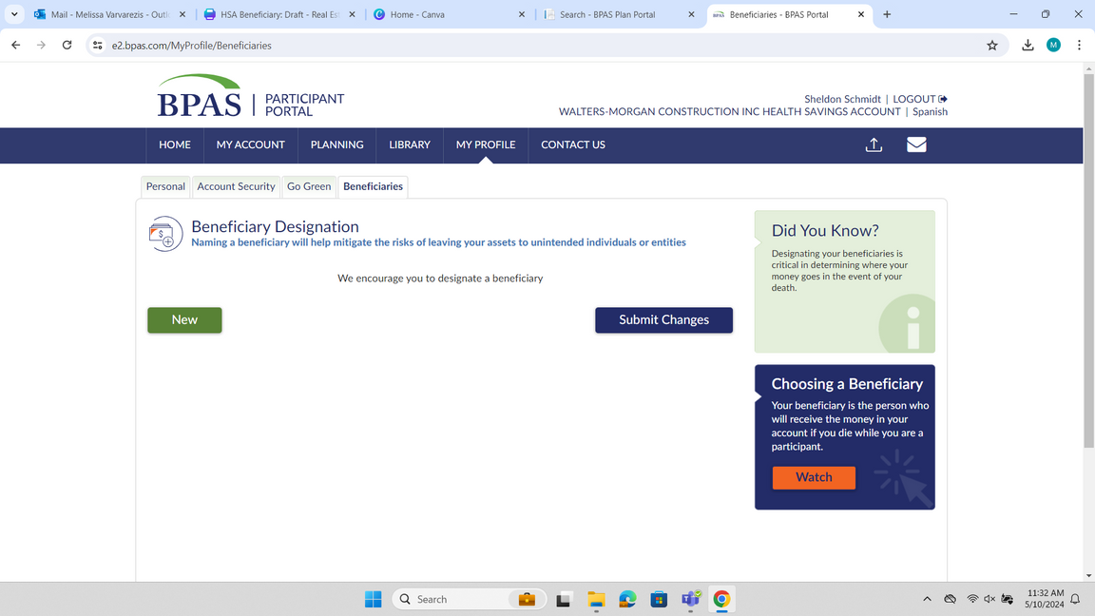
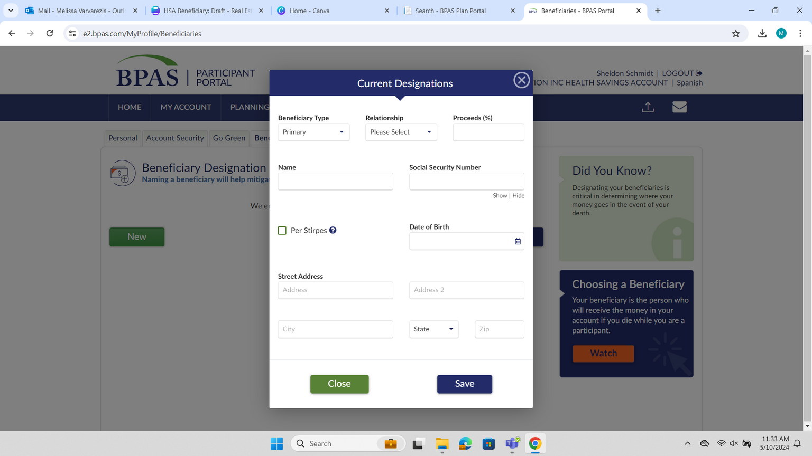

Designate Your Beneficiaries
Update your beneficiaries at any time by logging into your account at u.bpas.com
  Navigate to My Profile and choose the Beneficiary tab.
  Add your Primary and Secondary Beneficiaries and submit when finished.
    Remember to list a Beneficiary for each of your BPAS accounts, keep a copy with your estate documents, and consult with an estate attorney for consistency in beneficiary choices.
Review Your Beneficiaries Often!
After life changes like marriage, divorce, death, or birth in the family to ensure peace of mind for you and your loved ones.
Notes:
Beneficiaries
Once you’ve met the vesting requirements, the money in your ESOP will be available for your retirement years. To ensure that your loved ones receive the assets in a timely manner, it’s important to periodically access your account to review and designate beneficiaries.
Last but not least: Don’t’ forget to update your beneficiaries! Naming a beneficiary will help mitigate risks of leaving your assets to unintended individuals or entities should something happen to you.
Adding or updating a beneficiary is easy! Simply log in to your account select My profile & then the beneficiaries tab.

Slide 35

Account Statements
  Statements will be mailed to your home address quarterly.
    The value of your ESOP will be listed on your statement. Keep in mind that it is valued annually. (Remove if ESOP is daily valued)
    Statements are also saved in your Participant Portal, by logging into your account at u.bpas.com
  If you move, be sure to contact your employer to update the address on your account.
Notes:
Employee Stock Ownership Plan (ESOP):
a retirement plan where your employer makes contributions of employer stock for retirement on your behalf.
an extra benefit, in addition to your compensation and other benefits
contribution are made by the employer into company stock

Slide 36



Participant Services Center
Speak To A Representative
Send A Secure Message
Request A
Call Back
Participant Services
866-401-5272
Live representatives are available from Monday to Friday, 8 am to 8 pm EST.
All calls are recorded & archived for quality and educational purposes

Slide 37



To Do List
Login to your account at u.bpas.com
Adjust contributions or setup automatic increases
Review/update your personal information in My Profile
Review/update/add beneficiaries to your account
Review your investments for tolerance risk
U.BPAS.COM
Go Green
Notes:
Finally, whether you are new just getting started, or have been saving for years, here are some great steps to take while your retirement is at the top of your mind.
Log in to your account or setup your account if you have yet to do so.
Make sure your beneficiaries are up to date, especially if you have had any recent changes in marital or parental status.
Take a look at your current investments and make sure they reflect your time horizon and retirement objectives.
Consider increasing your contribution amount or setting up an automatic increase to help reach your retirement savings goals.
Lastly, opt to "go green" and receive all statements and notices online.

Slide 38


Questions?
Notes:
Now, I will open it up for any questions you may have.

Slide 39


Thank you
Presenter Name Here
Presenter Title Here
Presenter Company Here
Your logo here
©2025 BENEFIT PLANS ADMINISTRATIVE SERVICES, INC.

